Slide 1
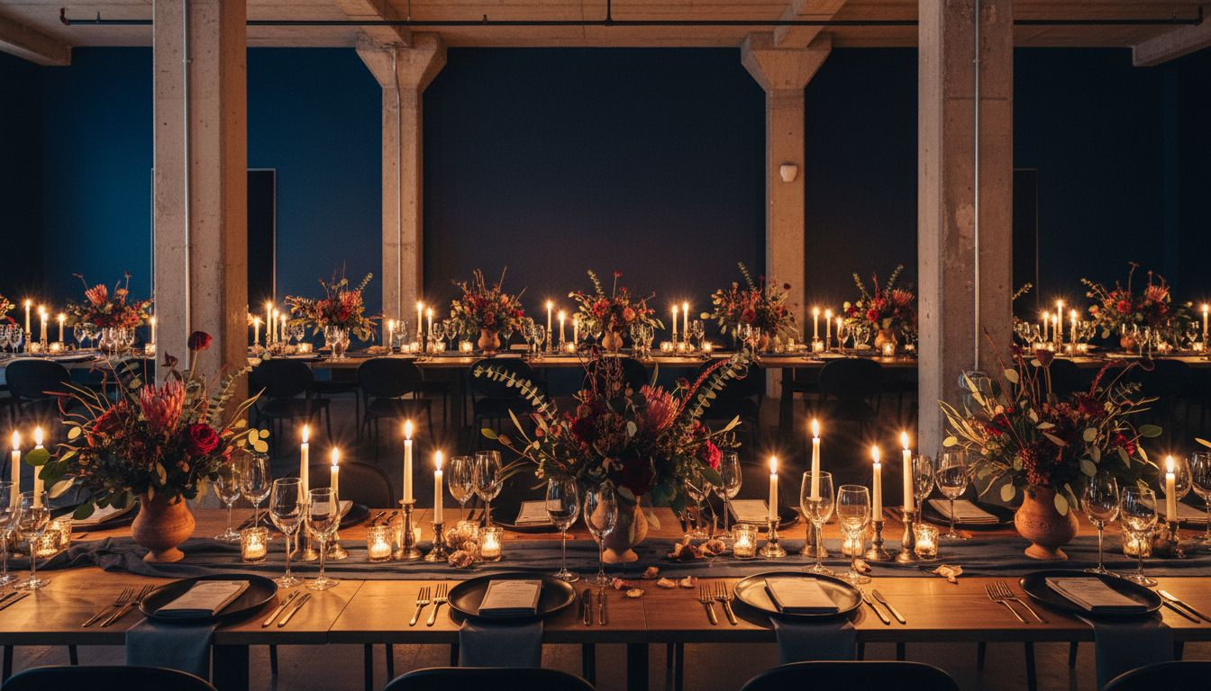
[Provider_Company_J] × Y COMBINATOR
Where Founders
Come to Remember
Bespoke Event Experiences for the World's Most Important Builders
Proposed: Fall 2026
[Provider_Company_J][Provider_Company_J].com | San Francisco

Slide 2
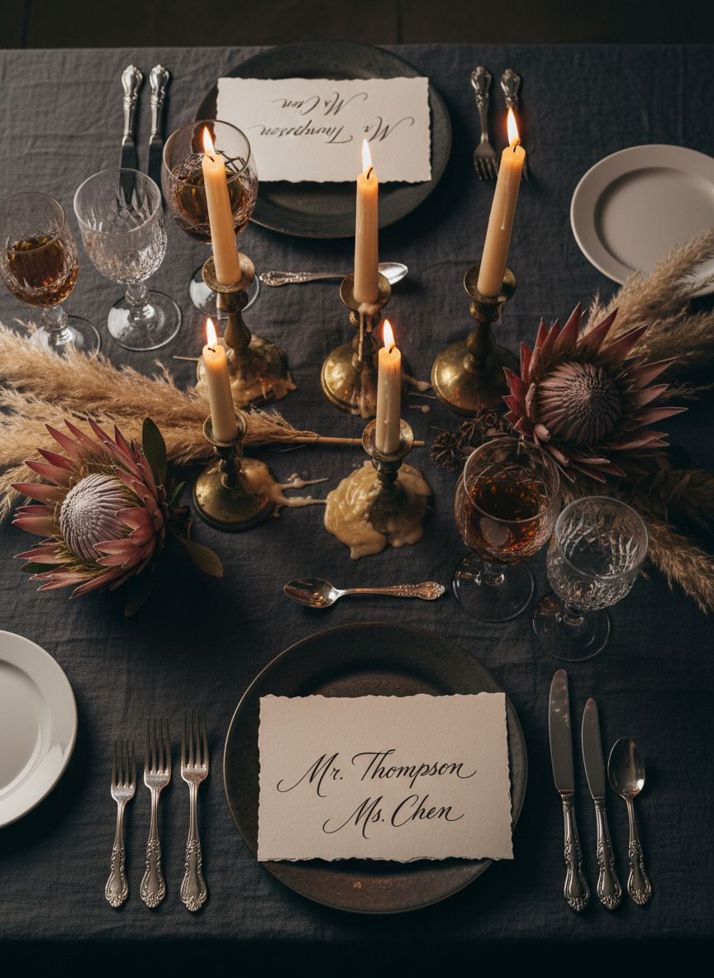
PROPOSAL OVERVIEW
A New Standard
for How Builders
Gather
— Y Combinator has shaped more defining companies than any institution in history.
— The events that surround that mission deserve the same level of craft.
— [Provider_Company_J] proposes three signature event experiences — each designed to match the ambition of the people in the room.
[Provider_Company_J]

Slide 3
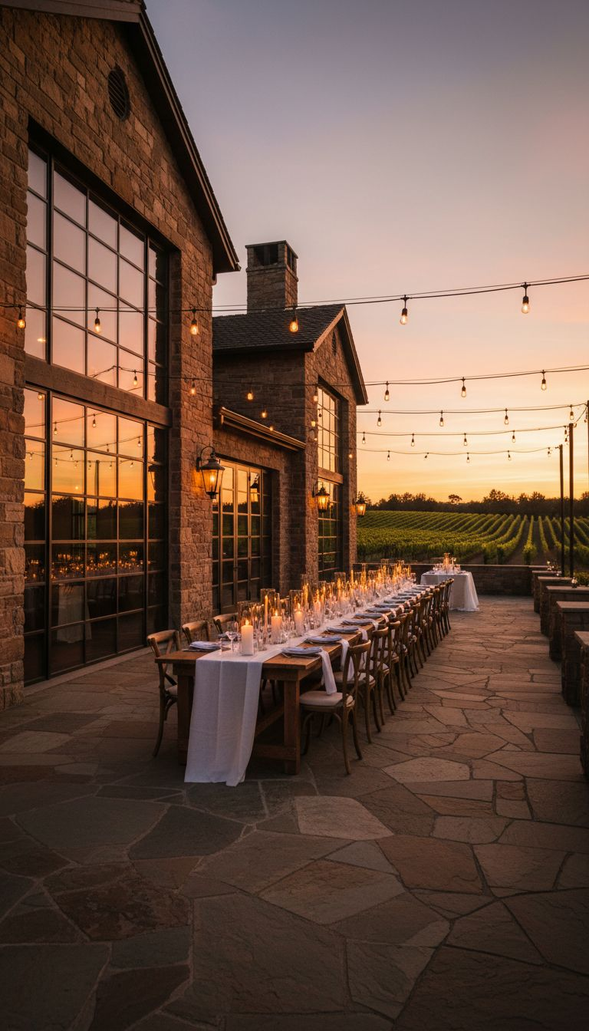
CONCEPT I
[Prospect_Company_A]
An Annual Rite of Passage
↳ Two-day immersive retreat for YC's most consequential founders and partners.
↳ Set against a transformative backdrop — vineyard estate, mountain lodge, or coastal property.
↳ Day one: curated dialogues, working sessions, and a state-dinner reception.
↳ Day two: open mornings, private experiences, and a closing gala dinner.
Proposed destinations: Napa Valley · Big Sur · Lake Tahoe

Slide 4
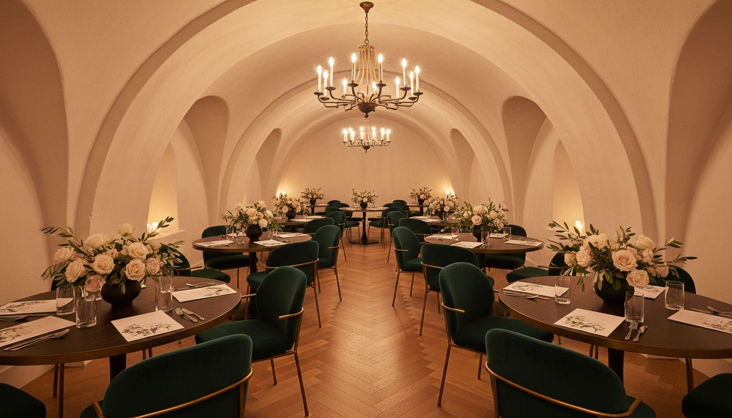
CONCEPT II
The Investor
Dinner Series
Eight seated dinners. Eight cities. One consistent standard of excellence.
— Intimate gatherings of 24–40 guests in private rooms, curated homes, or off-market venues.
— Menu collaboration with destination chefs. Bespoke tabletop design. Immersive conversation format.
— Each dinner leaves a mark — and a reason to come back.

Slide 5
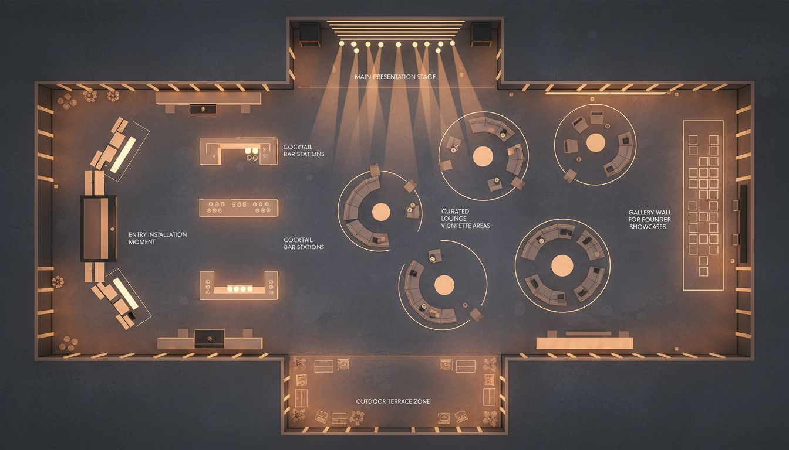
CONCEPT III · VENUE & FLOOR PLAN
Demo Day Reimagined
Proposed Venue: Fort Mason Center, San Francisco · 44,000 sq ft
Entry installation · Curated lounge zones · Post-presentation gala reception
Conceptual layout — venue floor plan to be confirmed with Fort Mason Center

Slide 6
INVESTMENT & SCOPE
Transparent Pricing.
No Surprises.
$285,000+
$45,000+
$180,000+
Founder Summit Retreat
Investor Dinner Series
Demo Day Transformation
2-day · 80 guests · destination property
Per city · 30 guests · private venue
Fort Mason · full production design
All pricing includes concept, design, production management, and on-site direction.
Travel, F&B, and venue fees quoted separately based on confirmed scope.

Slide 7
Let's Build Something
Unforgettable
[Provider_Company_J] brings the same uncompromising design conviction to your events
that your founders bring to their companies.
We'd love to begin with a creative alignment conversation.
[Provider_Company_J] · San Francisco · hello@[Provider_Company_J][Provider_Company_J].com

