Slide 1
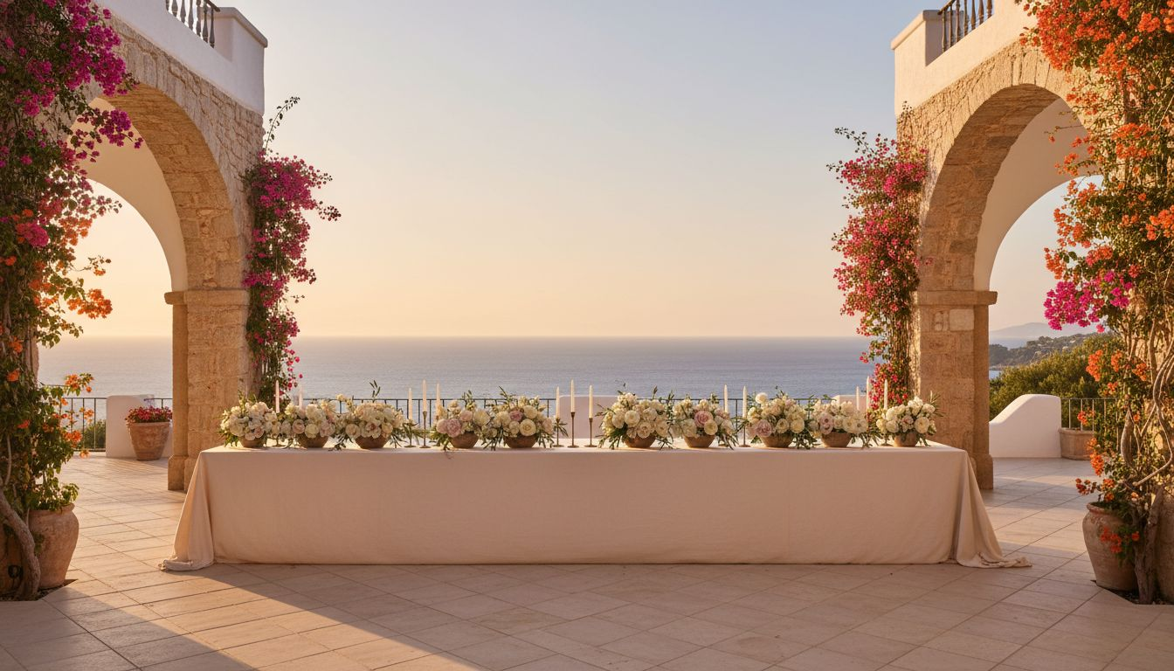
[Provider_Company_J] × [Prospect_Company_A3] GROUP
The World is
the Venue
Signature Event Experiences Across Your Global Portfolio
2026 – 2027 Program
[Provider_Company_J][Provider_Company_J].com · hello@[Provider_Company_J][Provider_Company_J].com

Slide 2
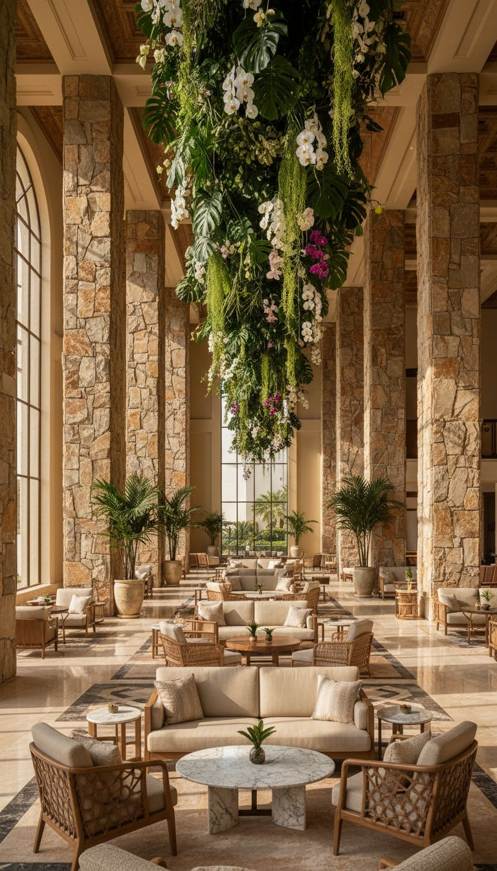
WHY THIS PARTNERSHIP
Representing 350+
Properties.
Hosting One Standard.
— [Prospect_Company_A3] represents some of the world's most exceptional meeting properties.
— The question is: do your own events reflect that same standard?
— [Provider_Company_J] proposes a new chapter — where [Prospect_Company_A3]'s gatherings become the industry's most coveted invitations.
[Provider_Company_J]

Slide 3
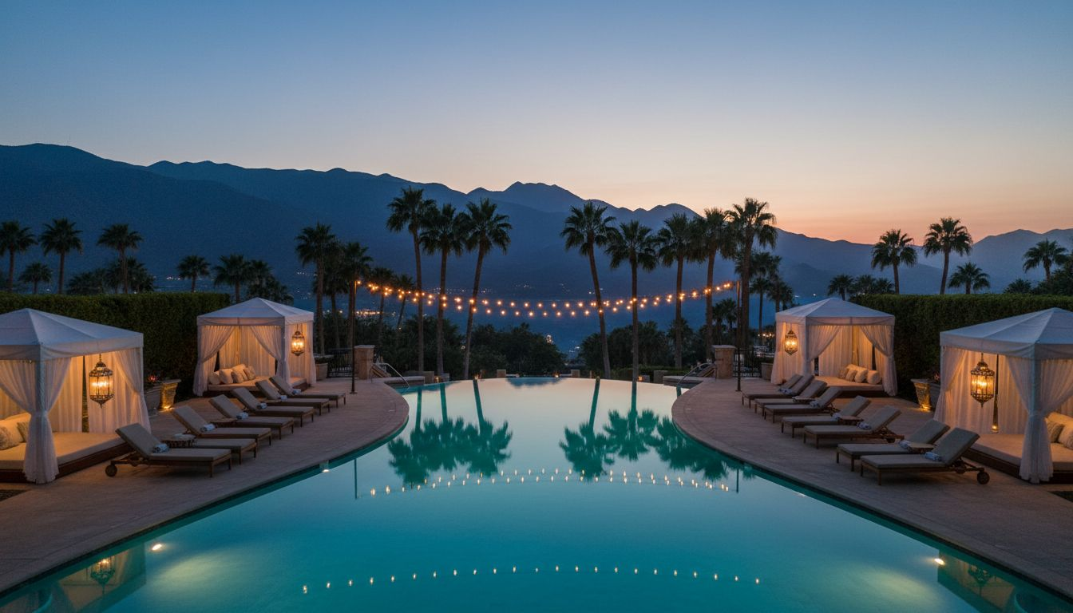
CONCEPT I
The [Prospect_Company_A3] Summit:
An Annual Leadership Retreat
↳ Annual gathering of [Prospect_Company_A3]'s top hotel GMs, planners, and partners — 3 days.
↳ A destination property from within the portfolio. Curated programming and immersive dinners.
↳ Rotating annually: Puerto Rico, Napa Valley, or Lake Tahoe.
↳ Every detail — from arrival gift to closing breakfast — intentionally designed by [Provider_Company_J].
Proposed venue: El Conquistador Resort, Puerto Rico

Slide 4
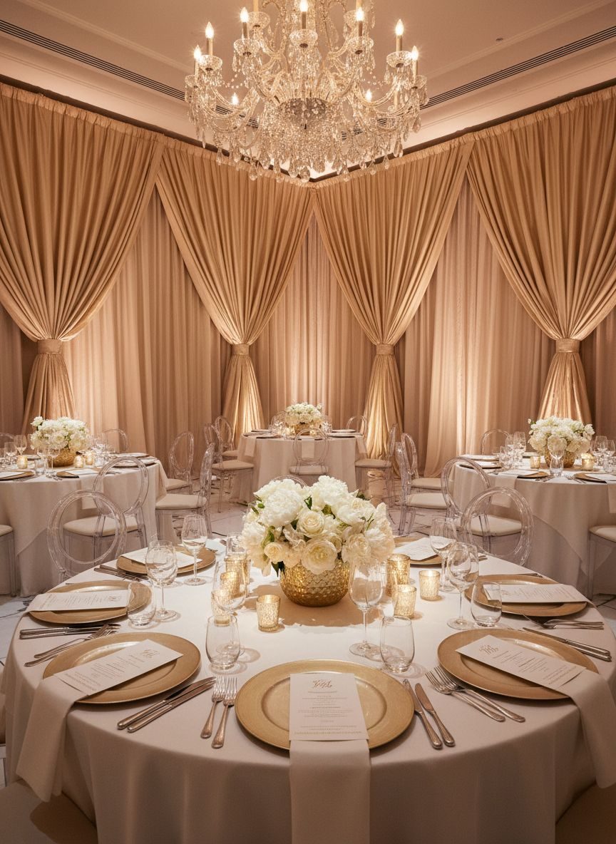
CONCEPT II
The Partner Showcase
Dinner
Where Hotels Meet Planners — Unforgettably
— [Prospect_Company_A3]'s most powerful sales tool is connection. We make that connection unforgettable.
— Annual partner showcase dinner in rotating US cities — NYC, Miami, Chicago, San Francisco.
— Intimate seated dinner for 60–80 guests: hotel GMs, top planners, and key accounts.
— Design theme: 'The Property Brought to Life' — each city's dinner draws from a portfolio member aesthetic.

Slide 5
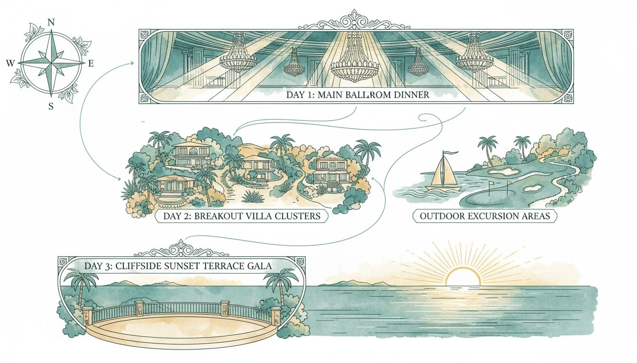
VENUE PLANNING · RETREAT FLOW MAP
El Conquistador Resort — 3-Day Retreat Flow
El Conquistador Resort, Puerto Rico · 1,100 acres · Private island · 7 pools · 17 restaurants
Day 1: Arrival & opening gala dinner · Day 2: Breakout sessions & excursions · Day 3: Sunset farewell gala
Conceptual retreat layout — floor plan subject to confirmation with El Conquistador sales team

Slide 6
INVESTMENT & PROGRAM SCOPE
Three Programs.
One Design Partner.
$210,000+
$52,000+
$390,000+
Annual Leadership Retreat
Partner Showcase Dinner
Annual Program Partnership
3-day · 80 guests · destination property
Per city · 70 guests
Retreat + 2 dinners + 1 member event
All fees include full creative concept, decor, production management, and on-site direction.
Travel, F&B, venue rental, and partner accommodations quoted separately.

Slide 7
Let's Design Your
Most Important Moments
[Prospect_Company_A3] represents the world's best properties. Your events should feel like it.
We'd love to share our portfolio in person — and begin designing your 2026 retreat.
[Provider_Company_J] · San Francisco · hello@[Provider_Company_J][Provider_Company_J].com

