Slide 1
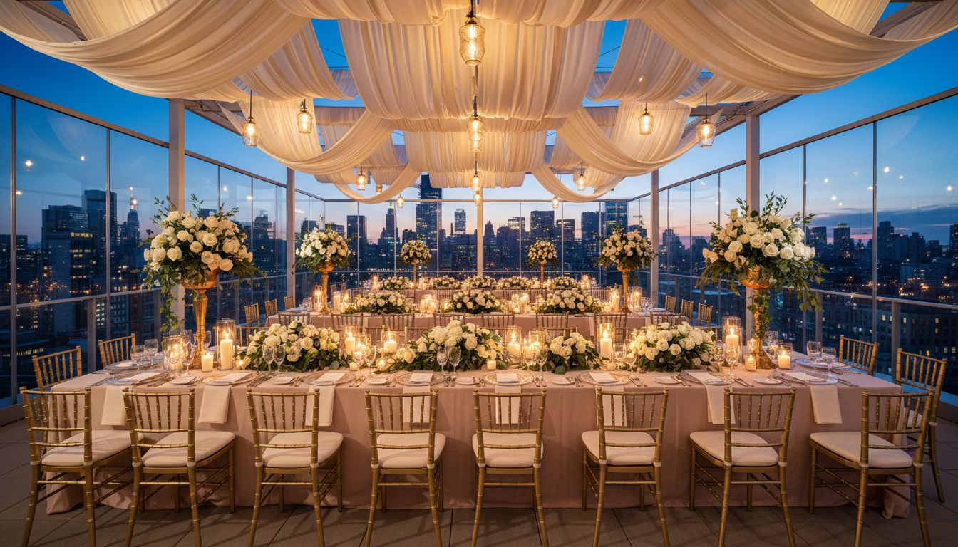
[Provider_Company_J] × BACKAL [Prospect_Company_A2] GROUP
The Art of
Making People Feel
A Design Partnership for New York's Most Ambitious [Prospect_Company_A2] Moments
2026 – 2027 Season
[Provider_Company_J][Provider_Company_J].com · hello@[Provider_Company_J][Provider_Company_J].com

Slide 2
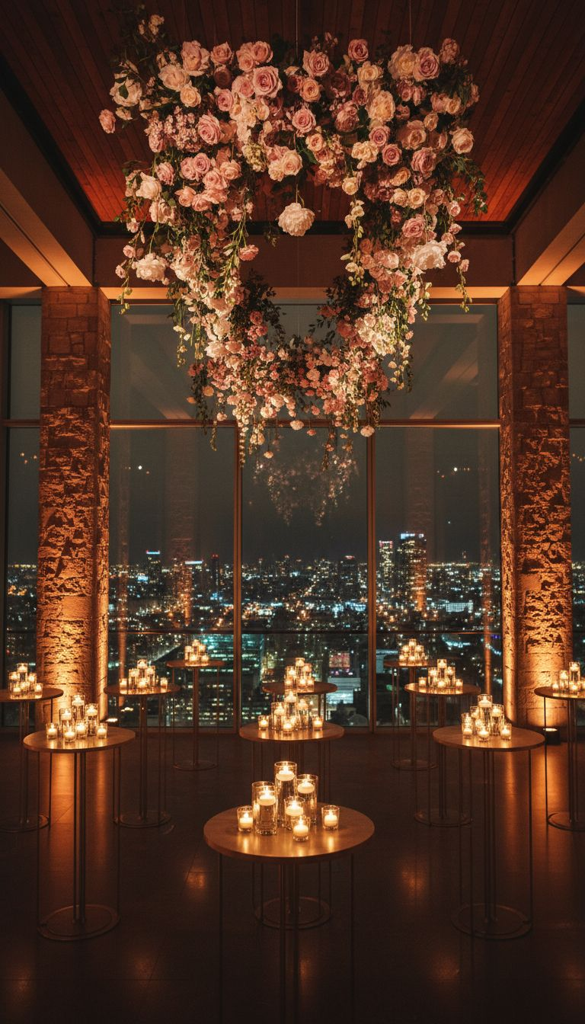
PARTNERSHIP OVERVIEW
New York's Stage,
Redesigned
— Backal [Prospect_Company_A2] Group commands some of New York's most sought-after event venues.
— [Provider_Company_J] brings the design language that transforms a beautiful space into a memory.
— Together, we propose a new tier of corporate event experience — one that commands premium fees.
[Provider_Company_J]

Slide 3
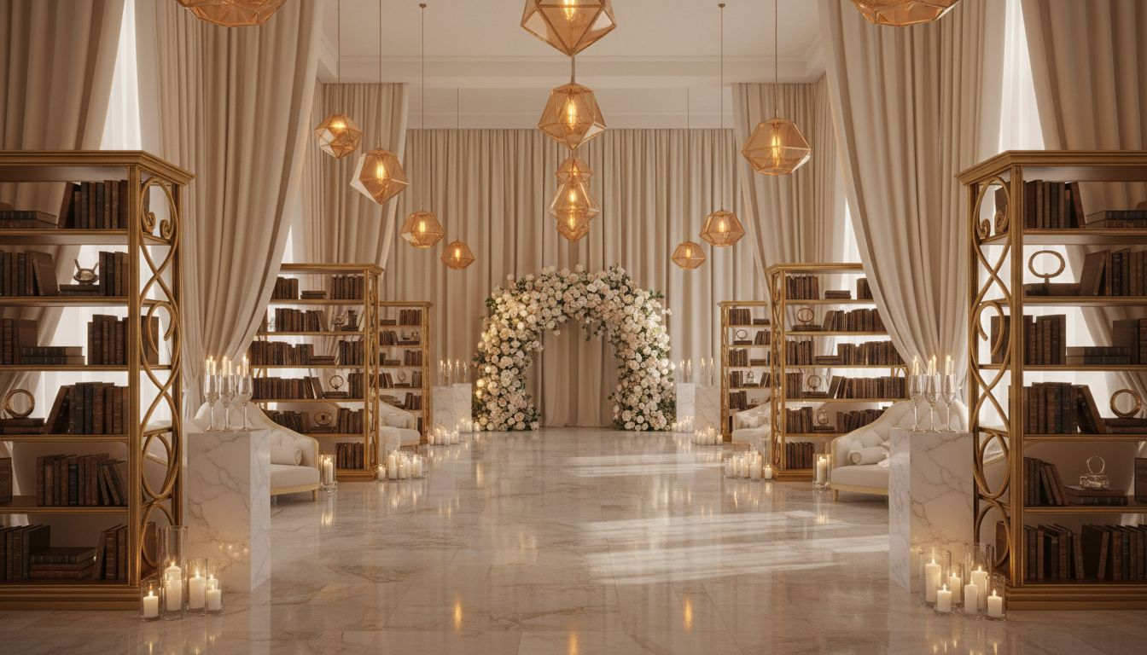
CONCEPT I
The Executive Gala
— Apella Transformed
— Apella is a world-class venue waiting for a world-class creative partner.
— Proposed annual corporate gala for law firms, financial institutions, and tech companies.
— Concept: 'The Gilded Archive' — library-meets-gallery with draped rooms and champagne alcoves.
— Capacity: 200–400 guests. East River backdrop. AV/staging fully managed.
Apella by Alexandria, 450 E 29th Street, New York

Slide 4
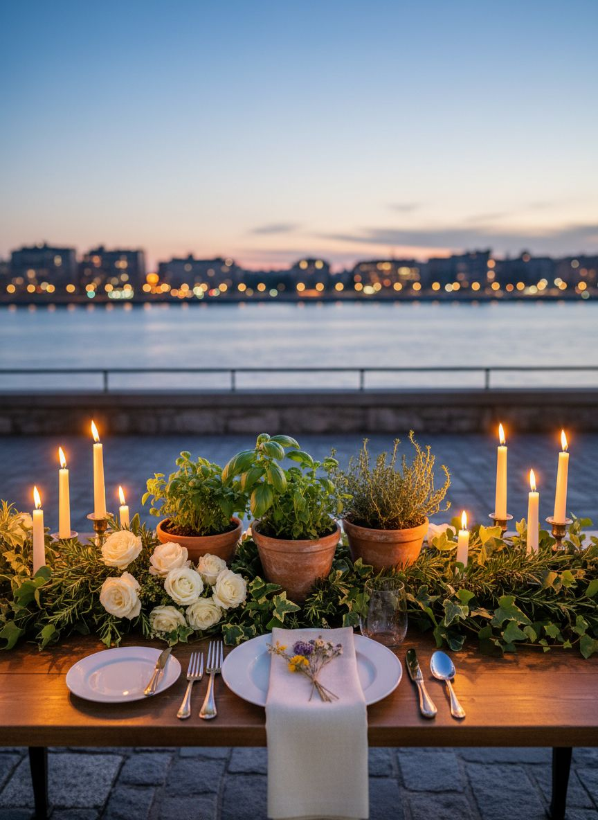
CONCEPT II
The Members' Dinner
— Riverpark Private Format
[Prospect_Company_A]
↳ Riverpark's terrace and dining room become a private members' club for the evening.
↳ Curated for 40–80 guests: C-suite entertaining, board dinners, and client appreciation.
↳ Botanical abundance, candlelight, estate-grown menu, hand-pressed floral keepsakes.
↳ Each guest leaves with a memory — and a standing request for next year's invitation.

Slide 5
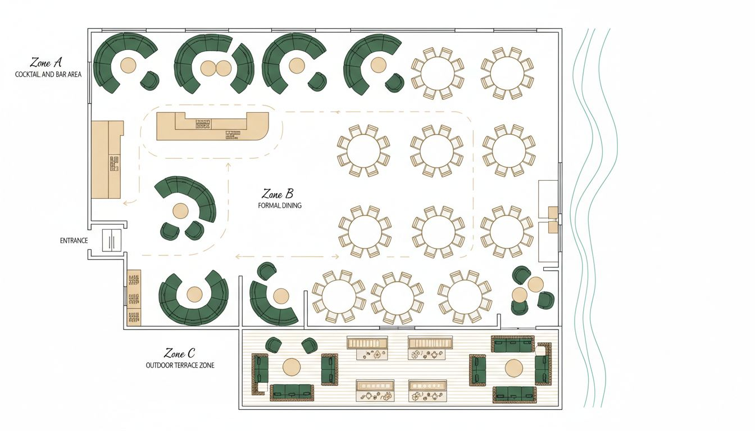
VENUE PLANNING · FLOOR PLAN
Apella by Alexandria — Event Flow
Apella by Alexandria · 450 E 29th Street, New York, NY · 18,000 sq ft · East River views
Zone A: Cocktail gallery & bar · Zone B: Seated dinner (200–400) · Zone C: Terrace dessert reception
Conceptual layout — venue floor plan subject to confirmation with Alexandria sales team

Slide 6
INVESTMENT & PARTNERSHIP SCOPE
Three Ways to Begin.
$165,000+
$38,000+
$320,000+
Executive Gala — Apella
Members' Dinner — Riverpark
Annual Design Partnership
200–400 guests · full production design
40–80 guests · per event
4 signature events per year
All fees include full creative concept, decor, production management, and on-site direction.
Venue rental, F&B, staffing, and lighting quoted per event scope.

Slide 7
Begin the
Conversation
Every great event begins with a single creative conversation.
We'd love to walk Apella with you and share what we see.
[Provider_Company_J] · San Francisco & New York · hello@[Provider_Company_J][Provider_Company_J].com

