Slide 1
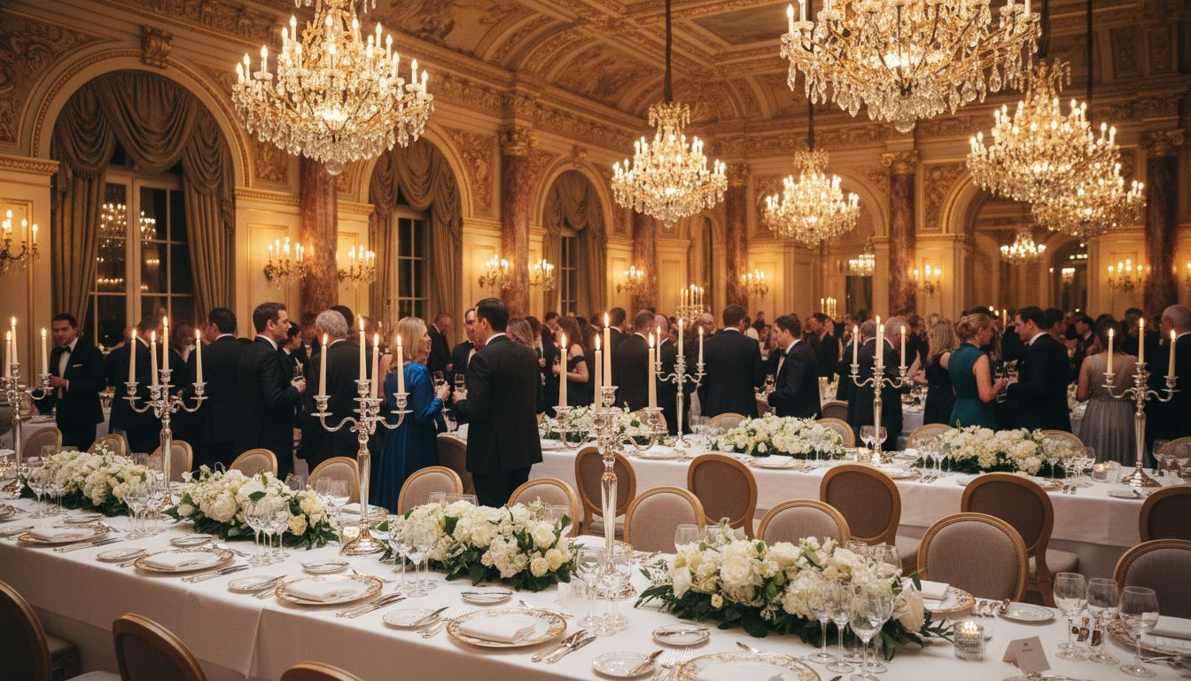
Elevating [Prospect_Company_A1] Experiences at Every Scale
[Provider_Company_I] × [Prospect_Company_A1] Events | Production Partnership Proposal
Proposed: Q4 2026
1/7

Slide 2
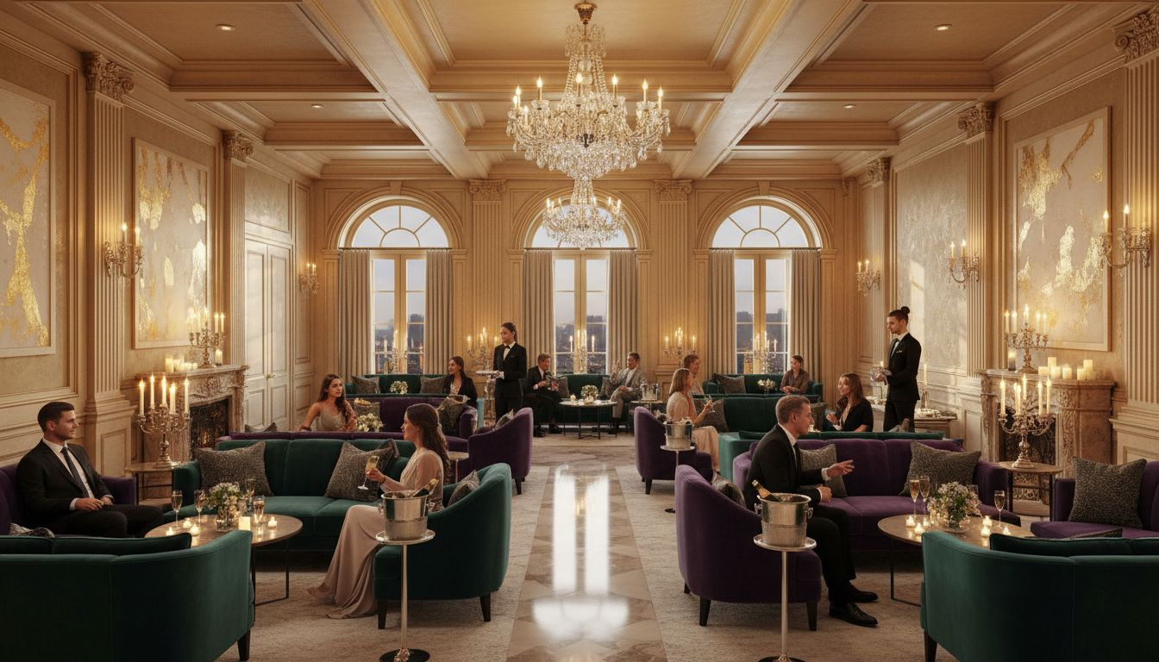
[Prospect_Company_A]
What we each bring to the table
[Prospect_Company_A1]
30,000+ guests/year • 23 years of excellence • Clients include KPMG, Samsung, Barclays, HSBC
[Provider_Company_I]
450+ events globally • Exhibition & conference production at scale • Hybrid event infrastructure
Combined
World-class hospitality experiences powered by world-class event production
From Royal Ascot hospitality suites to global conference stages — together, the full event experience.
2/7

Slide 3

Venue Planning & Event Flow
Venue Transformation
Bespoke set design for [Prospect_Company_A1] dinners, conference breakouts, and awards nights — from arrival to close
Registration Flow
Branded arrivals experience: digital check-in, welcome packs, and guest journey mapping
Production Access
Coordination of load-in, backstage logistics, AV crew, and lighting rigs with venue management
Conceptual layout; final venue floor plan to be confirmed with client
3/7

Slide 4
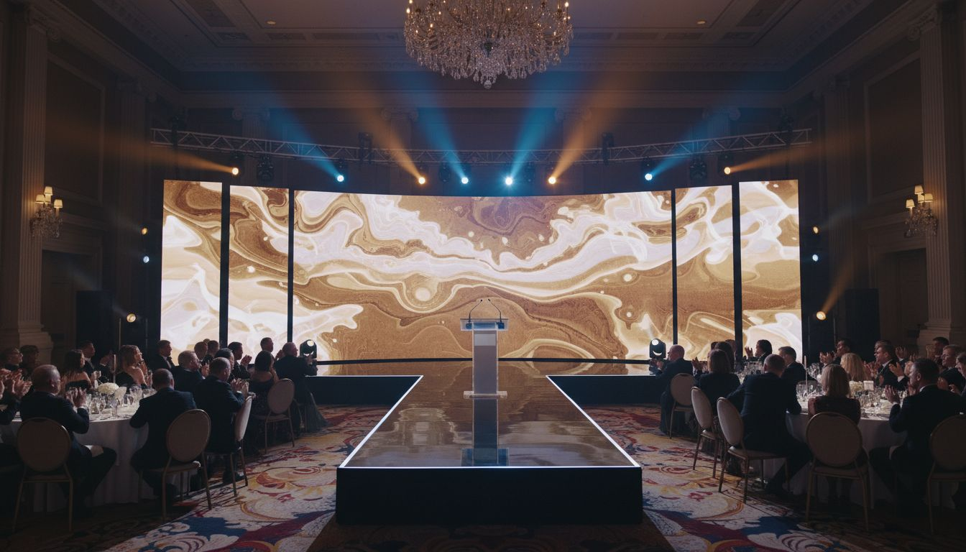
Stage Design & Production
Broadcast-Quality Builds
Immersive LED Backdrops
Full AV Production
Award-ceremony and conference stages with LED backdrop systems, scenic design, and full lighting rigs
Custom motion-graphic content, live brand messaging, and real-time show control
Lighting, sound, streaming, camera direction, and dedicated on-site crew for every show
4/7

Slide 5
Hybrid & Scalable Event Packaging
Reach every guest — whether they are in the room or watching from anywhere in the world.
Live Broadcast
On-Demand Packaging
[Prospect_Company_A1] dinners, awards nights, and conferences broadcast live to remote participants via professional streaming infrastructure
Every session recorded, edited, and distributed as premium on-demand content for post-event engagement
Interactive Remote Experience
Content Repurposing
Live polling, audience Q&A, and digital networking tools connecting in-room and remote guests seamlessly
Highlights reels, sponsor placement in recordings, and branded content packages for social and internal distribution
5/7

Slide 6
Scope & Investment
Pricing is scoped by event format, venue, production complexity, and guest count.
Essentials
Production support: AV, lighting, basic stage, registration flow
Up to 200 guests
Scoped on brief
Enhanced
All Essentials + scenic design, hybrid broadcast, custom registration experience
200–500 guests
Scoped on brief
Premium
All Enhanced + full LED stage, broadcast crew, on-demand packaging, sponsor zones
500+ guests
Scoped on brief
All packages include full project management, dedicated on-site production staff, and post-event reporting.
6/7

Slide 7
Ready to [Prospect_Company_A] Together
[Provider_Company_I] — Production Excellence for World-Class [Prospect_Company_A1] Experiences
[Contact Name]
[email@[Provider_Company_I].com] | [+44 xxx xxxx xxxx]
Book a partnership briefing today

