Slide 1
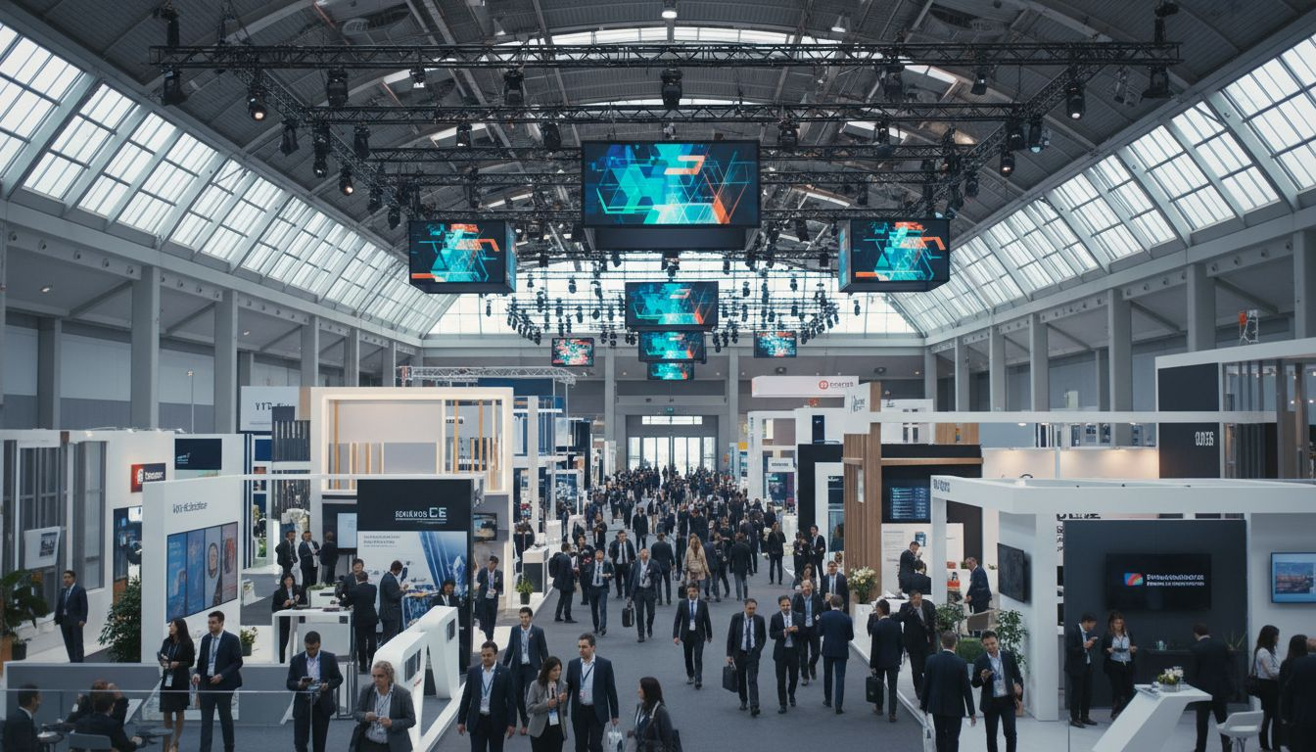
[Prospect_Company_A] Industry Trade Shows
[Provider_Company_I] × [Prospect_Company_Z] | Exhibition Production Partnership Proposal
Proposed: October 2026 ([Prospect_Company_Z] America) / May 2027 ([Prospect_Company_Z] Frankfurt)
1/7

Slide 2
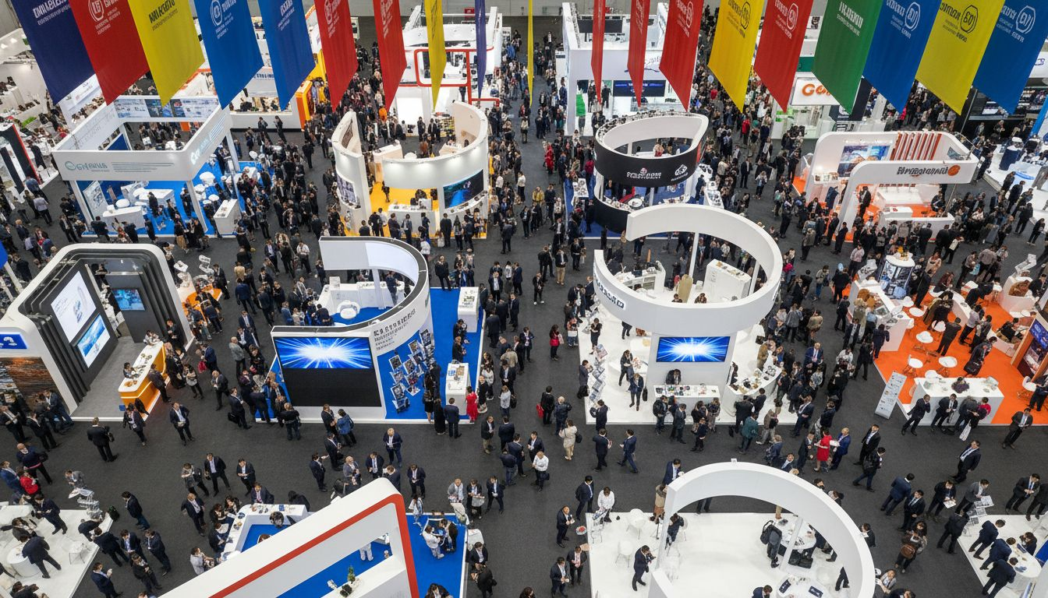
Why [Prospect_Company_Z] × [Provider_Company_I]
2
A natural partnership at scale
155,000+
meetings facilitated at [Prospect_Company_Z] shows per year
30,000+
participants at [Prospect_Company_Z] Frankfurt & [Prospect_Company_Z] America
450+
global B2B events managed by [Provider_Company_I]
20+ years
of [Prospect_Company_Z] shows advancing the global events industry
Shared commitment to connecting industries, driving commerce, and advancing event innovation worldwide.

Slide 3
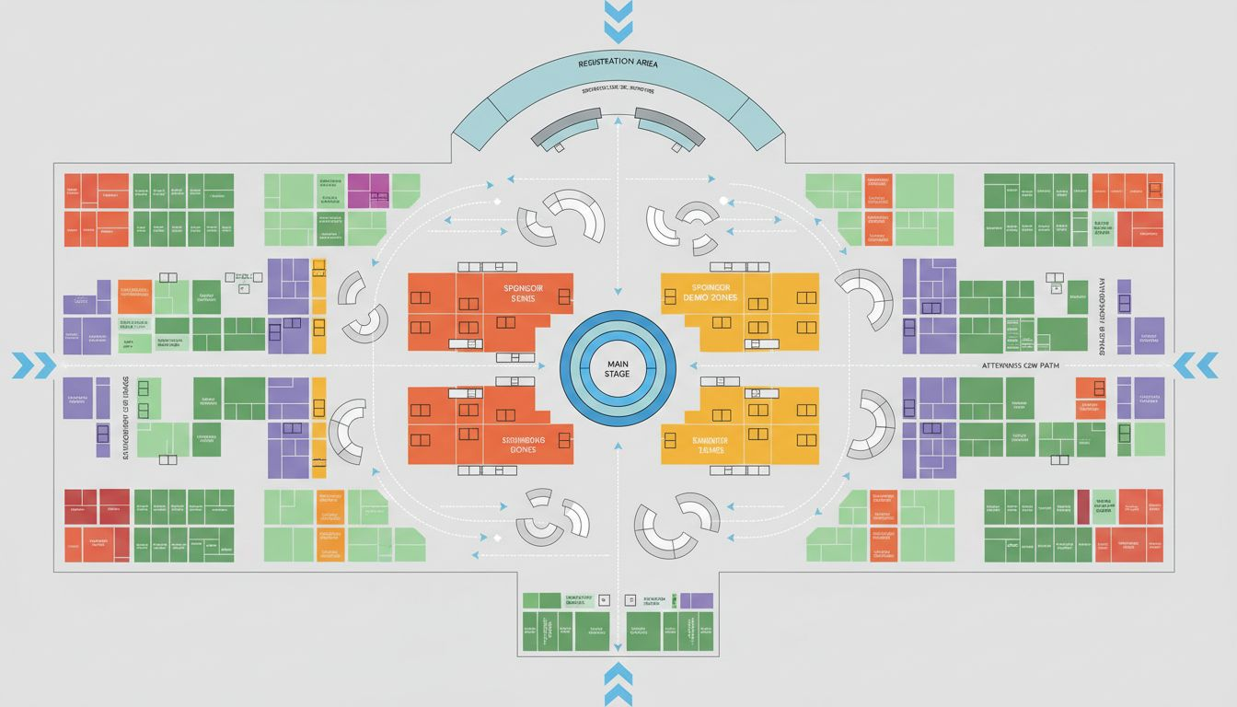
Exhibition Floor Design & Venue Transformation
3
Exhibitor Stand Builds
Modular, scalable builds for [Prospect_Company_Z] Frankfurt's Messe Frankfurt and [Prospect_Company_Z] America's Las Vegas Convention Centre
Signage & Wayfinding
Full venue signage systems, digital display management, and guest directional flow
Production Logistics
High-traffic zone planning, load-in logistics, backstage crew management, and vendor coordination
Conceptual layout; venue floor plan not available — indicative only

Slide 4
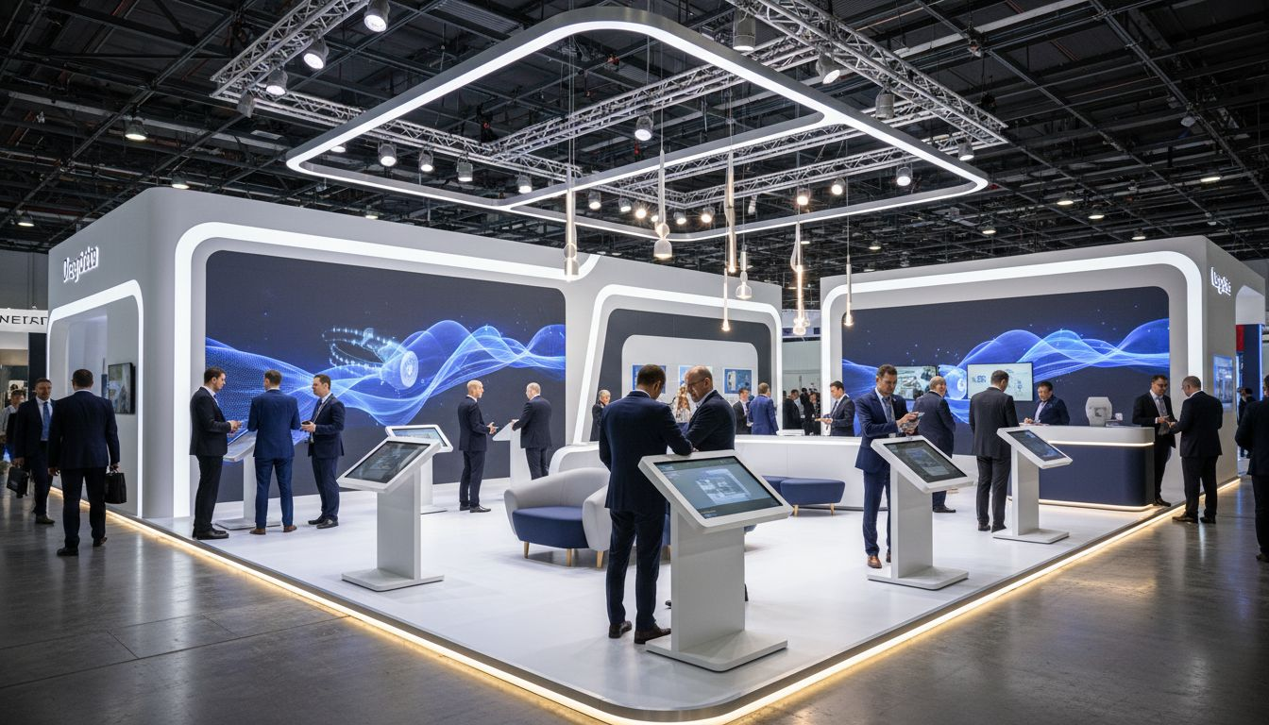
Sponsor Activation & Attendee Engagement
4
Premium Sponsor Lanes
Digital Lead-Gen Stations
Hosted Buyer Lounges
Interactive demo experiences in high-traffic aisles. Branded activations that drive dwell time and qualified leads.
Badge scanning, QR interactions, and AI-powered matchmaking tools at every sponsor zone.
Dedicated meeting pods connecting hosted buyers with exhibitors — [Prospect_Company_Z]'s core value proposition elevated.

Slide 5
Hybrid Show Production
5
Extending the [Prospect_Company_Z] experience beyond the show floor — reaching global audiences wherever they are.
Broadcast-Quality Keynote Stages
Live-Stream Studios on the Show Floor
On-Demand Content Packaging
Full stage production with LED backdrops, broadcast cameras, and live-switched multi-angle direction for [Prospect_Company_Z]'s main stage sessions.
Dedicated broadcast booths embedded within the exhibition floor — capturing education sessions and sponsor announcements in real time.
Post-show content editing, packaging, and distribution for [Prospect_Company_Z]'s global community — extending the show's reach for weeks after closing.

Slide 6
Scope & Investment Overview
6
All packages are modular and scoped to show format, venue, production requirements, and attendee volume.
Package
Inclusions
Best For
Investment
Essentials
Exhibition floor build, signage, basic AV, registration desk
Single-city show, 5,000–10,000 attendees
Scoped on brief
Enhanced
All Essentials + hybrid broadcast, sponsor zone design, hosted buyer lounges
[Prospect_Company_Z] America or Frankfurt at standard scale
Scoped on brief
Premium
All Enhanced + full stage production, broadcast studio, content packaging, post-show analytics
Flagship shows at full scale
Scoped on brief
Full project management, on-site production crew, and post-show debrief included in all packages.

Slide 7
[Prospect_Company_A] Together
[Provider_Company_I] — Your Exhibition Production Partner for [Prospect_Company_Z] Frankfurt 2027 & [Prospect_Company_Z] America 2026
[Contact Name] | [email@[Provider_Company_I].com] | [+44 xxx xxxx xxxx]
Ready to discuss: Partnership Discovery Call

