Slide 1
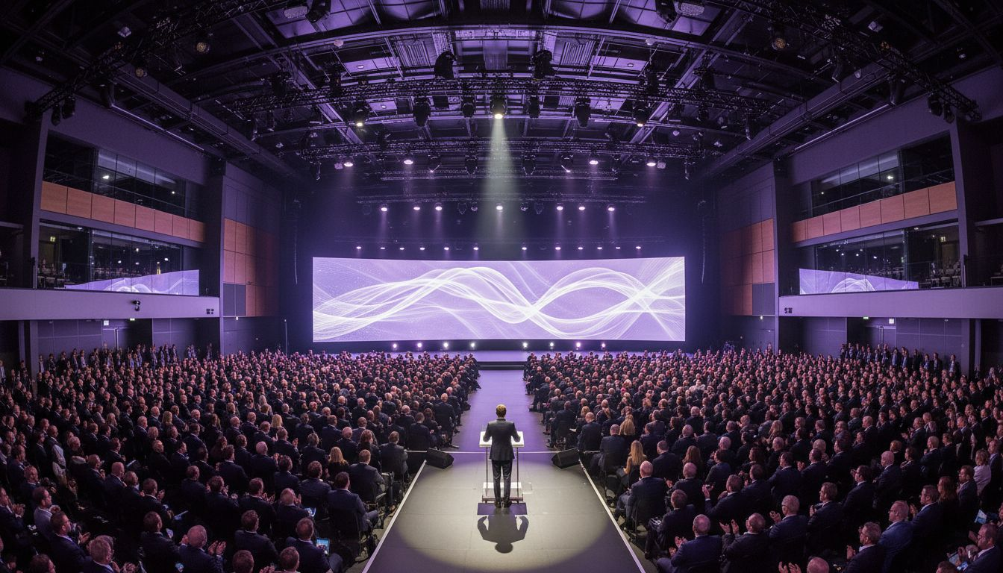
Advancing UK [Prospect_Company_Y] [Prospect_Company_A]
[Provider_Company_I] × [Prospect_Company_Y] | Association Conference Production Partnership
Proposed: Spring 2027 | Annual [Prospect_Company_Y] Conference + Member Event Programme
1/7

Slide 2
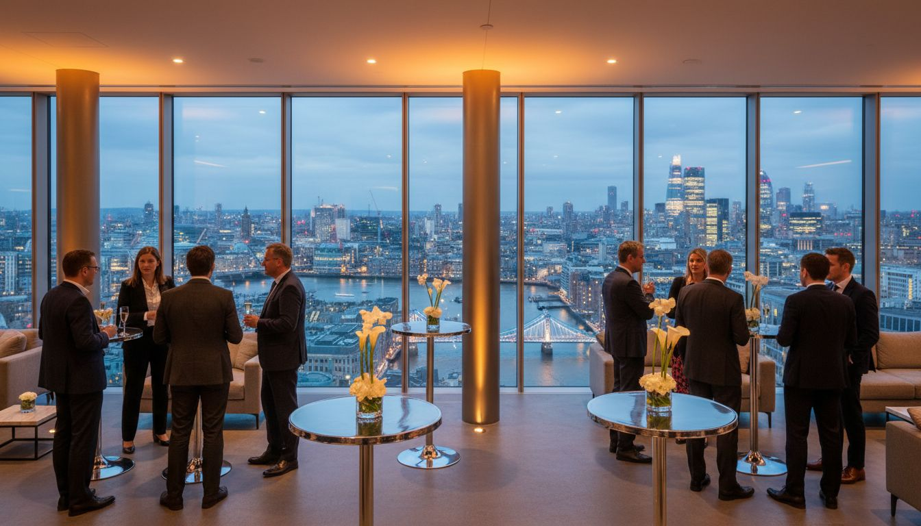
Supporting the BRC's Most Important Industry Moments
2
The BRC runs some of UK [Prospect_Company_Y]'s most influential events
200+
Major [Prospect_Company_Y] brand members including Tesco, M&S, IKEA, John Lewis
c.80%
of UK [Prospect_Company_Y] sales flow through BRC member organisations
14
Member communities running forums, roundtables, and learning events
Annual
[Prospect_Company_Y] Conference bringing together [Prospect_Company_Y]ers and policy makers
[Provider_Company_I]: proven production for trade associations, conferences, and hybrid member events globally.
2/7

Slide 3
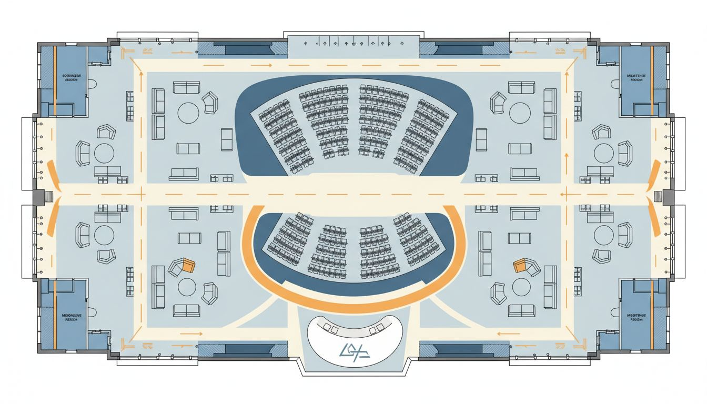
Venue Planning & Conference Flow
3
Registration Experience
Branded arrivals, digital badge scanning, delegate welcome packs, and guest journey mapping from arrival to sessions
Conference Flow
Theatre seating for keynote sessions, breakout rooms, networking areas, and sponsor exhibition zones — all within one managed flow
Sponsor Integration
Sponsor demo zones embedded in high-traffic delegate paths — connecting associate members with [Prospect_Company_Y] decision-makers
Conceptual layout — proposed for Queen Elizabeth II Centre or ExCeL London
3/7

Slide 4
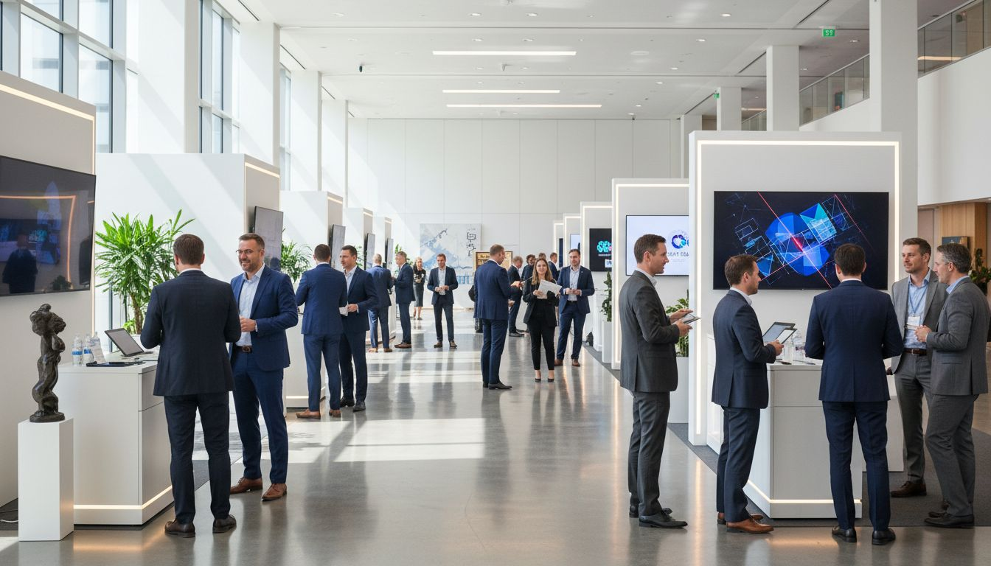
Sponsor Activation & Exhibitor Value
4
Branded Sponsor Zones
Digital Lead Generation
Sponsor ROI Reporting
Designed activation stands connecting BRC associate members with [Prospect_Company_Y] decision-makers in high-traffic conference areas.
Badge-scan technology, QR interaction points, and session-specific sponsor messaging driving measurable engagement.
Post-event analytics: lead quality, dwell time, and engagement data delivered to every sponsor after the conference.
4/7

Slide 5
[Prospect_Company_A] & Content Packaging
5
Extending BRC conference value to every member — in the room and beyond.
Live Broadcast to Members
On-Demand Community Hub Content
BRC conferences broadcast live to members across the UK who cannot attend in person — extending reach across all 200+ member organisations.
Sessions recorded, edited, and published to the BRC Community Hub as on-demand content accessible to the full member community.
Interactive Remote Participation
Scalable Format Library
Live Q&A, audience polling, and digital networking tools — keeping remote attendees fully engaged with the room in real time.
Proven production formats for 200 to 1,500 delegate events — from intimate member forums to the full Annual [Prospect_Company_Y] Conference.
5/7

Slide 6
Scope & Programme Options
6
Modular packages designed to support the full BRC events calendar — from flagship conferences to member community forums.
Annual [Prospect_Company_Y] Conference
Full production takeover: stage design, keynote AV, sponsor demo zones, delegate registration, hybrid broadcast, awards ceremony option
1,000–1,500 delegates
Member Forums & Roundtables
Scalable production: AV, registration, modular stage, networking zone design, and hybrid broadcast
200–800 delegates
Award Ceremony Add-On
Premium stage build, custom trophy presentation setup, MC production support, photography, and highlights reel
Optional add-on for any event
All packages include dedicated project management, on-site crew, post-event debrief, and sponsor/delegate analytics.
6/7

Slide 7
Let's Shape the Future of [Prospect_Company_Y] Together
[Provider_Company_I] — Powering Association Conferences & Industry Events
[Contact Name] [email@[Provider_Company_I].com] | [+44 xxx xxxx xxxx] Let's discuss BRC's 2027 conference programme

