Slide 1
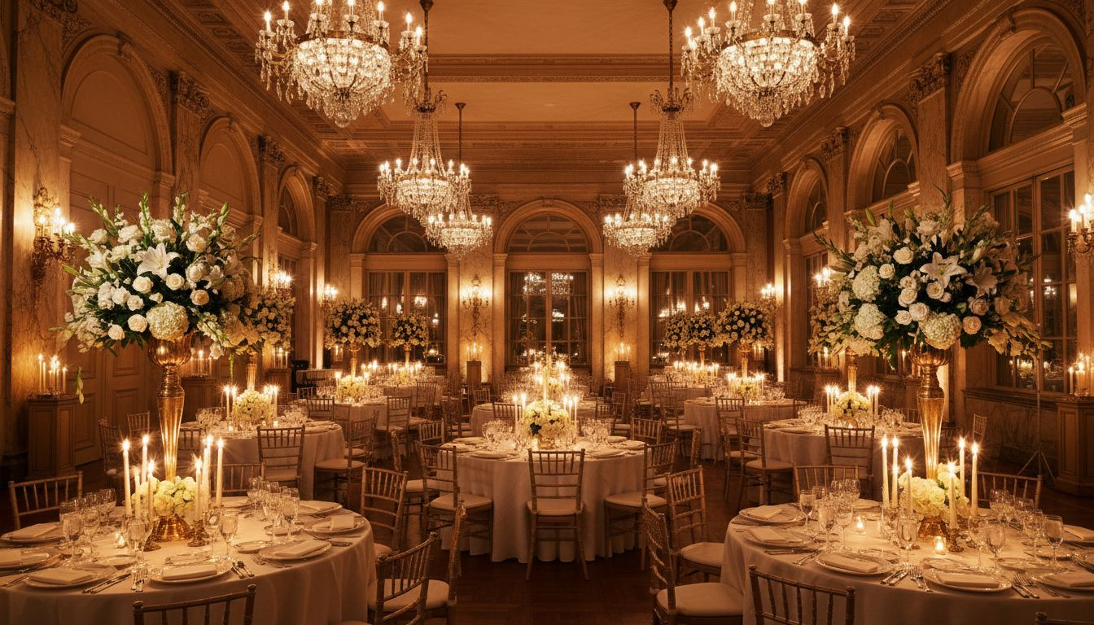
GALA & LEADERSHIP EVENT PROPOSAL | 2027
[Prospect_Company_A]
[Prospect_Company_A] & Global Leadership Awards Gala
A [Provider_Company_H] Group Event Proposal
Proposed: June 2027 | Washington, D.C.
www.[Provider_Company_H][Company_Website_A]

Slide 2
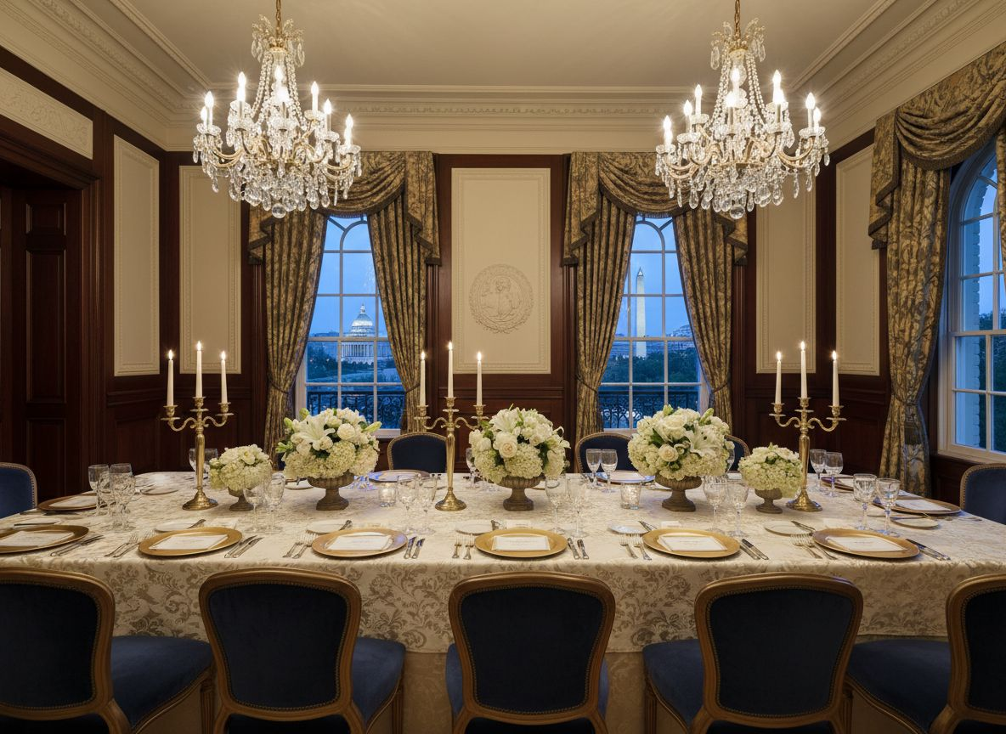
ABOUT US
The [Provider_Company_H] Group
Global Event Management | Washington, D.C.
[Prospect_Company_A]
Headquartered in Washington, D.C. — the center of
diplomatic and association event management.
Diplomatic & Executive Events
Specialists in high-protocol galas, leadership summits,
awards ceremonies, and government convenings.
Turnkey Delivery
Full-service: venue sourcing, production, VIP protocol,
speaker logistics, décor, and post-event reporting.
Partnership-First Approach
We extend your team's capacity with white-glove service
and seamless stakeholder coordination.
www.[Provider_Company_H][Company_Website_A]

Slide 3
WHY [Provider_Company_H] GROUP FOR [Prospect_Company_X]
The Right Partner for Washington's Most Prestigious Bilateral Gala
D.C.-Native
Diplomacy
Global
Execution
Gala &
Awards Expertise
Prestige
Venue Access
Headquartered blocks from Embassy Row — fluent in diplomatic protocol, VIP management, and government-adjacent event logistics.
[Prospect_Company_X]'s U.S.-India-Japan multi-stakeholder network demands a partner with [Prospect_Company_A]
Awards choreography, speaker transitions, gala dinner production, and media coordination built in to every engagement.
From Kennedy Center to Waldorf Astoria — we know Washington's premier event venues and their protocols.
Emphasizing summit management, VIP protocol, speaker handling, and high-level stakeholder engagement.

Slide 4
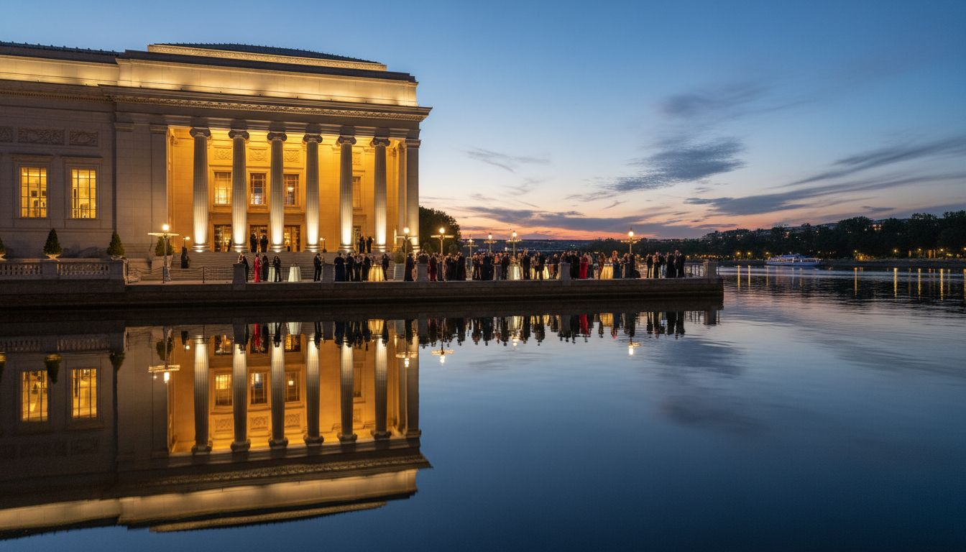
EVENT VISION
[Prospect_Company_A] & Global Leadership Awards Gala
An evening that elevates U.S.-India-Japan bilateral diplomacy
Fireside
Conversations
Global Leadership
Awards Ceremony
Black-Tie
Gala Dinner
VIP Reception
Senior officials,
ambassadors & CEOs
Recognizing bilateral
business leaders
Seated dinner with
diplomats & ministers
Cocktails & pre-dinner
exclusive access
Proposed: June 2027 | Kennedy Center / Waldorf Astoria | Washington, D.C.
Senior U.S. and Indian government officials · Lawmakers · Diplomats · Business leaders

Slide 5
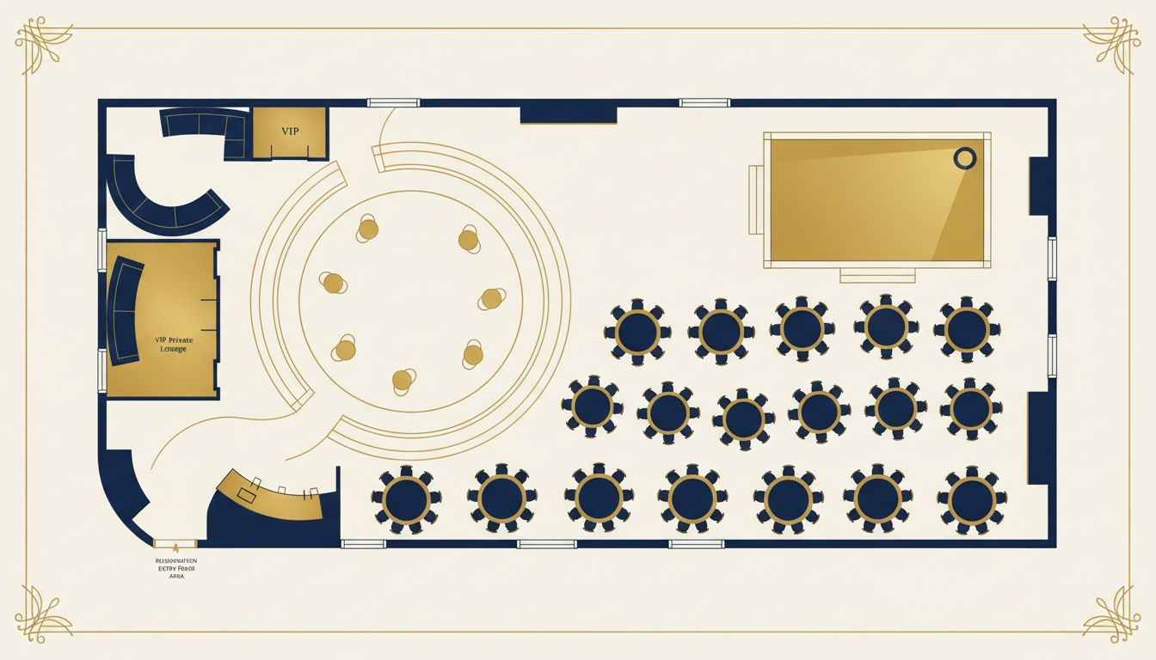
VENUE & EVENT LAYOUT
Kennedy Center or Waldorf Astoria Washington DC
VENUE OPTIONS
Kennedy Center Grand Foyer
Waldorf Astoria Washington DC Ballroom
EVENT ZONES
VIP Cocktail Reception · Awards Stage
Seated Gala Dinner · Media Riser
CAPACITY
200–600 guests
(Full venue transformation)
DESIGN
Floral installations, ambient lighting,
gold table settings, diplomatic staging
PROTOCOL
VIP arrival coordination
Ambassadorial & ministerial green rooms
Conceptual layout — venue floor plan not available

Slide 6
SUMMIT & GALA SERVICES
Full-Service Leadership Event Management
◆
Awards Ceremony Production
◆
Gala Dinner Programming
Script coordination, presenter staging, A/V cues, and award presentation choreography.
Course timing, entertainment cues, A/V production, and ambient design coordination.
◆
VIP & Speaker Protocol
◆
Press & Media Coordination
Green room management, escort logistics, briefing packets, and run-of-show [Provider_Company_A].
Media riser setup, press credential management, and live-stream logistics.
◆
Diplomatic Reception Logistics
◆
Full Venue & Décor Management
Guest sequencing, seating protocol, cultural coordination, and security liaison.
Venue sourcing, floral, lighting design, catering, and full on-site management.

Slide 7
INVESTMENT OVERVIEW
Scoped to Your Summit Vision & Venue
[Prospect_Company_A]
& Awards Gala (Full Turnkey)
$75K – $250K+
Complete gala management: venue sourcing, production, VIP protocol, awards ceremony,
gala dinner, décor, A/V, press coordination, and on-site management.
Awards Ceremony Only
(Production & A/V)
$20K – $60K
Awards script, staging, A/V cues, presenter coordination, and run-of-show management.
VIP Reception Management
$15K – $40K
Cocktail reception logistics, guest sequencing, venue styling, and VIP coordination.
Day-of Summit Management
$10K – $35K
On-site event management team for full summit or single-day program execution.
* Pricing is indicative. Custom proposal provided upon discovery call with [Prospect_Company_X] program team.

Slide 8
PARTNER WITH US
The [Provider_Company_H] Group makes high-stakes events feel effortless.
We'd be honored to support [Prospect_Company_X]'s next Leadership Summit & Awards Gala —
bringing Washington, D.C.'s most prestigious diplomatic venue experience to life.
Schedule a Discovery Call
The [Provider_Company_H] Group | Global Event Management
www.[Provider_Company_H][Company_Website_A] | Washington, D.C.
Women-Owned · Association · Diplomatic · Corporate · Global

