Slide 1
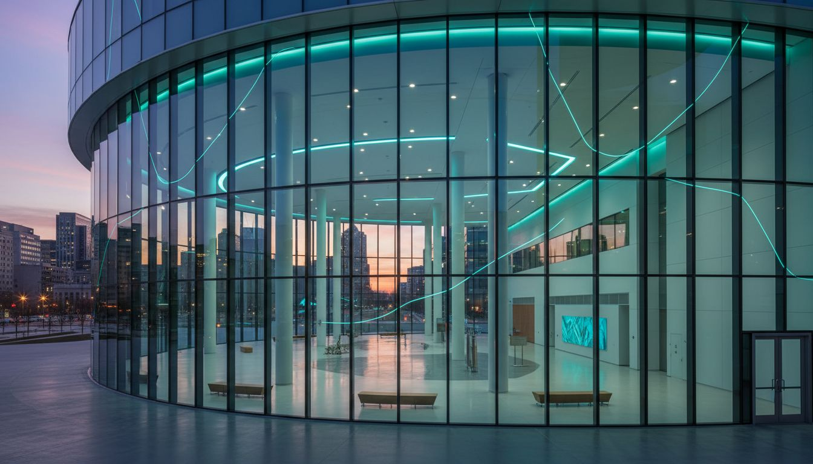
HYBRID & MULTI-CITY PROGRAM PROPOSAL | 2027
[Prospect_Company_A]
2027 Annual Conference & Multi-City Member Programs
A [Provider_Company_H] Group Event Proposal
Washington, D.C. · San Francisco · Hybrid | Proposed: October 2027
www.[Provider_Company_H][Company_Website_A]

Slide 2
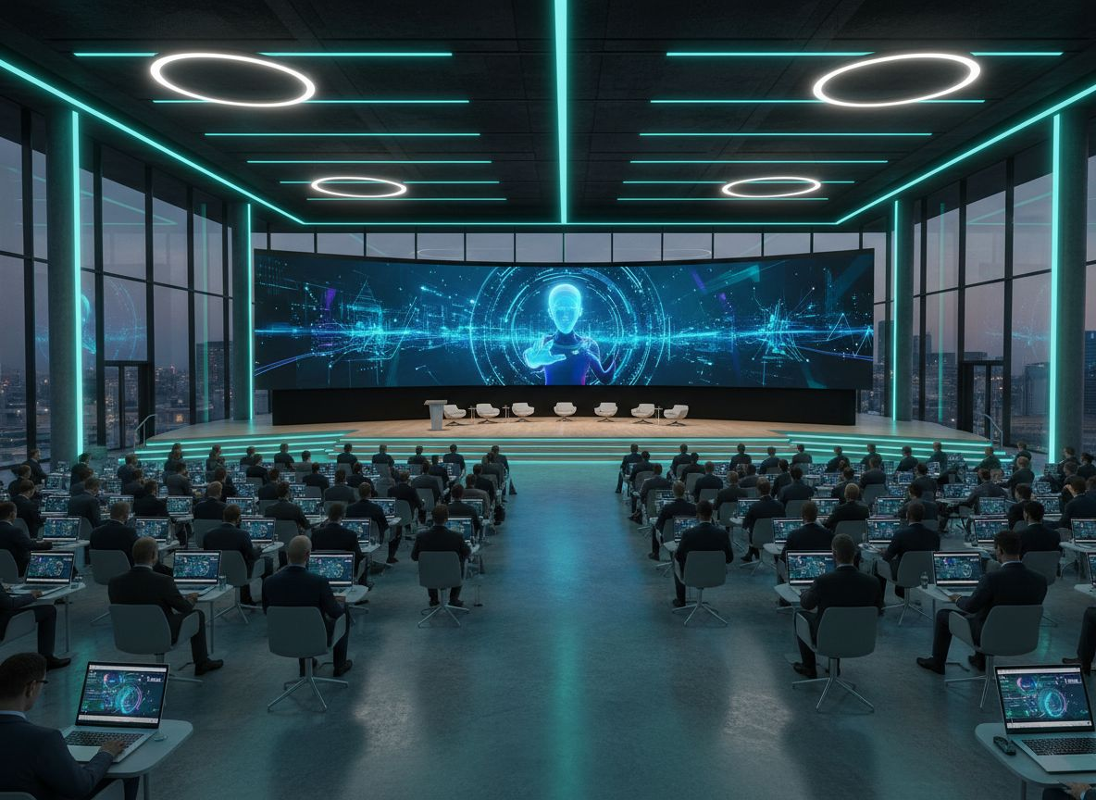
ABOUT US
The [Provider_Company_H] Group
Global Event Management | Washington, D.C.
[Prospect_Company_A]
D.C.-based with national and international
execution capacity across multi-city programs.
Hybrid & Multi-City Expertise
Conference production, hybrid broadcast setup,
and cross-city coordination at scale.
Association Conference Specialists
Annual conferences, leadership dinners, member
programs, and executive convenings.
Turnkey Partnership Approach
End-to-end management: planning through
post-event reporting and analytics.
www.[Provider_Company_H][Company_Website_A]

Slide 3
WHY [Provider_Company_H] GROUP FOR [Prospect_Company_W]
The Multi-City Event Partner for the National VC Ecosystem
DC HQ
& SF Hub
Hybrid
Broadcast
Association
Expertise
Sponsor &
Stakeholder Mgmt
[Prospect_Company_W] operates across both coasts. We deliver consistent quality from D.C. to San Francisco — and everywhere in between.
Live-stream, virtual networking, and on-demand replay built into every flagship event — extending [Prospect_Company_W]'s reach nationally.
Recurring conferences, board events, member programs, and leadership awards: our core service portfolio matches your calendar.
We handle sponsor activations, exhibitor logistics, and multi-stakeholder coordination so your team focuses on mission.
Lead with support for flagship conferences, board events, member summits, and sponsor coordination across a national audience.

Slide 4
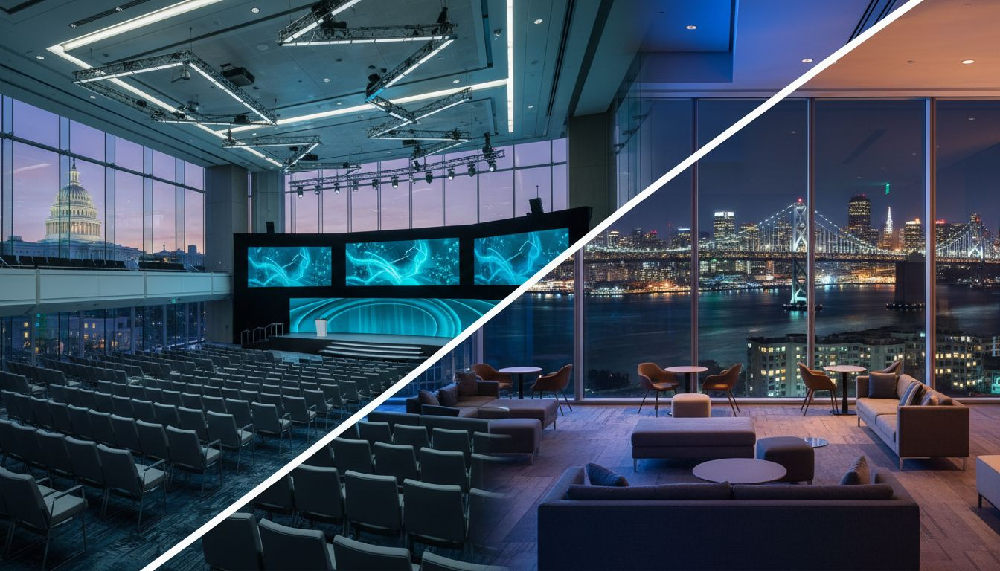
PROGRAM VISION
Multi-City & Hybrid Event Architecture
Washington, D.C.
Flagship
San Francisco
Hub
Hybrid
Broadcast Layer
Quarterly
Regional Programs
[Prospect_Company_A]
Leadership Awards Dinner
[Prospect_Company_A]
Emerging Manager Program
VC Unlocked Sessions
Live-Streamed Keynotes
Virtual Networking
On-Demand Replay
[Prospect_Company_A]
4 Cities/Year
Executive Roundtables
Proposed: October 2027 | Washington, D.C. + San Francisco + Hybrid
Seamless continuity across cities, time zones, and member access points

Slide 5
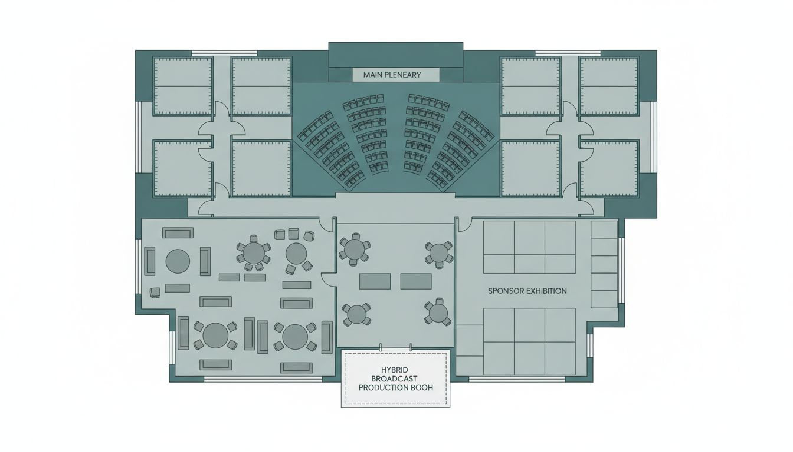
VENUE & EVENT LAYOUT
Washington, D.C. Flagship + San Francisco Hub Venues
D.C. FLAGSHIP VENUE
Ronald Reagan Building & International Trade Center
Washington, D.C. 20004
SF HUB VENUE
Salesforce Tower Event Spaces
or equivalent SoMa conference venue
D.C. EVENT ZONES
Plenary Stage · Breakout Rooms · Expo Hall
Hybrid Broadcast Studio · Networking Reception
SF EVENT ZONES
Executive Briefing Center · Roundtable Room
Evening Reception Area
HYBRID SETUP
Redundant streaming, interactive Q&A,
virtual expo booths, and on-demand library
Conceptual layout — venue floor plan not available

Slide 6
OUR MULTI-CITY SERVICES
Full-Spectrum Hybrid & Multi-City Event Management
→
Annual Conference Management
→
Leadership Awards Dinner
D.C. and SF full production: stage, A/V, sessions, registration, and on-site team.
Awards ceremony production, gala dinner management, A/V, and run-of-show.
→
Hybrid Broadcast Platform
→
Quarterly Regional Programs
Live-stream setup, virtual networking, on-demand replay, and virtual attendee engagement.
Member event support across 4+ cities/year — consistent [Provider_Company_H] quality everywhere.
→
Speaker & Sponsor Logistics
→
Cross-City Attendee Engagement
Speaker booking, green-room management, sponsor booth integration, and fulfillment.
Unified registration, mobile app, and attendee journey design across all program cities.

Slide 7
BUDGET & PROGRAM OPTIONS
Modular Investment Options for [Prospect_Company_W]'s Event Calendar
Annual Conference Package
(D.C. + SF + Hybrid)
TBD / Scoped
Full flagship event management for D.C. and SF conference tracks plus hybrid broadcast. Includes production, A/V, speaker logistics, registration, and on-site team.
Leadership Awards Dinner
$30K – $100K
Awards ceremony production, venue sourcing, gala dinner management, A/V, and on-site team.
Quarterly Regional Programs
(4 cities/year)
$12K – $45K /event
Consistent member event support across 4 city markets — logistics, venue, production, and coordination.
Hybrid Broadcast Add-On
$15K – $40K
Live-stream platform, virtual networking, on-demand post-event library, and virtual attendee experience layer.
* All packages custom-scoped by headcount, format, and production level. Custom proposal provided upon discovery call.

Slide 8
LET'S SHAPE 2027 TOGETHER
The [Provider_Company_H] Group brings multi-city coordination,
hybrid excellence, and executive polish to every [Prospect_Company_W] program.
We're ready to help you build the 2027 event calendar — from D.C. to S.F.
and everywhere in between.
Schedule a Discovery Call
The [Provider_Company_H] Group | Global Event Management
www.[Provider_Company_H][Company_Website_A] | Washington, D.C.
Women-Owned · Association · Hybrid · Multi-City · Global

