Slide 1
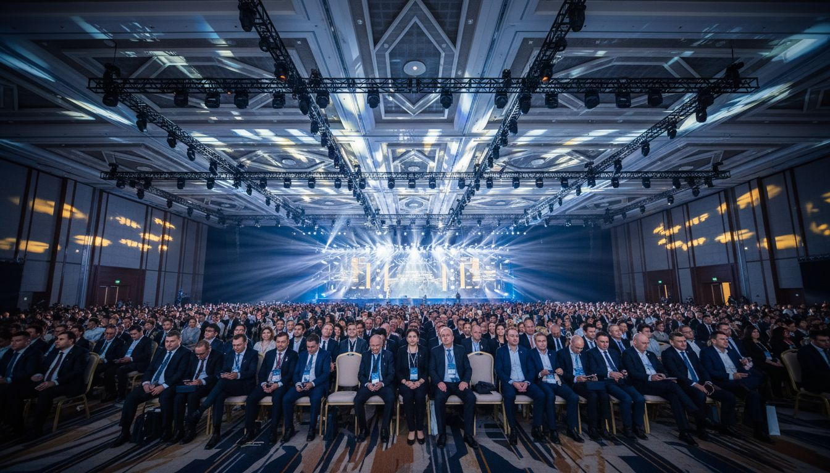
EVENT PROPOSAL | 2027
Meeting Professionals International
World Education Congress 2027
A [Provider_Company_H] Group Event Management Partnership Proposal
Proposed: June 2027 | San Antonio, TX
www.[Provider_Company_H][Company_Website_A]

Slide 2
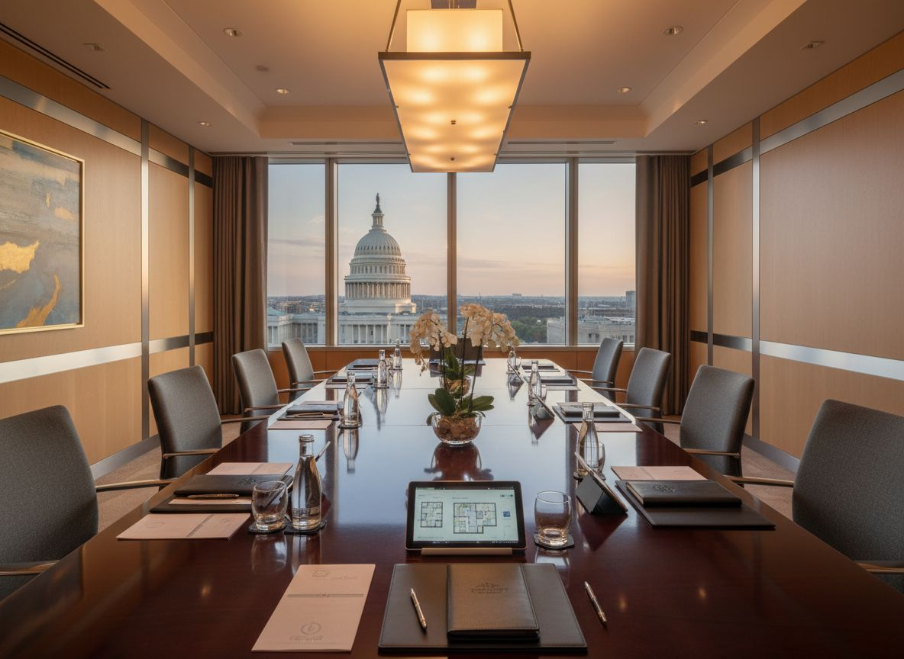
ABOUT US
The [Provider_Company_H] Group
Global Event Management | Washington, D.C.
Women-owned global event management agency
Specialists in association conferences, galas,
and government/corporate convenings
Turnkey delivery from concept through close
Full production, logistics, speaker & sponsor mgmt
Washington, D.C. credibility
With global execution capacity across markets
Trusted by executives, associations
& government stakeholders
Partnership-first, outcomes-driven
www.[Provider_Company_H][Company_Website_A]

Slide 3
WHY THIS PARTNERSHIP
[Prospect_Company_V] + [Provider_Company_H] Group: A Natural Partnership
Industry
Alignment
Production
Excellence
Global
Community
DC
Credibility
[Prospect_Company_V] runs the world's most important meetings-industry events. [Provider_Company_H] Group is built for exactly this complexity.
Multi-session conference production, VIP coordination, and sponsor logistics are our home territory.
130K+ [Prospect_Company_V] members worldwide deserve a flawless execution partner who prioritizes attendee experience.
Headquartered in Washington, D.C. — fluent in the language of associations, policy, and professional communities.
Position [Provider_Company_H] Group as [Prospect_Company_V]'s trusted production partner for conferences, annual meetings, and VIP programs.

Slide 4
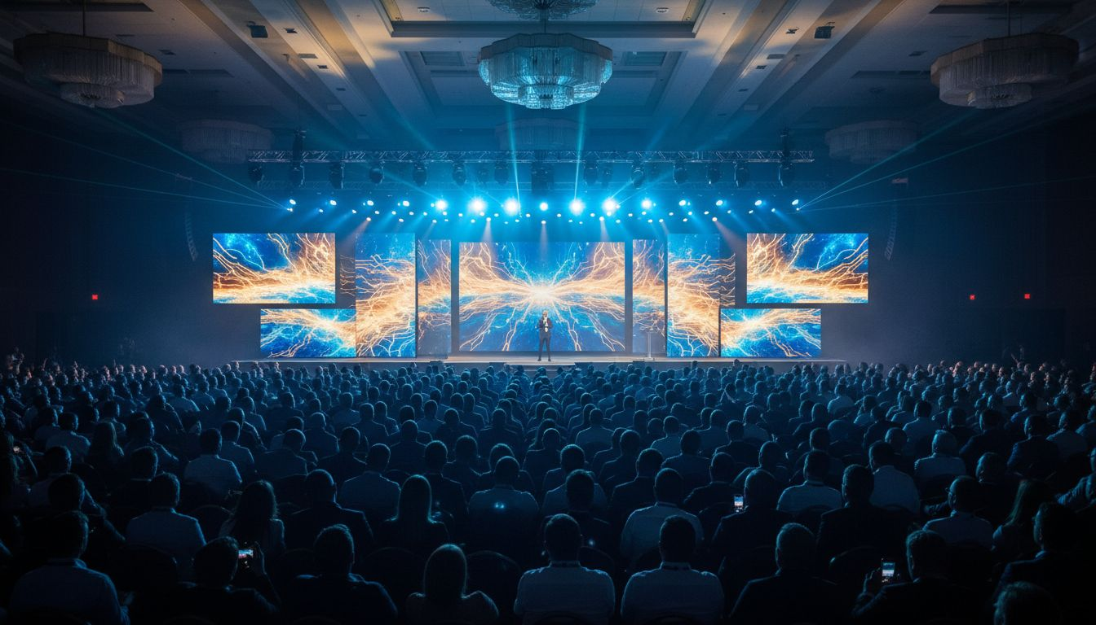
EVENT CONCEPT
World Education Congress 2027
Multi-day flagship annual conference for the meetings & events industry
General Sessions
Breakout Tracks
Hosted Buyer
Program
Evening Gala
Keynotes & Plenaries
Education & Certification
Supplier Marketplace
Awards & Networking
Proposed: June 2027 | Major U.S. Convention City
Turnkey management: pre-event planning through post-event reporting

Slide 5
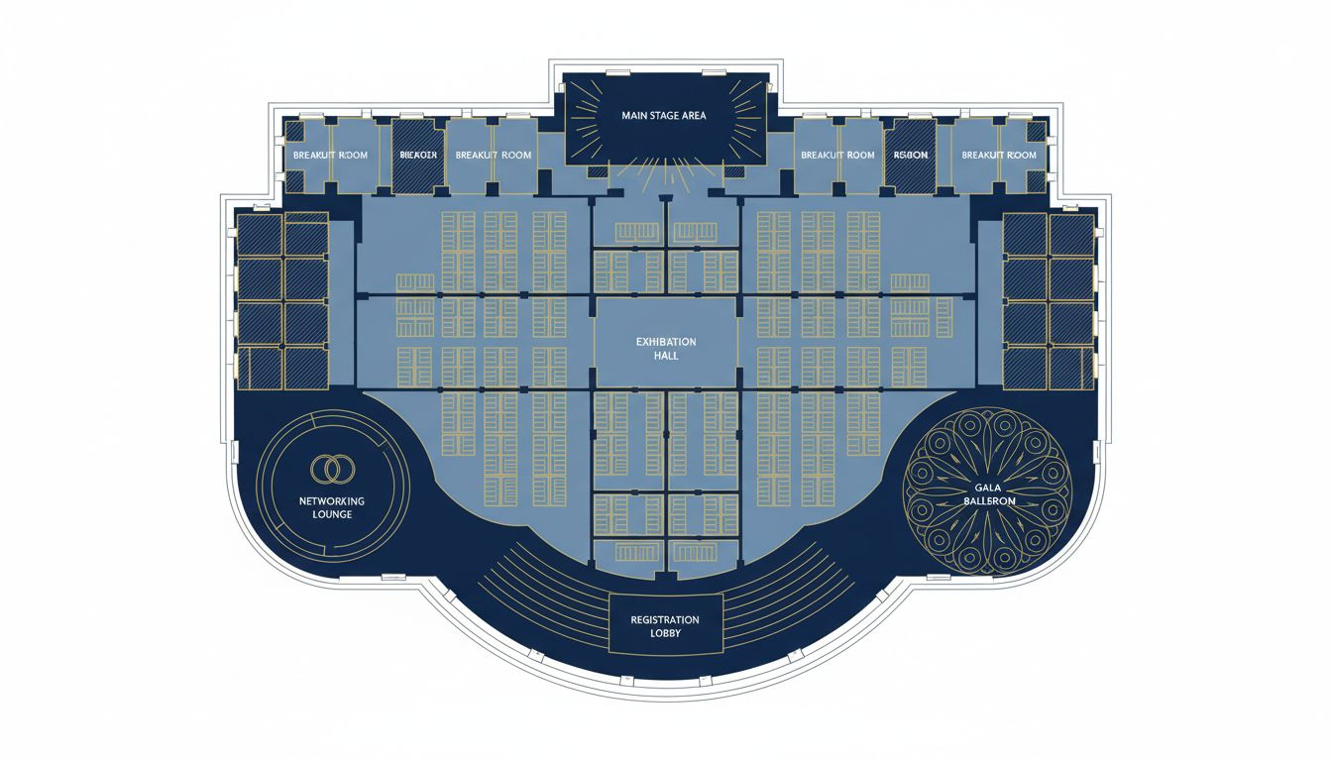
VENUE & FLOOR PLAN
Henry B. Gonzalez Convention Center | San Antonio, TX
VENUE
Henry B. Gonzalez Convention Center
San Antonio, TX 78205
CAPACITY
250,000+ sq ft total event space
6,000+ conference seating capacity
EVENT ZONES
Main Ballroom · General Session Hall
Breakout Suites · Expo Hall · Networking Lounge
SETUP
Multi-day load-in access
Full A/V & production infrastructure
NOTE
Alternative venues available upon scoping
call (convention cities: DC, Chicago, Vegas)
Conceptual layout — venue floor plan not available

Slide 6
OUR SCOPE OF SERVICES
End-to-End Conference & Event Management
✓
Full Production Management
✓
Sponsor Integration
Stage, A/V, lighting, and technical direction from concept through strike.
Booth placement, branded activations, and sponsor fulfillment.
✓
Speaker & VIP Coordination
✓
Hosted Buyer Program Logistics
Scheduling, green-room management, and run-of-show [Provider_Company_A].
Buyer/supplier matching, appointment management, and hospitality.
✓
Registration & Attendee Engagement
✓
On-Site Team & Post-Event Reporting
Platform setup, check-in, mobile apps, and engagement strategy.
Dedicated [Provider_Company_H] Group team on-site through wrap + full analysis.

Slide 7
BUDGET & SCOPE OVERVIEW
Investment Framework — Scoped to Your Event
Flagship Conference Package
(Full WEC-Scale)
$150K – $500K+
Complete conference management: pre-event planning, full production, A/V, speaker management, sponsor integration, on-site team, and post-event reporting.
Chapter Conference Support
$25K – $85K
Tailored support for regional [Prospect_Company_V] chapter events: logistics, production, A/V, on-site coordination.
Hosted Buyer Program Add-On
TBD / Scoped
Appointment management, supplier coordination, reception events, and buyer hospitality.
VIP & Award Evening Production
$20K – $75K
Evening gala or awards ceremony production, staging, A/V, décor coordination, and run-of-show.
* All pricing is indicative and subject to final scoping. Custom proposals provided upon discovery call.

Slide 8
LET'S BUILD WEC 2027 TOGETHER
The [Provider_Company_H] Group brings Washington, D.C. credibility
and global execution to every event we manage.
We'd love to learn more about [Prospect_Company_V]'s 2027 conference vision
and discuss how we can serve as your trusted production partner.
Schedule a Discovery Call
The [Provider_Company_H] Group | Global Event Management
www.[Provider_Company_H][Company_Website_A] | Washington, D.C.
Women-Owned · Association · Corporate · Government · Global

