Slide 1
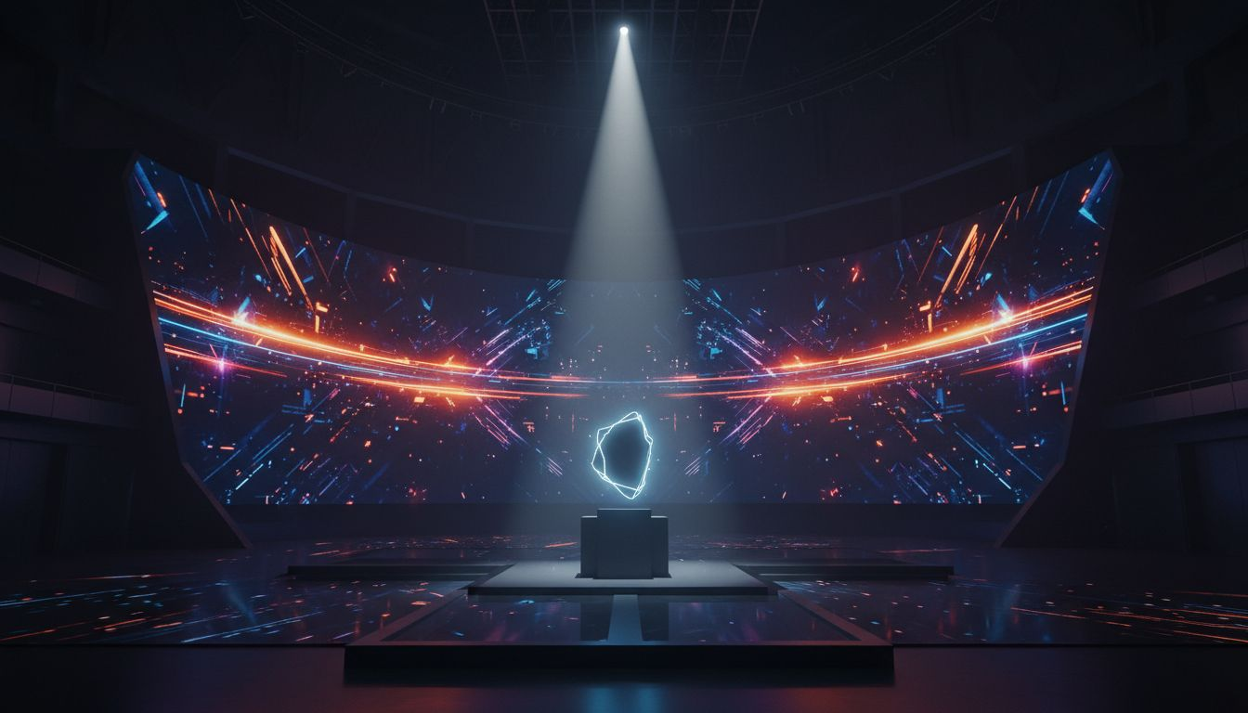
PRODUCT LAUNCH PROPOSAL | VOX MEDIA / THE [Prospect_Company_U]
THE
[Prospect_Company_U] [Prospect_Company_U]
A [Prospect_Company_U] × [Provider_Company_G]® | Premium Tech Product Launch Experience
Chelsea Factory | New York City
Proposed: October 2027
[Provider_Company_G]® | Experiential by Design

Slide 2
OPENING PROVOCATION
What If a Product
Launch Was Actually
Unmissable?
The [Prospect_Company_U] covers the moment tech becomes culture
[Provider_Company_G]® proposes: produce the moment itself — live, cinematic, experiential
THE [Prospect_Company_U] [Prospect_Company_U]: An annual [Prospect_Company_U] signature event where launches become culture
From editorial authority → live experience authority — the [Prospect_Company_U] frontier

Slide 3
THE CASE FOR PARTNERSHIP
Why The [Prospect_Company_U] + [Provider_Company_G]®
🎯 AUDIENCE AUTHORITY
🎬 PRODUCTION EXPERTISE
The [Prospect_Company_U] owns the tech-curious
tastemaker audience globally
[Provider_Company_G]® owns live-moment execution
at Fortune 500 global scale
✍️ STORYTELLING DNA
💰 REVENUE UNLOCK
Both brands lead with narrative,
craft, and boundary-pushing design
Sponsor integration, ticket revenue
& content licensing in one IP

Slide 4
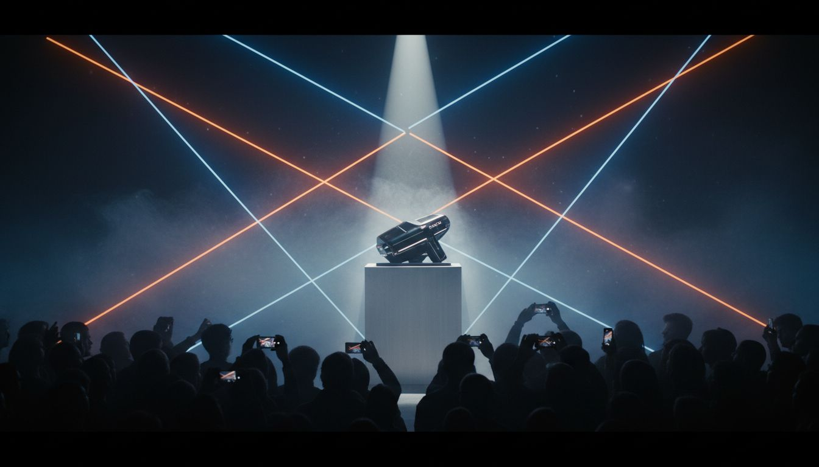
EVENT CONCEPT
THE [Prospect_Company_U] [Prospect_Company_U]
Experience
FORMAT
The launch event
that defines the
year in tech.
Annual live event: 800–1,200 attendees
+ global livestream audience
OPENING ACT
Cinematic 20-min narrative film —
'The Year in Tech'
LAUNCH ZONE
3 product reveal stages with
immersive hands-on demo environments
[Prospect_Company_U] LIVE
Journalist-hosted interview stage
with product makers & founders
AFTER DARK
Sponsor activation spaces transform
into a brand experience party

Slide 5
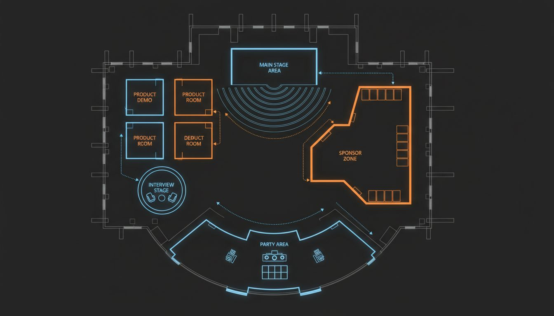
VENUE & SPACE PLANNING
Chelsea Factory, NYC
VENUE
Chelsea Factory — 20,000 sq ft
raw industrial premium event space, Manhattan
MAIN STAGE
800-person standing config with
full rigging & load-in access
PRODUCT DEMO ZONE
3 individually branded
reveal rooms off main hall
[Prospect_Company_U] LIVE STAGE
Secondary interview stage
in dedicated media alcove
AFTER DARK
Full venue re-skin for sponsor
brand experiences post-show
NOTE
Conceptual layout;
floor plan TBD with venue

Slide 6
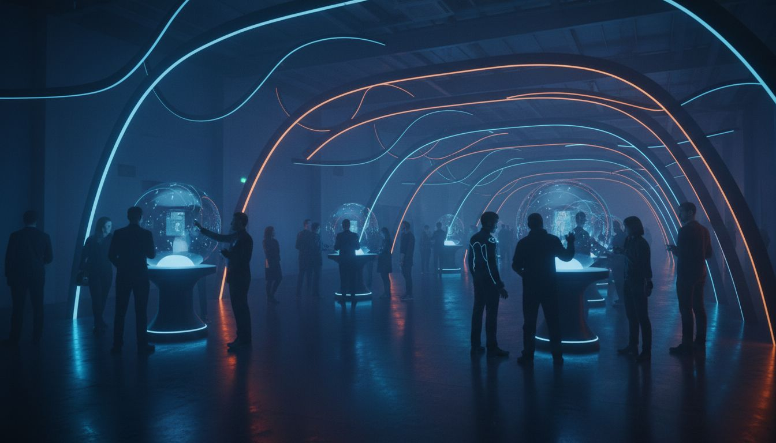
STAGE DESIGN & IMMERSIVE ZONES
Production Specifications
MAIN STAGE
LIGHTING
PRODUCT REVEAL
DEMO ZONES
BROADCAST
80-ft multi-panel LED wall
with AR integration
Full theatrical rig — movers,
neon strip practicals, IMAG
Custom trap-door reveal platforms
with sync'd lighting moments
Individually designed immersive
product experience environments
Multi-camera live production for
global [Prospect_Company_U] livestream

Slide 7
INVESTMENT & SCOPE
Budget Overview
SCOPE ITEM
INVESTMENT RANGE
Full Event Production (Stage, AV, Lighting, Scenic, Show Calling)
$200,000 – $240,000
Product Demo Zone Build & Interactives (3 rooms)
$75,000 – $95,000
Creative Direction & Content Production
$45,000
Event Management & Staffing
$40,000
Livestream Production & Broadcast
$35,000
Optional: After Dark Brand Activation Build
+ $50,000
TOTAL ESTIMATED INVESTMENT (excl. Optional)
$395,000 – $415,000
* All figures are estimates. Final investment based on confirmed scope, venue, and production specifications.

Slide 8
CALL TO ACTION
Ready to Own
the Launch Moment?
The [Prospect_Company_U] tells the story. [Provider_Company_G]® makes it live.
Together: the most talked-about tech event of 2027.
[Prospect_Company_U] Step: Production Strategy Session — Let's Scope THE [Prospect_Company_U] [Prospect_Company_U]
launches@[Provider_Company_G].com | [Lead_Phone_A] | [Provider_Company_G].com
[Provider_Company_G]®
Experiential by Design | New York City

