Slide 1
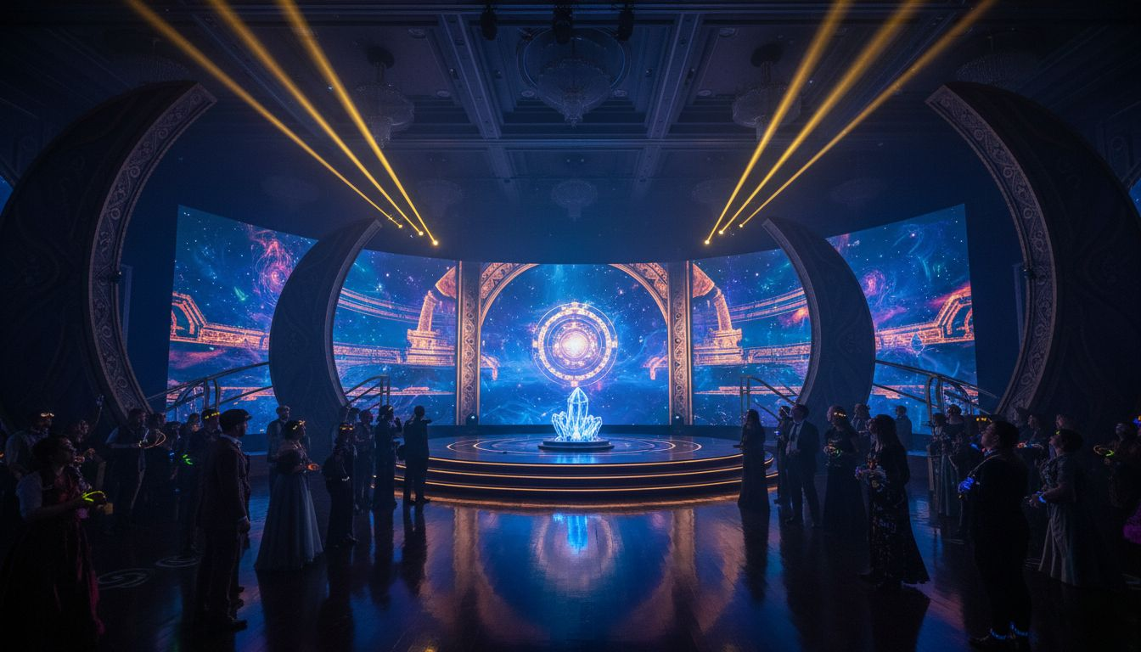
BRAND ACTIVATION PROPOSAL | [Prospect_Company_T] [Prospect_Company_T] CONFERENCE
[Prospect_Company_T]
[Prospect_Company_T] 2027
A [Prospect_Company_T] Annual Conference Experience — Produced by [Provider_Company_G]®
Marriott Marquis Times Square | New York City
Proposed: April 2027
[Provider_Company_G]® | Experiential by Design

Slide 2
What If [Prospect_Company_T] Felt Like
the Experiences You Create?
◆ [Prospect_Company_T] members design wonder for millions of guests every year
◆ [Provider_Company_G]® proposes: make [Prospect_Company_T] the most immersive professional conference in the world
◆ A fully produced, story-driven event environment — from arrival to close
◆ Purpose: [Prospect_Company_T] the people who [Prospect_Company_T] the world

Slide 3
THE PARTNERSHIP CASE
Why [Provider_Company_G]® × [Prospect_Company_T]
SHARED LANGUAGE
PRODUCTION PEDIGREE
[Provider_Company_G]® speaks themed entertainment — from
stage design to world-building
Fortune 500 launches, global summits,
immersive brand environments
END-TO-END OWNERSHIP
COMMUNITY FIT
Creative direction, scenic design, AV,
show calling, event management
Shared commitment to wonder, craft,
and authentic human connection

Slide 4
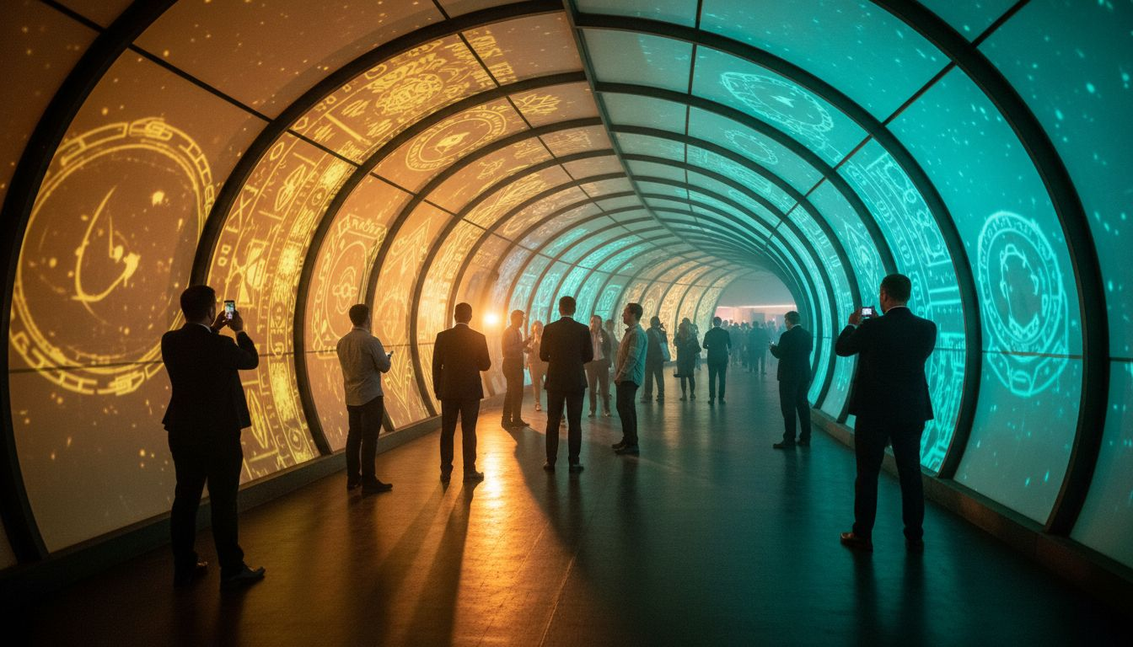
CONCEPT OVERVIEW
[Prospect_Company_T] [Prospect_Company_T]
The [Prospect_Company_T] Experience
"The Story We Build Together"
THEME
"The Story We Build Together"
A journey through themed entertainment's future
ARRIVAL
Immersive 80-ft entry corridor transforming
into a themed narrative environment
MAIN STAGE
Cinematic scenic design, theatrical
lighting, and show-called program direction
BREAKOUT ZONES
Individually themed sponsor
experience hubs with brand environments
THEA AWARDS GALA
Full theatrical production for the
annual Thea Awards celebration

Slide 5
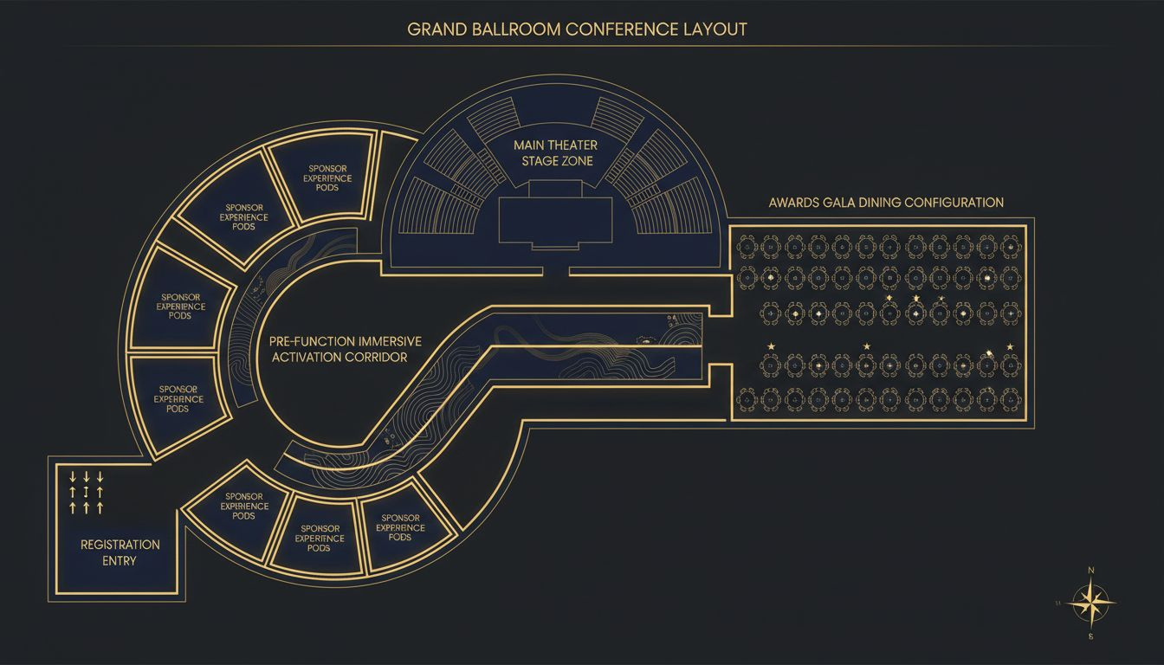
VENUE & SPACE PLANNING
Marriott Marquis Times Square, NYC
MAIN STAGE
Broadway Ballroom — 500-person theater
with full scenic rigging access
ENTRY ACTIVATION
80-ft immersive projection-mapped
narrative arrival corridor
SPONSOR HUBS
8 individually themed activation zones
in the pre-function area
AWARDS GALA
Marquis Ballroom — elegant dinner
for the Thea Awards celebration
FLOOR PLAN NOTE
Conceptual layout;
venue floor plan TBD post-engagement

Slide 6
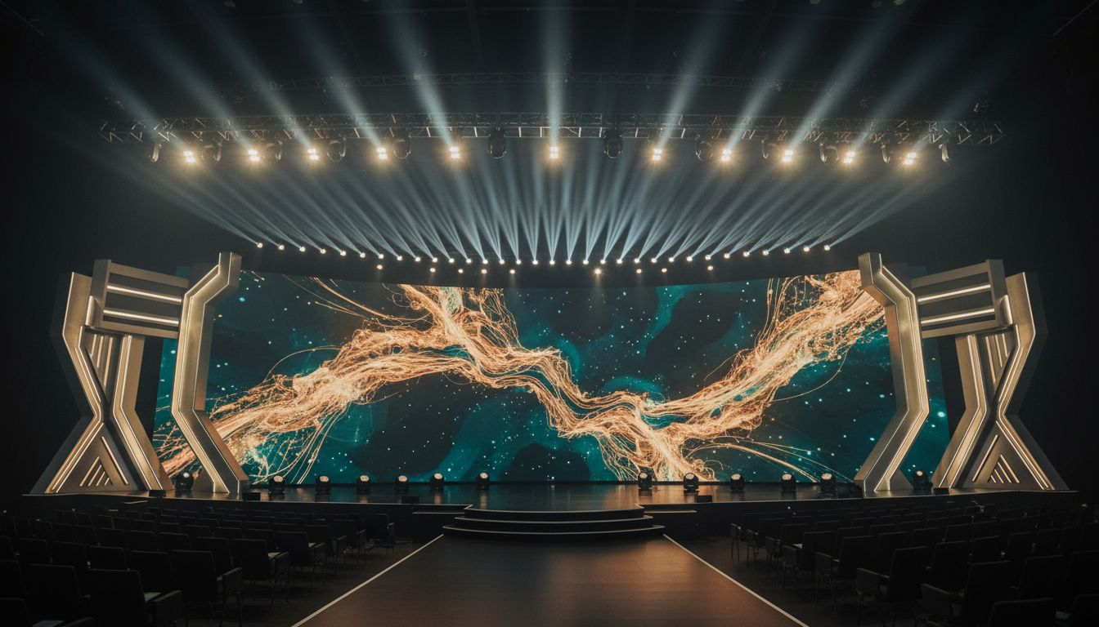
STAGE DESIGN & SCENIC CONCEPTS
Production Specifications
MAIN STAGE
LIGHTING
AUDIO
SHOW CALLING
BROADCAST
60-ft curved LED wall with live
content direction
Full theatrical rig — moving heads,
haze, and spot systems
L'Acoustics concert-grade line array;
in-ear monitors for speakers
Dedicated [Provider_Company_G]® show caller
and technical director on site
Multi-camera hybrid livestream
for global [Prospect_Company_T] audience

Slide 7
INVESTMENT & PRODUCTION SCOPE
Budget Overview
SCOPE ITEM
INVESTMENT RANGE
Full Conference Production (Scenic, AV, Lighting, Show Calling)
$180,000 – $220,000
Immersive Entry Activation Build & Installation
$45,000 – $65,000
Creative Direction & Art Direction
$40,000
Event Management & On-Site Staffing
$35,000
Awards Gala Full Production
$55,000 – $70,000
Optional: Post-Event Content Capture & Highlight Reel
+ $22,000
TOTAL ESTIMATED INVESTMENT (excl. Optional items)
$300,000 – $355,000
* All figures are estimates. Final investment based on confirmed scope, attendee count, and venue specifics.

Slide 8
CLOSING
Let's Make [Prospect_Company_T]
Unforgettable
[Provider_Company_G]® is ready to bring [Prospect_Company_T]'s own values —
wonder, craft, community — to life on stage.
Next Step: 30-Minute Production Discovery Call with our Creative [Prospect_Company_T]m
hello@[Provider_Company_G].com | [Lead_Phone_A] | [Provider_Company_G].com
[Provider_Company_G]®
Experiential by Design | New York City

