Slide 1
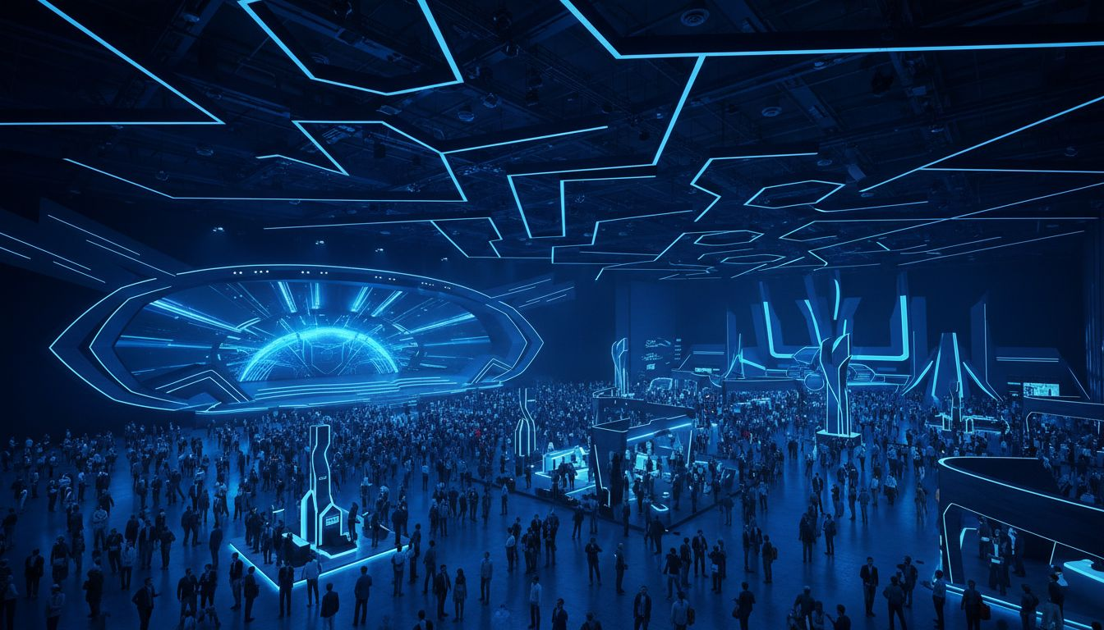
[Provider_Company_F] × [Prospect_Company_R]
A Production Proposal — 10th Anniversary Edition
Executive Conference & Showcase · Paris Expo Porte de Versailles · June 2026
[Provider_Company_F]

Slide 2
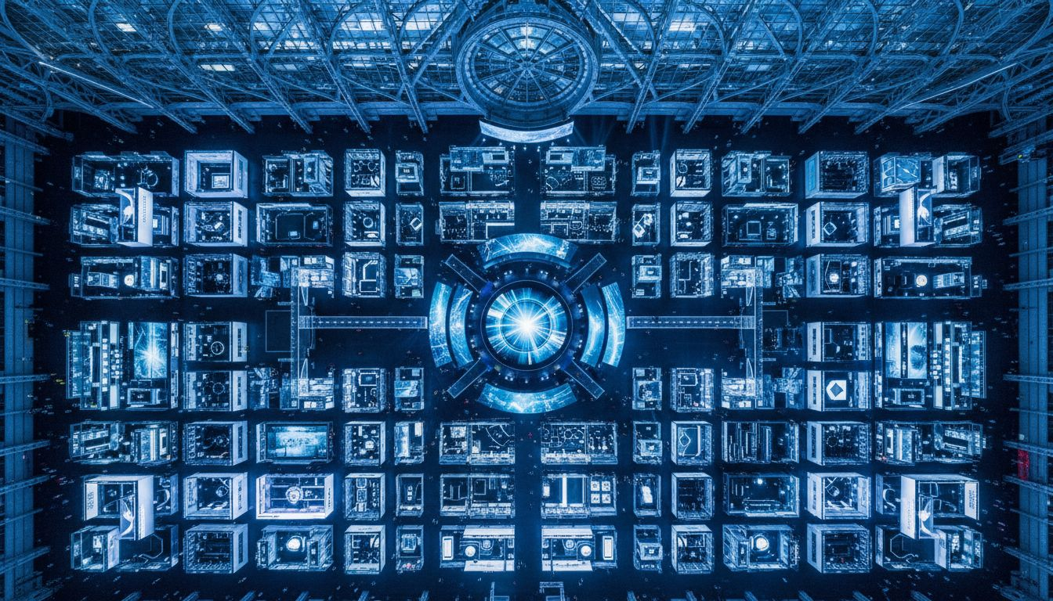
THE STAGE
[Prospect_Company_R] —
[Prospect_Company_A]
180,000+ attendees from 171 countries
14,000+ startups · 4,000 investors
2026: 10th anniversary — Hall 7, Porte de Versailles
30% expanded footprint · 20,000 m² new exhibition space
[Provider_Company_F] brings premium scenography to Europe's most ambitious stage.
[Provider_Company_F]

Slide 3
CONCEPTS FOR 2026
Three Proposals for [Prospect_Company_R] 10th Anniversary
A
B
C
[Prospect_Company_R] ORIGINES
LE PAVILLON CONNECT
SIGNAL ★
10th Anniversary Keynote Stage
Sponsor Brand Universes
The Immersive [Prospect_Company_R] Showcase
Custom keynote architecture celebrating a decade of European [Prospect_Company_R] leadership. Modular LED backdrop towers, curved scenic proscenium, projection-mapped milestone timeline. The stage as symbol.
A curated sponsor pavilion design system — premium modular environments with individual branded immersive zones, scenic gateways, demo stages, and networking lounges. Built by [Provider_Company_F].
A signature experiential zone within Hall 7 — a 2,000 m² cinematic walk-through where breakthrough [Prospect_Company_R]nologies come alive as spatial installations. RECOMMENDED CONCEPT.
[Provider_Company_F]

Slide 4
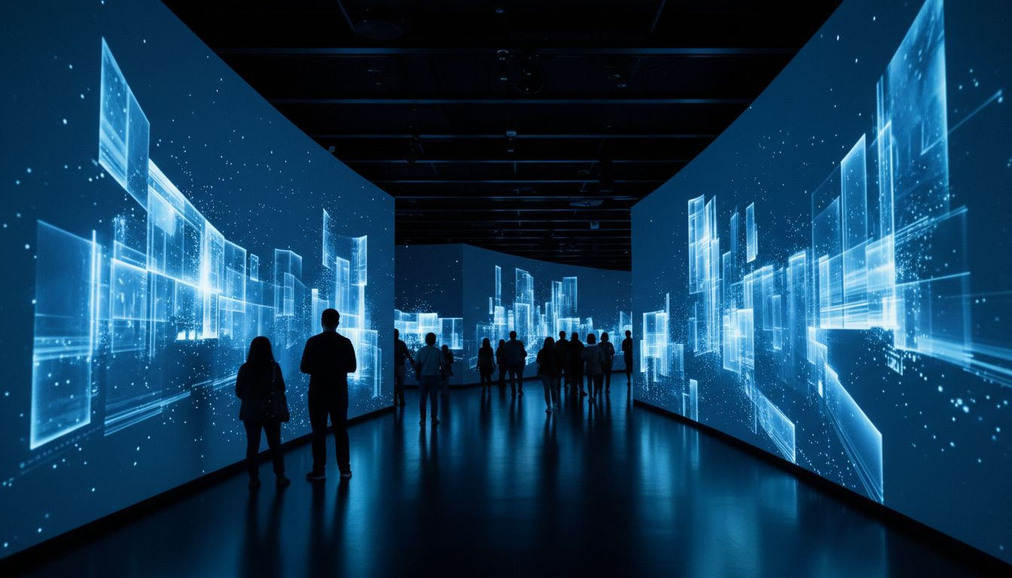
RECOMMENDED CONCEPT
SIGNAL
The Immersive [Prospect_Company_R] Showcase
A signature experiential zone — spatial storytelling at scale
2,000 m² walk-through environment within Hall 7, Paris Expo
Lighting choreography · projection mapping · scenographic narrative
Breakthrough [Prospect_Company_R]nologies come alive as immersive installations
[Provider_Company_F]

Slide 5
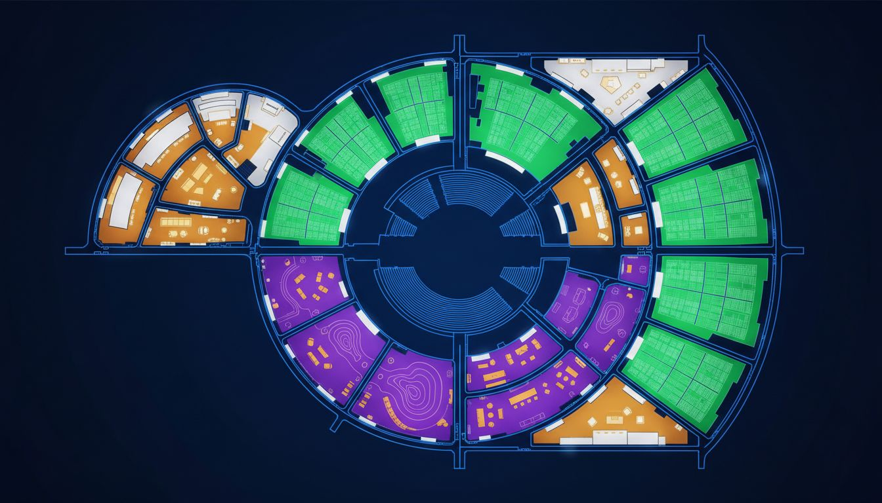
VENUE & SPATIAL STRATEGY
Hall 7
Paris Expo Porte de Versailles
Three floors · 20,000+ m² expanded exhibition footprint
Keynote stage (east) · Pavilions (north/south wings)
SIGNAL zone — Level 2 mezzanine, 2,000 m²
Entry sequence · Welcome zone · VIP terrace
Full load-in access · Production facilities on-site
[Provider_Company_F] manages full scenographic planning,
load-in schedule, and production build.
[Provider_Company_F]
Conceptual layout — venue floor plan not available

Slide 6
OUR CAPABILITIES
What [Provider_Company_F] Delivers
END-TO-END PRODUCTION
KEYNOTE STAGE ARCHITECTURE
From concept to installation to strike — [Provider_Company_F] owns the full production workflow.
Custom stage builds, LED environments, modular scenic systems, and reveal moments for main stages.
SPONSOR PAVILION BUILDS
SCENOGRAPHY & LIGHTING DESIGN
Premium exhibition environments — individual branded zones, scenic gateways, and demonstration stages.
Spatial storytelling through lighting choreography, projection mapping, and environmental design.
[Provider_Company_F] — Paris & Lyon · [Provider_Company_F].fr · contact@[Provider_Company_F].fr
[Provider_Company_F]

Slide 7
SCOPE & INVESTMENT
Production Scope Overview
SCOPE ITEM
DESCRIPTION
INVESTMENT
SIGNAL Zone
Full scenography, scenic build & [Prospect_Company_R]nical production, 2,000 m²
On request
Keynote Stage
Architecture, LED environment, speaker reveal moments
On request
Sponsor Pavilion System
Modular premium builds per pavilion unit
Per unit
Project Management
Creative direction, site visits, production coordination
Included
Sustai[Prospect_Company_A]ility Plan
Eco-responsible materials, reusable scenic elements
Included
All pricing subject to final scope confirmation and site assessment.
[Provider_Company_F]

Slide 8
LET'S BUILD THIS TOGETHER
Next Step
Invite [Provider_Company_F] for a 45-minute creative presentation.
We arrive with sketches, spatial concepts, and production references — ready to build.
[Provider_Company_F] — Agence Créative + Studio
Paris · Lyon
contact@[Provider_Company_F].fr
[Lead_Phone_A]
[Provider_Company_F].fr
[Provider_Company_F]

