Slide 1
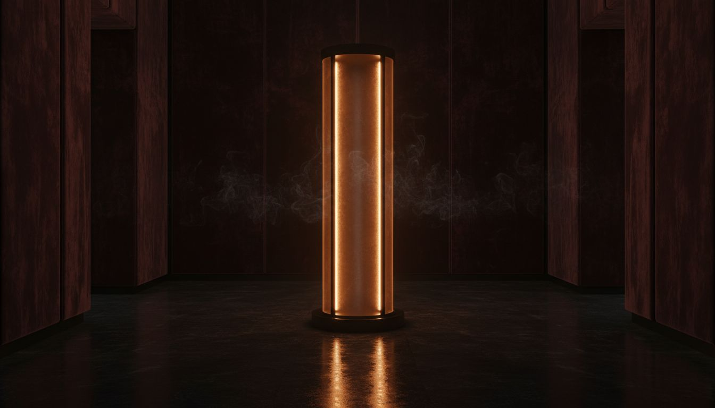
[Provider_Company_F] × FRÉDÉRIC [Prospect_Company_Q]
A Brand Activation Proposal — Paris, Autumn 2026
Brand Activation · Paris, Ile-de-France
[Provider_Company_F]

Slide 2
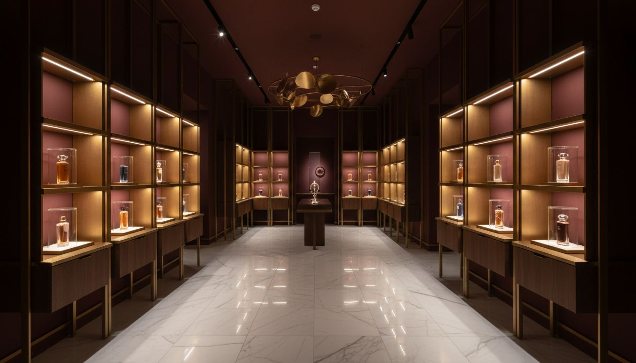
THE HOUSE
Frédéric [Prospect_Company_Q] —
L'Avant-Garde du Parfum
Founded 2000 — perfumers given total creative freedom
Architecture as experience: boutiques by celebrated architects
Signature smelling columns, refrigerated perfume cabinets
Portrait of a Lady · Carnal Flower · Musc Ravageur
Owned by The Estée Lauder Companies since 2015
[Provider_Company_F] translates this philosophy into extraordinary live experiences.
[Provider_Company_F]

Slide 3
ACTIVATION CONCEPTS
Three Activation Concepts
A
B
C
L'ATELIER DE MÉMOIRE ★
PORTRAIT VIVANT
LA COLONNE
Immersive Scent Journey — Recommended
Boutique Launch Celebration
Ephemeral Installation & Press Event
Five bespoke rooms, each built around an iconic fragrance. Light, sound, material, and scent combined as spatial memory. Guests move at their own pace, guided by the perfumers' narratives.
An intimate VIP evening transforming the boutique into a curated experience space — custom lighting, scent diffusion architecture, live music commission, and personal discovery moments.
A temporary immersive installation at a prestigious Paris cultural venue — black-walled gallery with illuminated alcoves, each fragrance presented with material-forward sensory décor.
[Provider_Company_F]

Slide 4
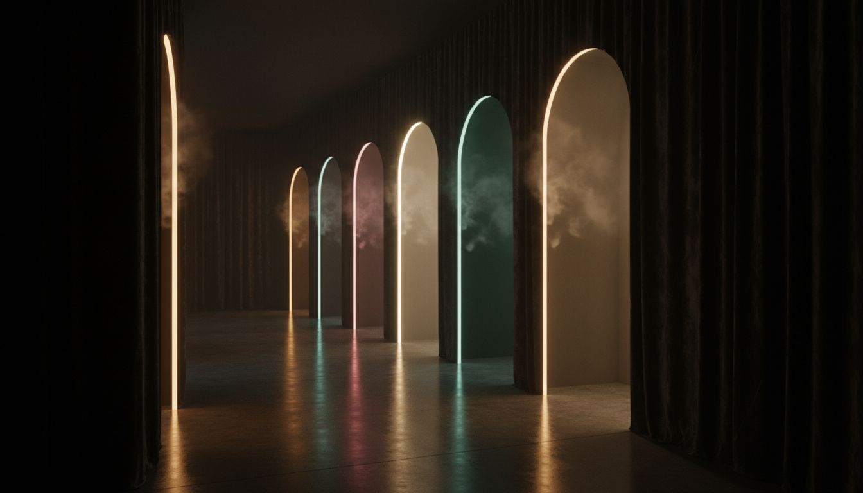
RECOMMENDED CONCEPT
L'ATELIER DE MÉMOIRE
The Immersive Scent Journey — Paris, Autumn 2026
Five bespoke rooms — each built around one iconic fragrance
Light · sound · material · scent — combined into spatial memory
Guests move at their own pace, guided by the perfumers' own stories
An experience as singular and uncompromising as the fragrances themselves
[Provider_Company_F]

Slide 5
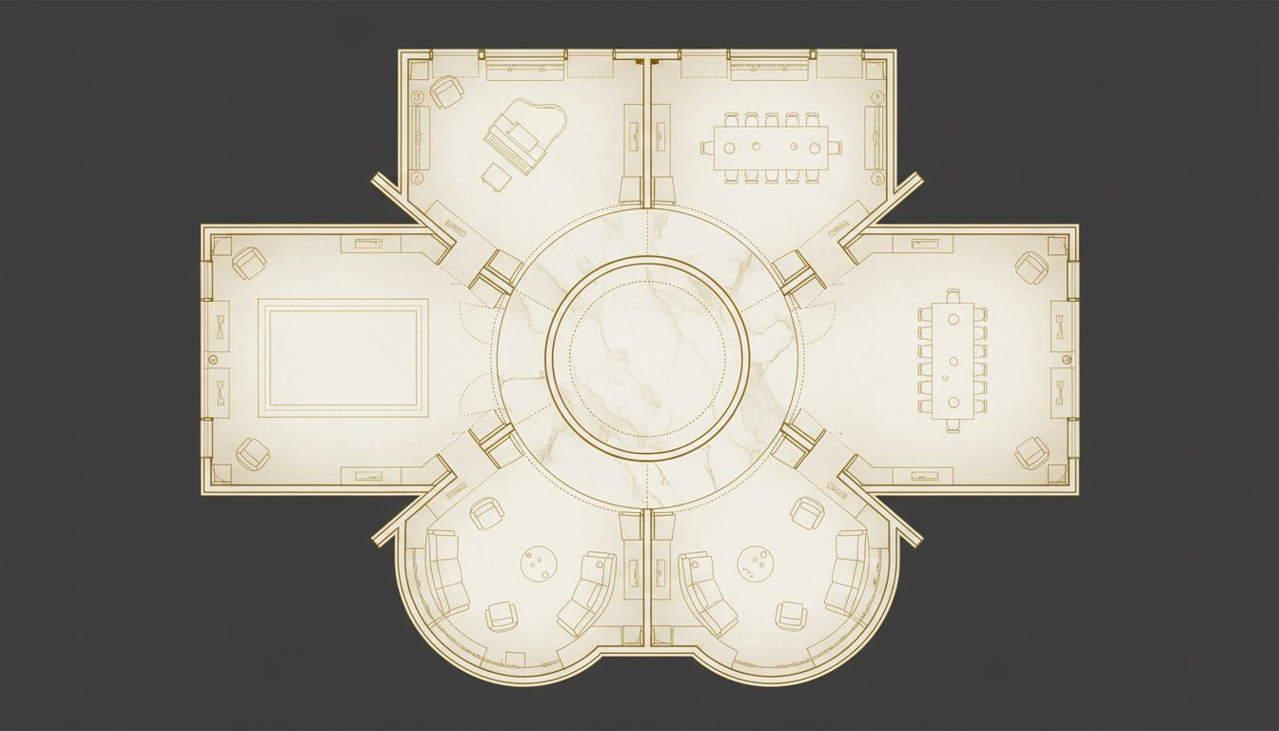
VENUE & SPATIAL DESIGN
Hôtel Particulier
Paris, 6e or 16e
Private Parisian mansion or prestigious cultural institution
Five fragrance rooms across the main floor
Entry atrium · Fragrance journey · Close cocktail salon
Capacity: 80–150 guests per session · Invitation-only
[Provider_Company_F] manages spatial design, build, and technical production
Venue scouting and creative consultation
included in [Provider_Company_F]'s full service.
[Provider_Company_F]
Conceptual layout — venue selection pending brief

Slide 6
OUR CAPABILITIES
What [Provider_Company_F] Delivers
IMMERSIVE SPATIAL DESIGN
LIGHTING & ATMOSPHERIC DIRECTION
Five bespoke environments — designed to specification, built to [Provider_Company_A], each one a world.
Intimate architectural lighting that creates mood, temperature, and sensory depth in each room.
SOUND & SCENT INTEGRATION
END-TO-END PRODUCTION
Working directly with your perfumers — spatial sound environments and scent diffusion architecture.
Concept through installation through strike — creative direction, project management, and craft.
[Provider_Company_F] — Paris & Lyon · [Provider_Company_F].fr · contact@[Provider_Company_F].fr
[Provider_Company_F]

Slide 7
SCOPE & INVESTMENT
Activation Scope Overview
SCOPE ITEM
DESCRIPTION
INVESTMENT
Five Fragrance Rooms
Full scenic design & build — each room a distinct sensory world
On request
Lighting & Sound
Architectural lighting installation + spatial sound environments
On request
Scent Integration
Coordination with your perfumers — diffusion architecture
Collaborative
Creative Direction
Spatial design, site visits, concept alignment with the house
Included
Venue Scouting
[Provider_Company_F] advises on Parisian venue options aligned with brand
Included
All investment figures subject to final scope confirmation and venue selection.
[Provider_Company_F]

Slide 8
UNE INVITATION À CRÉER ENSEMBLE
We Build Experiences
That Honour What Cannot
Be Expressed in Words
Invite [Provider_Company_F] for a private presentation of the activation concept.
We bring spatial references, lighting sketches, and a vision.
[Provider_Company_F] — Agence Créative + Studio
Paris · Lyon
contact@[Provider_Company_F].fr
[Lead_Phone_A] · [Provider_Company_F].fr
[Provider_Company_F]

