Slide 1
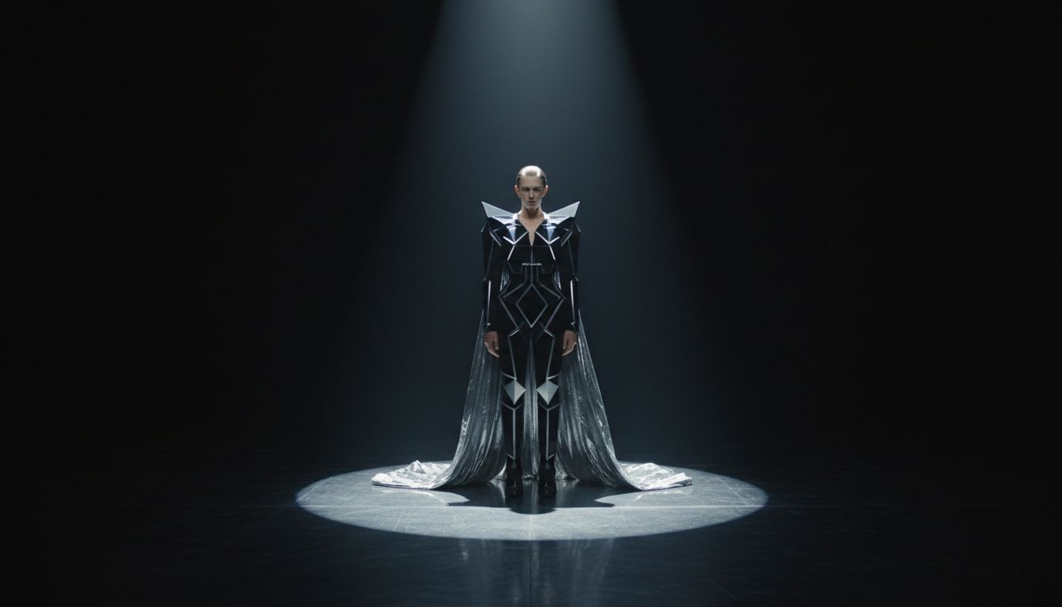
[Provider_Company_F] × [Prospect_Company_P]
A Corporate Launch Production Proposal — Paris, 2026
Corporate Launch · Paris, Ile-de-France
[Provider_Company_F]

Slide 2
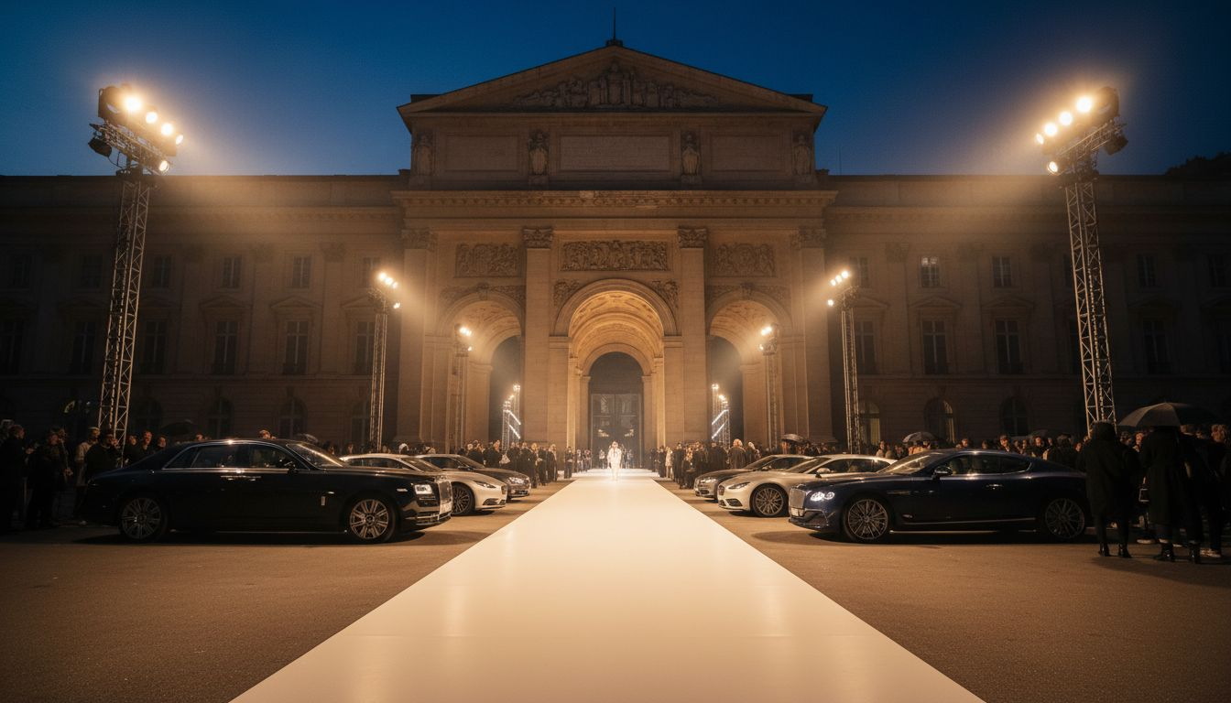
THE BRAND
[Prospect_Company_P] — Fashion as Cultural Event
Paris contemporary luxury — collections staged as spectacles
Disneyland runway · spray-on dress · LAN party at Adidas Arena
Each season, a moment that rewrites the show
Designers Sébastien Meyer & Arnaud Vaillant, Paris
[Provider_Company_F]: the production partner that builds the extraordinary.
[Provider_Company_F]

Slide 3
LAUNCH CONCEPTS
Three Concepts for Your Next Launch
A
B
C
MATIÈRE NOIRE
SIGNAL BLANC
CODE OUVERT ★
Midnight Press Preview
Showroom & Buyers Launch
Live Launch Spectacle — Recommended
Intimate press preview in a decommissioned Parisian industrial space. Black-walled gallery environment, surgical lighting, individual silhouette reveals. Guests move through the collection as an art experience.
Two-day immersive showroom in a curated Marais or Saint-Germain ephemeral space. Custom-designed environment with a discovery corridor, personalized appointments, and material-forward décor.
A site-specific Paris launch event — Palais Royal or Po[Prospect_Company_A]dou forecourt — with edited runway, live performance commission, and press cocktail. [Provider_Company_F] delivers full set design, lighting, and production.
[Provider_Company_F]

Slide 4
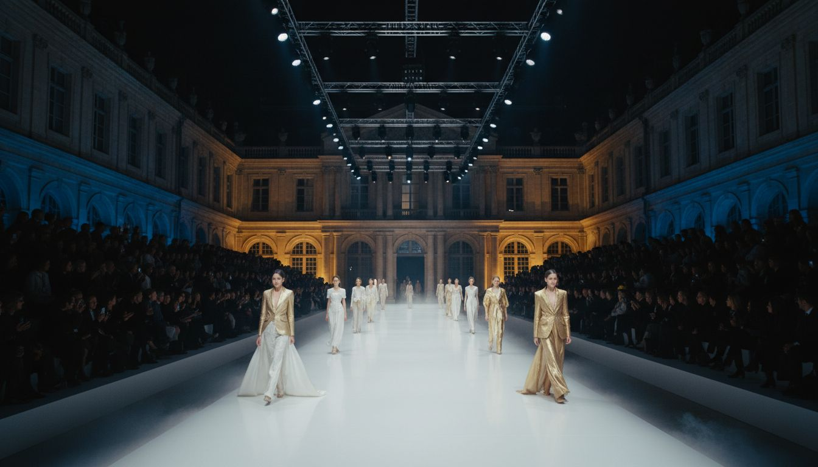
RECOMMENDED CONCEPT
CODE OUVERT
Live Launch Spectacle — Paris, 2026
A single evening that becomes the cultural moment of the season
Site-specific Paris venue — Palais Royal or Po[Prospect_Company_A]dou Forecourt
Full set design · lighting architecture · sound design · décor by [Provider_Company_F]
300–500 guests arrive to a world built entirely around the collection
[Provider_Company_F]

Slide 5
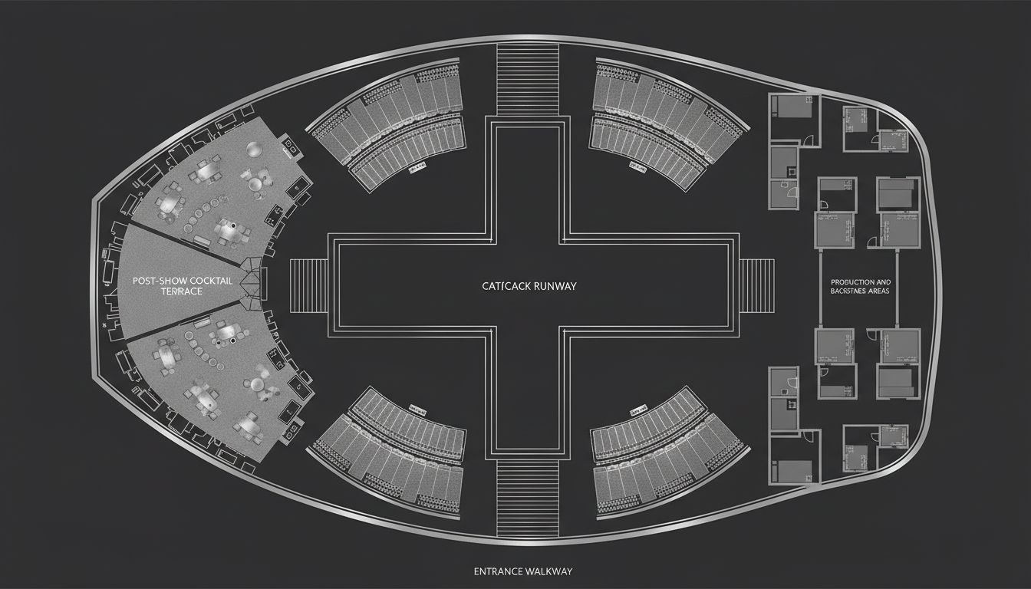
VENUE & STAGING
Palais Royal Gardens or Po[Prospect_Company_A]dou Forecourt
Site-specific outdoor or cultural venue · Paris 1er or 4e
Entry sequence → Pre-show cocktail → Runway moment → Close
Capacity: 300–500 press and VIP guests
Full production access · Load-in day prior
[Provider_Company_F] manages venue liaison, technical plot, and build
[Provider_Company_F] advises on final venue selection aligned with your creative vision.
[Provider_Company_F]
Conceptual layout — venue TBD pending final selection

Slide 6
OUR CAPABILITIES
What [Provider_Company_F] Delivers
SET DESIGN & SCENOGRAPHY
LIGHTING DIRECTION
Full scenic design and construction — concept sketches through final installation, every detail resolved.
Theatrical, editorial lighting rigs that create mood, define space, and deliver cinematic press imagery.
STAGE MANAGEMENT & LOGISTICS
CREATIVE DIRECTION ALIGNMENT
Show calling, rehearsal schedule, venue technical coordination, and full event-day management.
[Provider_Company_F]'s creative team works directly with your house to ensure every element is brand-true.
[Provider_Company_F] — Paris & Lyon · [Provider_Company_F].fr · contact@[Provider_Company_F].fr
[Provider_Company_F]

Slide 7
SCOPE & INVESTMENT
Production Scope Overview
SCOPE ITEM
DESCRIPTION
INVESTMENT
Set Design & Build
Full scenic construction — runway, staging, décor environments
On request
Lighting & Sound
Complete theatrical rig design and installation
On request
Creative Direction
Site visits, creative alignment, production briefing
Included
Stage & Event Management
Show calling, run of show, venue coordination
Included
Sustai[Prospect_Company_A]ility
Reusable scenic elements, responsible sourcing
Included
All pricing subject to final scope and venue confirmation.
[Provider_Company_F]

Slide 8
NEXT CHAPTER
Let's Create Something Unforgettable
[Provider_Company_F] brings creative ideas, production references, and a dedicated team to the first meeting. Schedule a 30-minute creative session — we're ready to build.
[Provider_Company_F] — Agence Créative + Studio
Paris · Lyon
contact@[Provider_Company_F].fr
[Lead_Phone_A] · [Provider_Company_F].fr
[Provider_Company_F]

