Slide 1
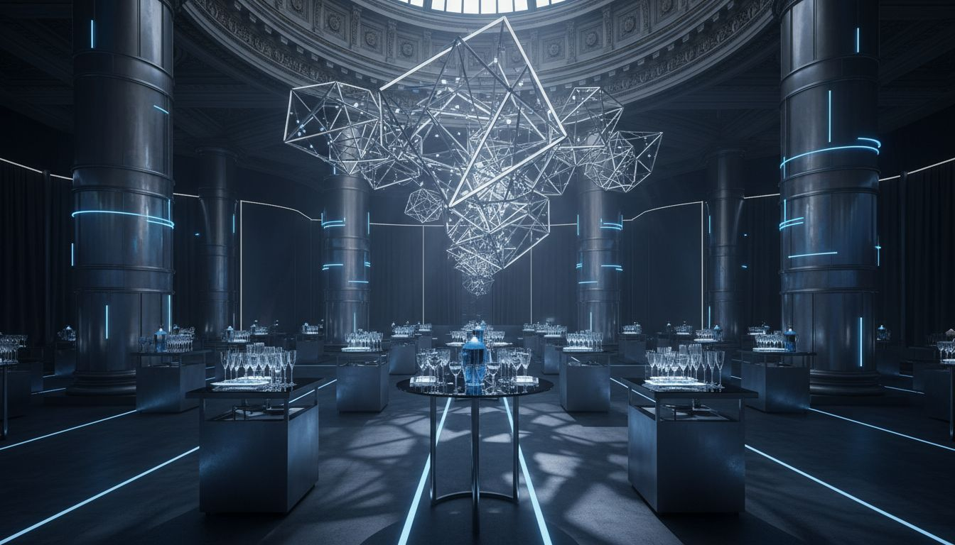
EVENT'IF × [Prospect_Company_O] 2026
The Production Partner
For [Prospect_Company_A]
Exclusive Moments.
VIP Soirée & Brand [Prospect_Company_O] Production
La S[Prospect_Company_A]ritaine, Paris 1er · June 2026
PARTNERSHIP PROPOSAL — CONFIDENTIAL

Slide 2

01 / THE OPPORTUNITY
BEYOND THE
CONFERENCE
FLOOR
180,000+ attendees at [Prospect_Company_O] 2025
The real deals happen after hours.
VIP dinners, [Prospect_Company_O]s, private lounges —
these are [Prospect_Company_O]'s most valuable moments.
EVENT'IF creates those moments with
[Provider_Company_A], creativity, and operational depth.
EVENT'IF — Founded 2009 | Paris & France | 130+ Events / Year

Slide 3
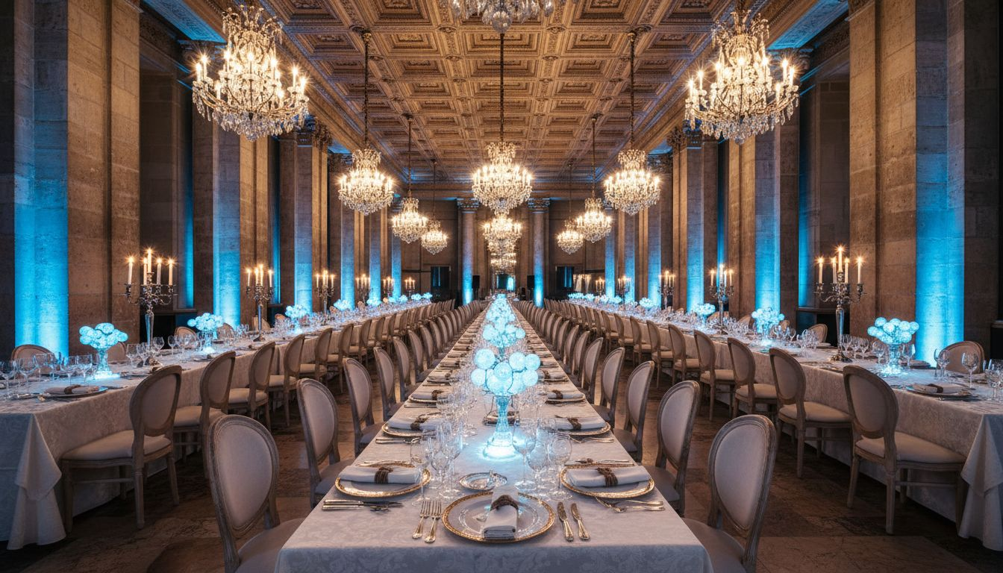
02 / FLAGSHIP SOIRÉE CONCEPT
SPARK PARIS
250-guest exclusive VIP soirée — June 18, 2026 · La S[Prospect_Company_A]ritaine
19:00
20:00
22:00
23:30
ARRIVAL
GALA DINNER
LIVE EXPERIENCE
CLOSE
Champagne reception &
live tech installations
Curated dining with
brand [Prospect_Company_O] stations
DJ set & branded photo
moments — shareable & iconic
Goodie distribution &
personalized guest farewell
EVENT'IF — Concept, Production & On-site Execution | Paris

Slide 4
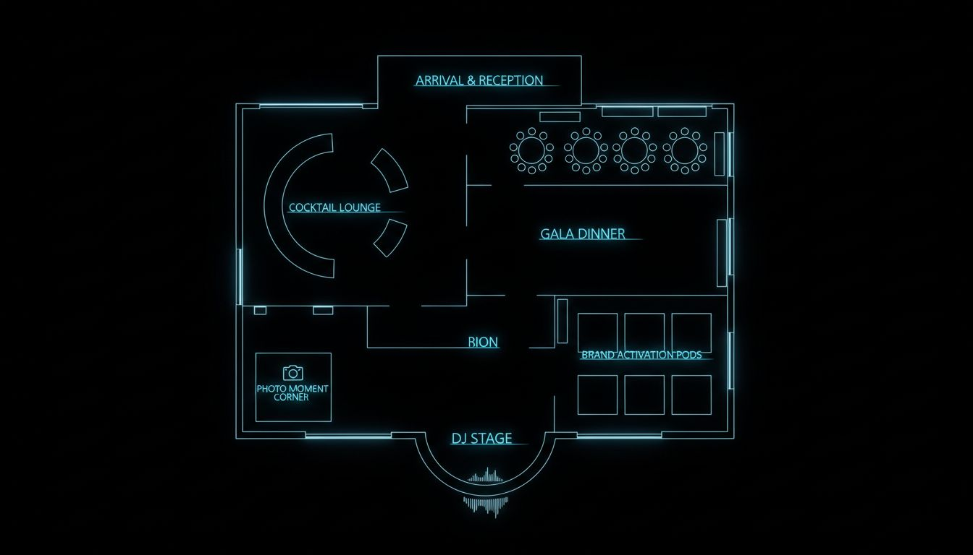
03 / VENUE
LA
S[Prospect_Company_A]RITAINE
Salon Rivoli
2 Rue de la Monnaie, Paris 1er
Steps from Pont-Neuf & the Seine
Up to 350 guests cocktail format
200 for seated gala dinner
Art Deco architecture, luxury renovation
Full exclusive privatization available
Conceptual layout — venue floor plan reference

Slide 5
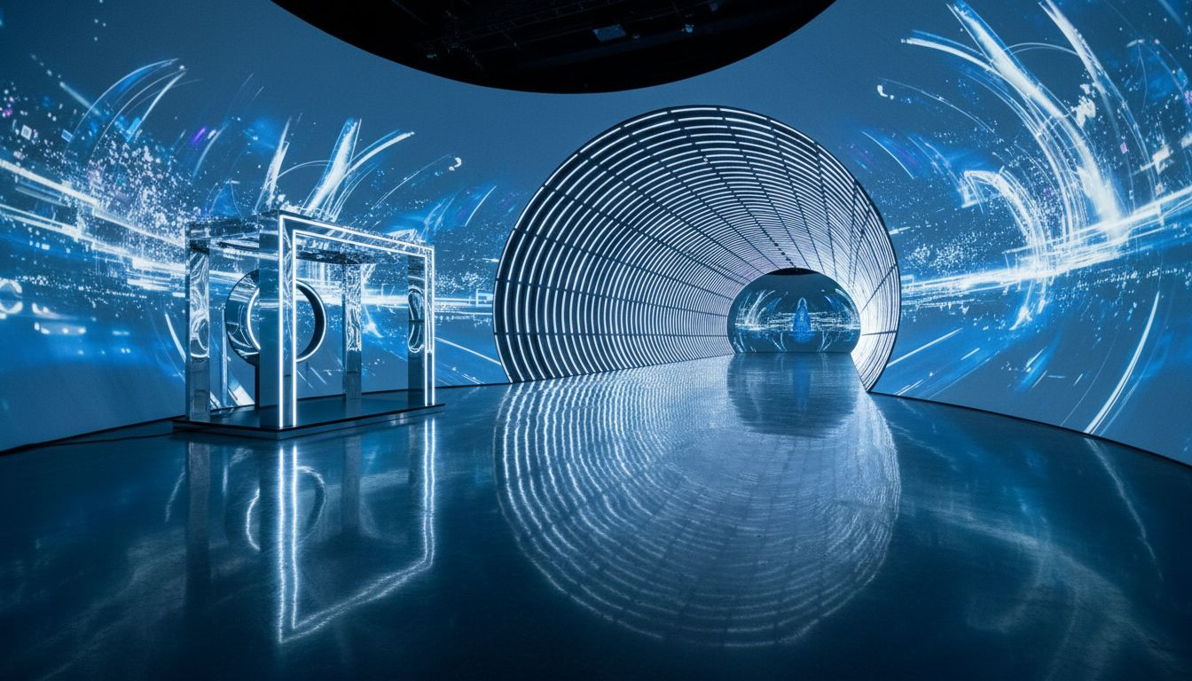
04 / BRAND [Prospect_Company_O]
[Prospect_Company_O]
STATIONS
◈ AI Portrait Booth
Interactive AI-powered photo experience, branded output
◈ Holographic Product Reveal
Floating 3D brand reveal for partner launches
◈ Immersive LED Tunnel
Walk-through light installation with brand messaging
◈ Partner Showcase Pod
Premium branded display with demo capability
All [Prospect_Company_O]s designed, produced & operated by EVENT'IF — turnkey, branded, photographable.

Slide 6
05 / PARTNERSHIP SCOPE & INVESTMENT
SCOPE &
INVESTMENT
PROGRAM
SCOPE
INVESTMENT
VIP Soirée — Spark Paris
250 guests, full evening production
From €85,000
Brand [Prospect_Company_O] Station
Turnkey per-station design & operation
From €12,000 / station
Full [Prospect_Company_O] 2026 VIP Program
Multi-evening + satellite [Prospect_Company_O]s
Custom brief
EVENT'IF production scope
Concept, venue, AV, catering, crew
Included
Post-event media & reporting
Photo, video wrap, debrief report
From €4,500
All pricing excludes VAT. Final scope confirmed after [Prospect_Company_O] 2026 brief.

Slide 7
06 / NEXT STEPS
LET'S MAKE
[Prospect_Company_O] 2026
UNFORGETTABLE.
EVENT'IF — Paris, since [Lead_Phone_A]+ events per year.
contact@[Provider_Company_E].fr | +33 1 XX XX XX XX
Request a [Prospect_Company_O] 2026 partnership brief today.

