Slide 1
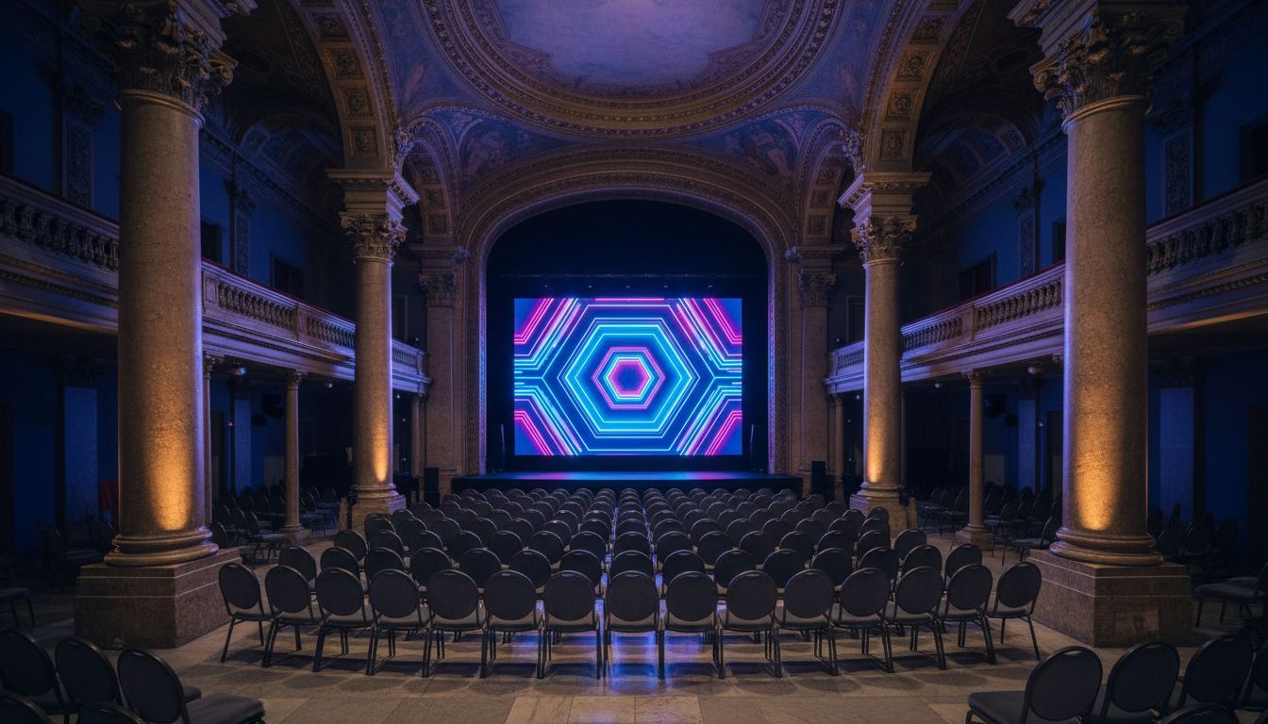
EVENT'IF × [Prospect_Company_N] EVENTS
Executive [Prospect_Company_N] Production Partnership
Palais Brongniart, Paris 2e
Proposed: Autumn 2026
STRICTLY CONFIDENTIAL — PARTNERSHIP PROPOSAL

Slide 2
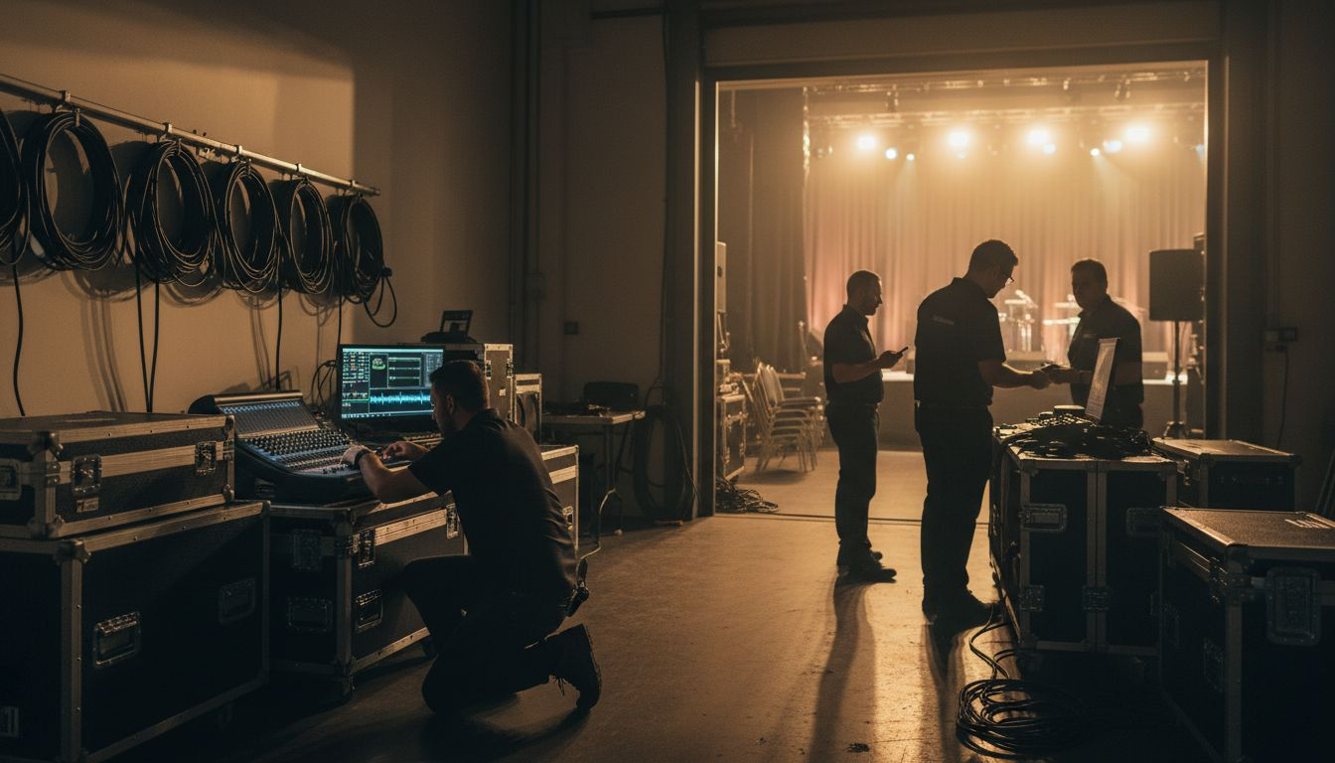
01 / THE OPPORTUNITY
WHY THIS
PARTNERSHIP
› [Prospect_Company_N] Events leads. EVENT'IF delivers.
› When client demand peaks, complexity grows, or specialty
expertise is needed — EVENT'IF steps in seamlessly.
› 130+ turnkey events per year in Paris & Île-de-France.
› White-label execution: your client never sees the seams.
EVENT'IF — Founded 2009 | 130+ Events / Year | Paris

Slide 3
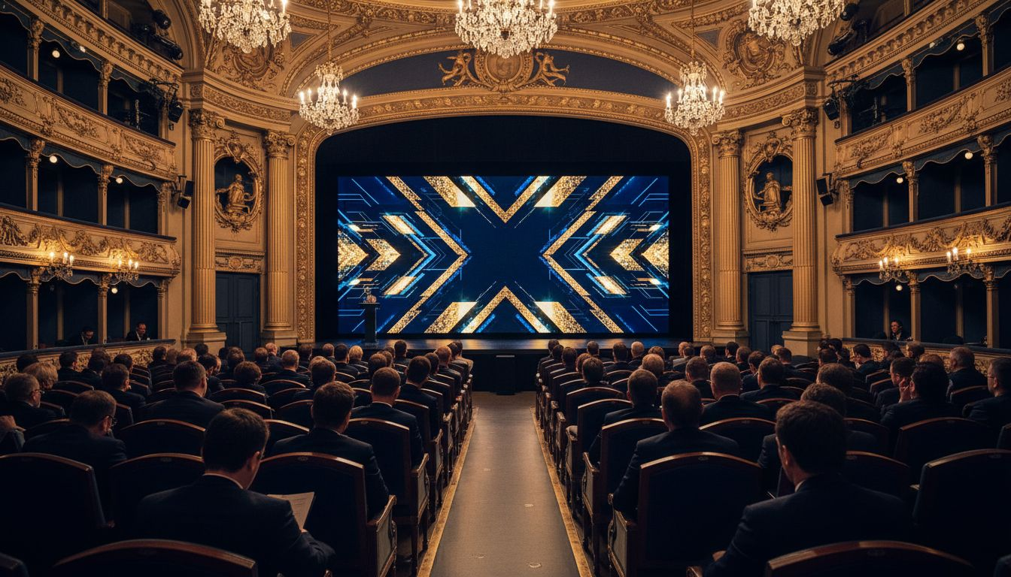
02 / EVENT CONCEPT
THE EXECUTIVE SUMMIT
A two-day immersive corporate [Prospect_Company_N] program
DAY 1 — MORNING
DAY 1 — AFTERNOON
DAY 1 — EVENING
DAY 2
Plenary keynotes on premium stage
with live AV & interpretation
Curated breakout workshops
in adjacent salon spaces
Private gala dinner for
150 senior executives
Strategic working sessions
& partner meetings
EVENT'IF — Paris | Concept & Full Production

Slide 4
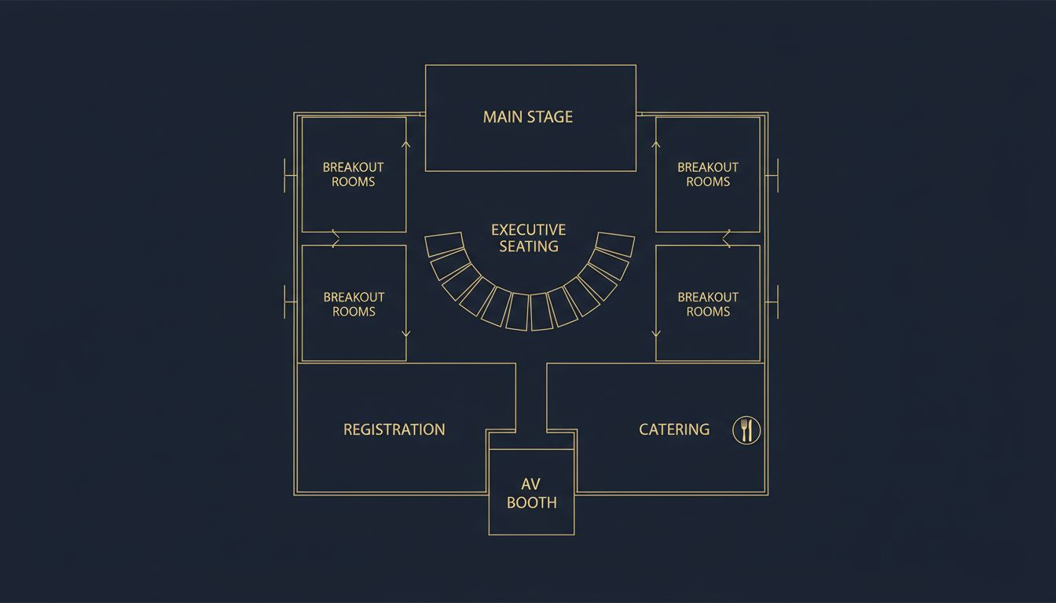
03 / VENUE
PALAIS
BRONGNIART
Place de la Bourse, Paris 2e
Up to 1,200 guests (plenary hall)
400 guests in main salon format
Grand neoclassical architecture
Full technical package: rigging,
power, AV infrastructure
Conceptual layout — venue floor plan reference

Slide 5

04 / WHAT EVENT'IF DELIVERS
END-TO-END
PRODUCTION LAYERS
✦
Concept & Creative Direction
Event vision, narrative, and design brief
✦
Stage Design & AV Production
Full AV, LED walls, sound, lighting design
✦
Catering & Hospitality
Venue catering coordination & F&B management
✦
On-site Logistics & Staffing
Full crew, registration, guest management
✦
Post-event Reporting
Debrief, sustai[Prospect_Company_A]ility audit, ROI metrics
EVENT'IF — Full Turnkey Production | Paris & Île-de-France | Since 2009

Slide 6
05 / PARTNERSHIP SCOPE & INVESTMENT
SCOPE & INVESTMENT
SERVICE
SCOPE
INVESTMENT
White-label day rate
Project director, full-time on mandate
From €2,500 / day
Executive [Prospect_Company_N] — Full Turnkey
2-day program, 200–400 guests, end-to-end
From €45,000
Overflow production support
On-demand, per-project basis
Custom brief
Brand compliance
NDA + white-label standard on all mandates
Included
Optional: sustai[Prospect_Company_A]le event audit
ISO 20121-aligned post-event reporting
From €1,500
All pricing excludes VAT. Costs are estimates; final scope confirmed after discovery brief.

Slide 7
06 / NEXT STEPS
LET'S BUILD
SOMETHING
EXCEPTIONAL
EVENT'IF — Paris-based since [Lead_Phone_A]+ events delivered per year. Trusted. Discreet. Precise.
contact@[Provider_Company_E].fr | +33 1 XX XX XX XX
We're ready when [Prospect_Company_N] Events needs an extra gear.

