Slide 1
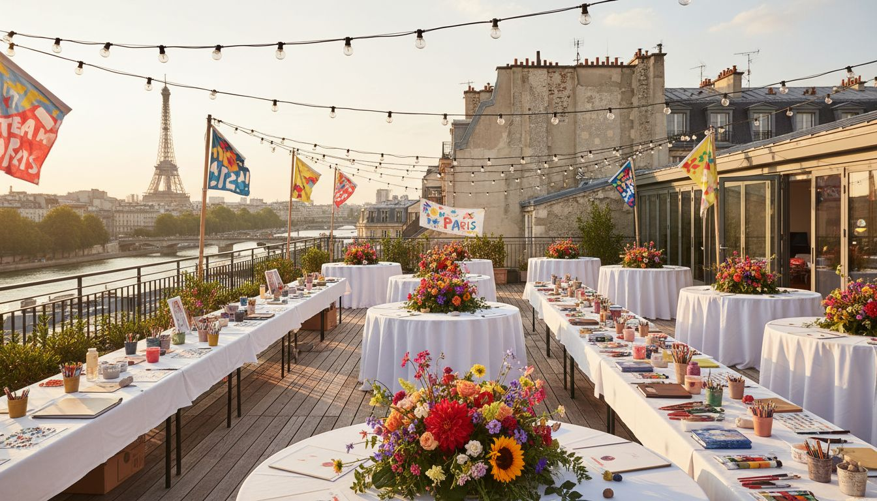
[Prospect_Company_M] RP × EVENT'IF
Your PR Concepts,
Brought to Life.
Team-Building & Employee
Engagement Event Production
Le Trianon, Montmartre Paris
Proposed: Spring 2026
PARTNERSHIP PROPOSAL — CONFIDENTIAL

Slide 2
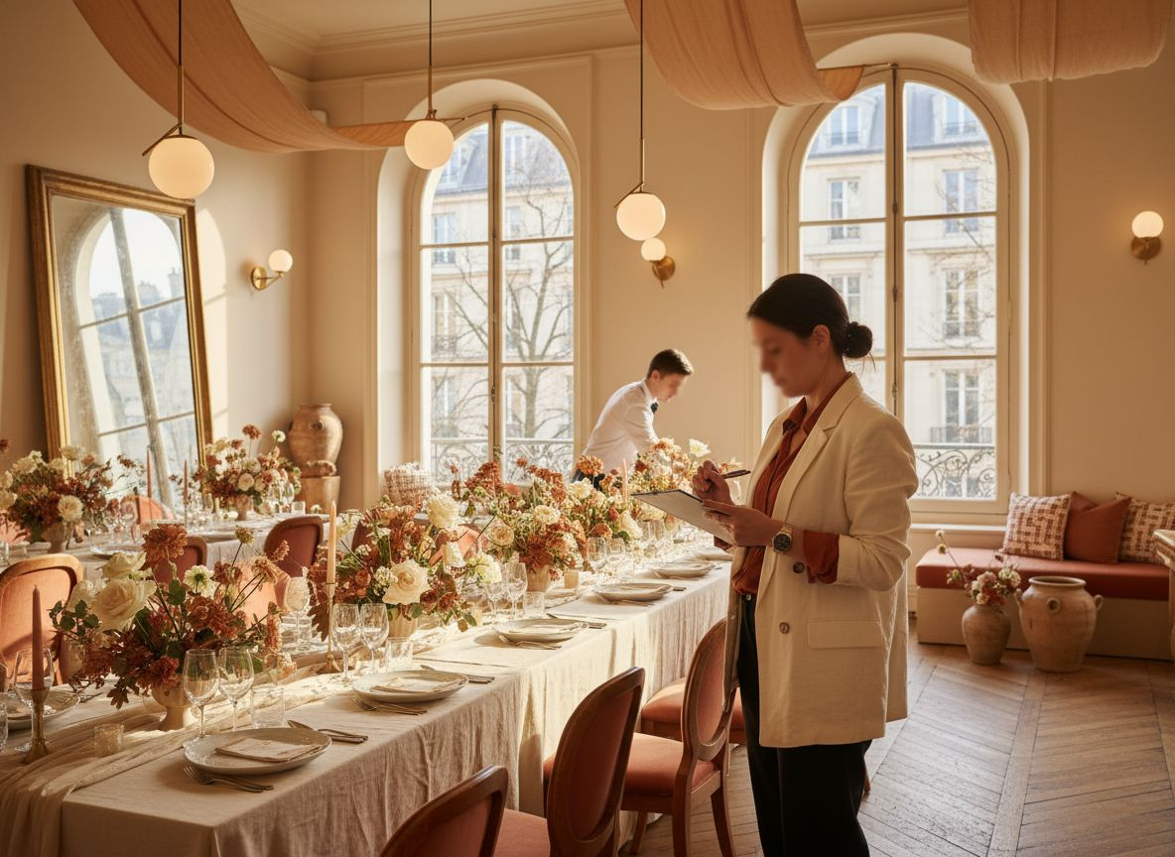
01 / THE OPPORTUNITY
FROM PR STRATEGY
TO LIVE EXPERIENCE
Your clients count on you for their image. They
also need their events to deliver.
EVENT'IF is the production partner behind the
scenes: concept, venue, logistics, animation.
You keep the client relationship.
We make the event happen flawlessly.
EVENT'IF — Founded 2009 | Paris & Île-de-France

Slide 3

02 / EVENT CONCEPT
CERCLE CRÉATIF
Half-day creative team-building workshop for 20–60 participants
09:00
10:00
12:30
14:30
ARRIVÉE
DÉFI CRÉATIF
DÉJEUNER PARTAGÉ
RÉVÉLATION
Welcome coffee & team icebreaker
Facilitated design sprint in teams
Chef-curated shared table experience
Team creations showcased & celebrated
EVENT'IF — Full production & facilitation | Paris

Slide 4
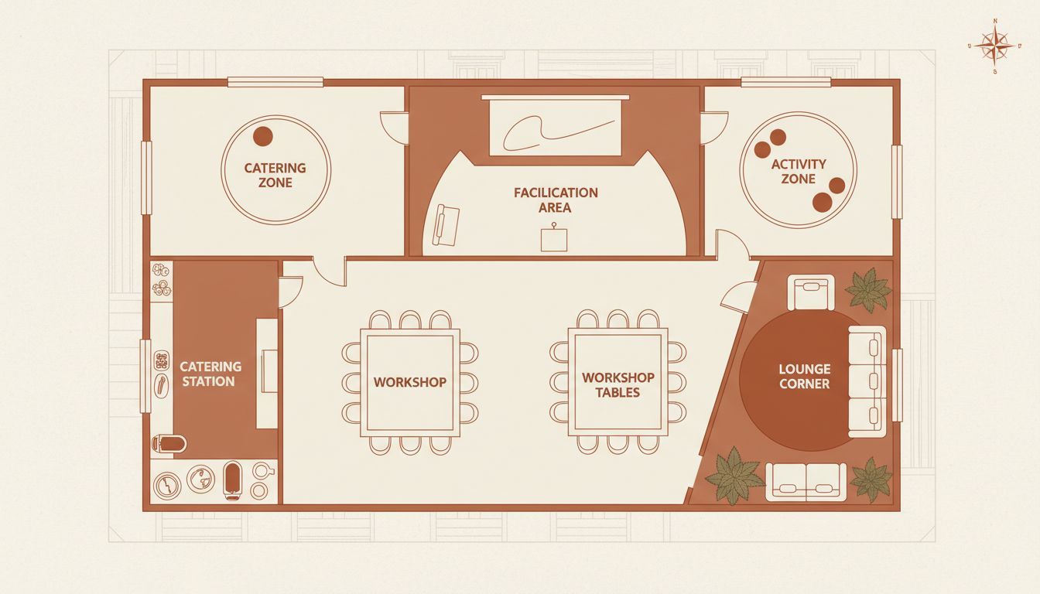
03 / VENUE
LE TRIANON
MONTMARTRE
80 Bd de Rochechouart, Paris 18e
Capacity: 20–120 guests
Iconic Montmartre character
Creative, intimate, photogenic
Modular furniture & natural light
Full catering access available
Conceptual layout — venue floor plan reference

Slide 5
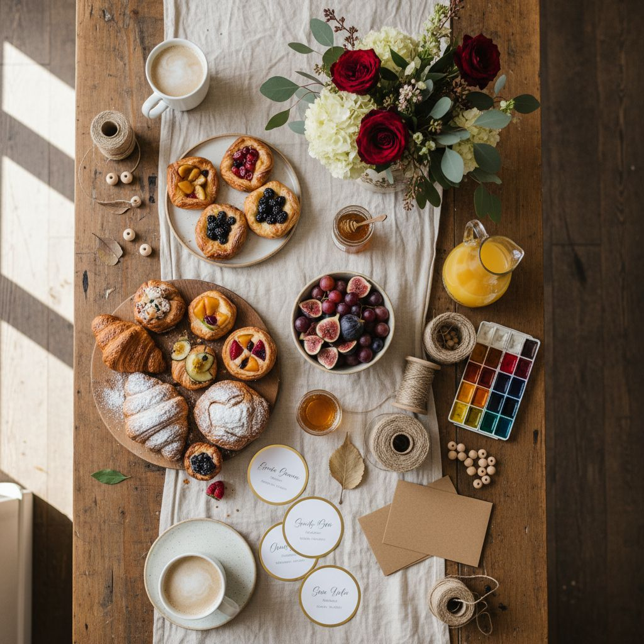
04 / WHAT EVENT'IF HANDLES
END-TO-END, SO
YOU DON'T HAVE TO.
✦
Venue Sourcing & Booking
Paris & Île-de-France — creative, premium, unique spaces
✦
Event Concept & Creative Direction
Visual universe, themes, story-driven experiences
✦
Catering & Hospitality
Chef tables, cocktail boards, dietary management
✦
Animation & Facilitation
Workshop leaders, entertainers, hosts, MCs
✦
On-site Coordination & Wrap
Full crew, guest management, post-event debrief
White-label available: [Prospect_Company_M] RP brand front, EVENT'IF production back

Slide 6
05 / SCOPE & INVESTMENT
SCOPE &
INVESTMENT
FORMAT
SCOPE
INVESTMENT
Half-day Cercle Créatif
30 guests, venue, facilitation, catering
From €8,500
Full-day format
50 guests, morning–evening program
From €14,000
Evening soirée add-on
Post-workshop cocktail & entertainment
From €3,500
White-label production
[Prospect_Company_M] RP front / EVENT'IF back
Custom brief
Optional brand photography
Dedicated photographer, edited gallery
From €1,200
All pricing excludes VAT. Final quote issued after discovery brief.

Slide 7
06 / LET'S CREATE TOGETHER
YOUR PR STORY.
OUR PRODUCTION.
ONE SEAMLESS
EXPERIENCE.
EVENT'IF — Paris, since [Lead_Phone_A]+ events per year.
contact@[Provider_Company_E].fr | +33 1 XX XX XX XX
Ready for a 30-minute discovery call?

