Slide 1
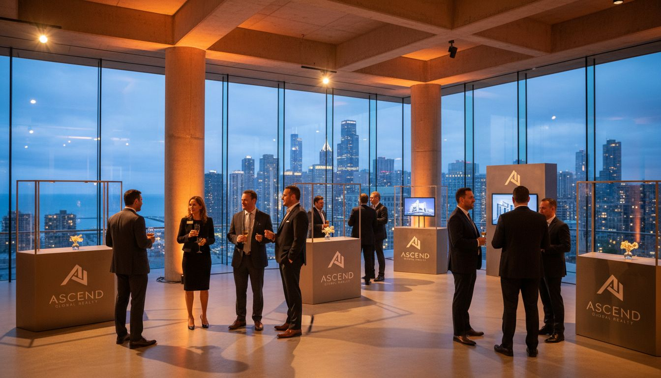
[Prospect_Company_L]
Client Appreciation &
Brand Activation
Proposed: Summer 2026
Chicago, Illinois
Produced by [Provider_Company_D] | Chicago, Illinois

Slide 2
A Proposal for [Prospect_Company_L]
Purpose
Vision
Approach
Bring your brand story to life through an unforgettable client experience that mirrors your project quality.
An elevated activation that showcases Chicago development leadership and celebrates the people who make it real.
End-to-end event production — venue sourcing, design, logistics, brand storytelling, and flawless execution.
[Provider_Company_D] | Chicago, Illinois | Brand Activation Proposal

Slide 3
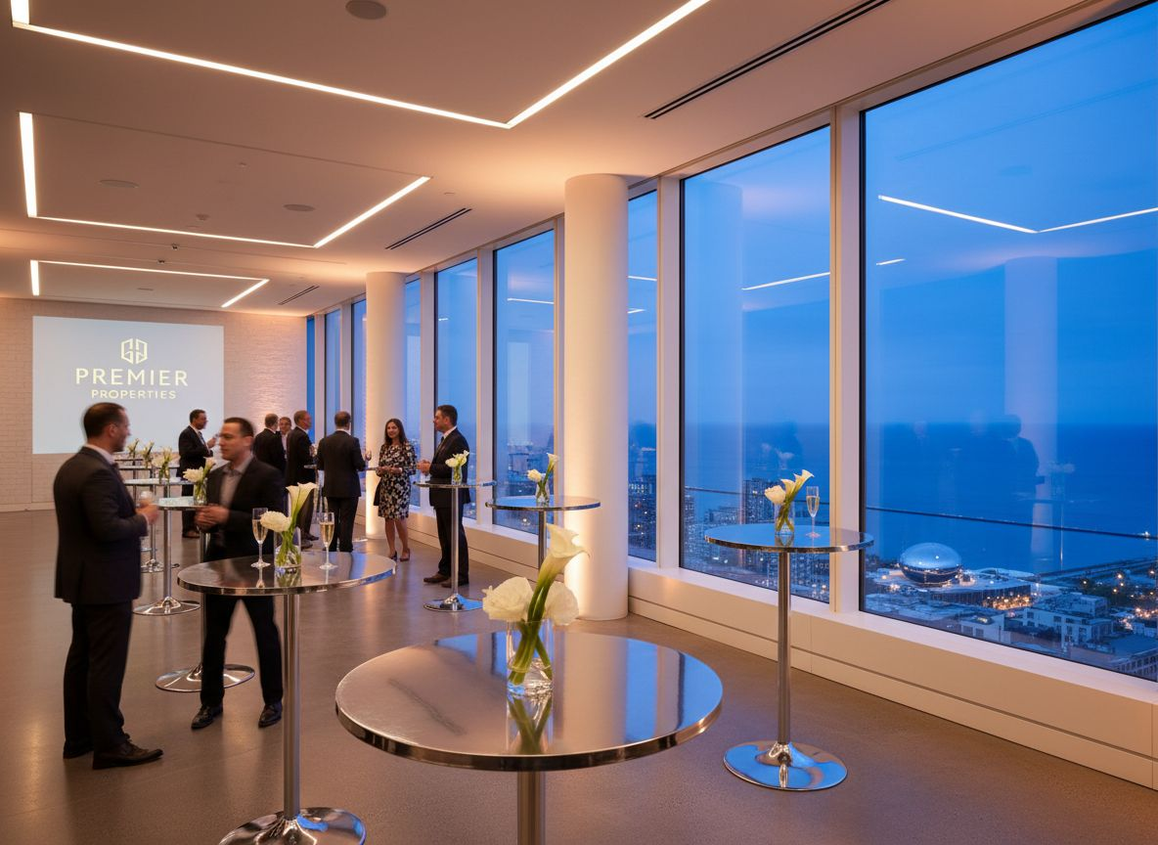
EVENT CONCEPT
The [Prospect_Company_L]
Experience
An immersive client appreciation and portfolio showcase
Cocktail reception · Project reveals · Curated networking
100–250 attendees | Clients, partners, stakeholders
Proposed: June 2026 | Chicago venue with SEM
[Provider_Company_D] | Brand Activation Proposal | [Prospect_Company_L]

Slide 4
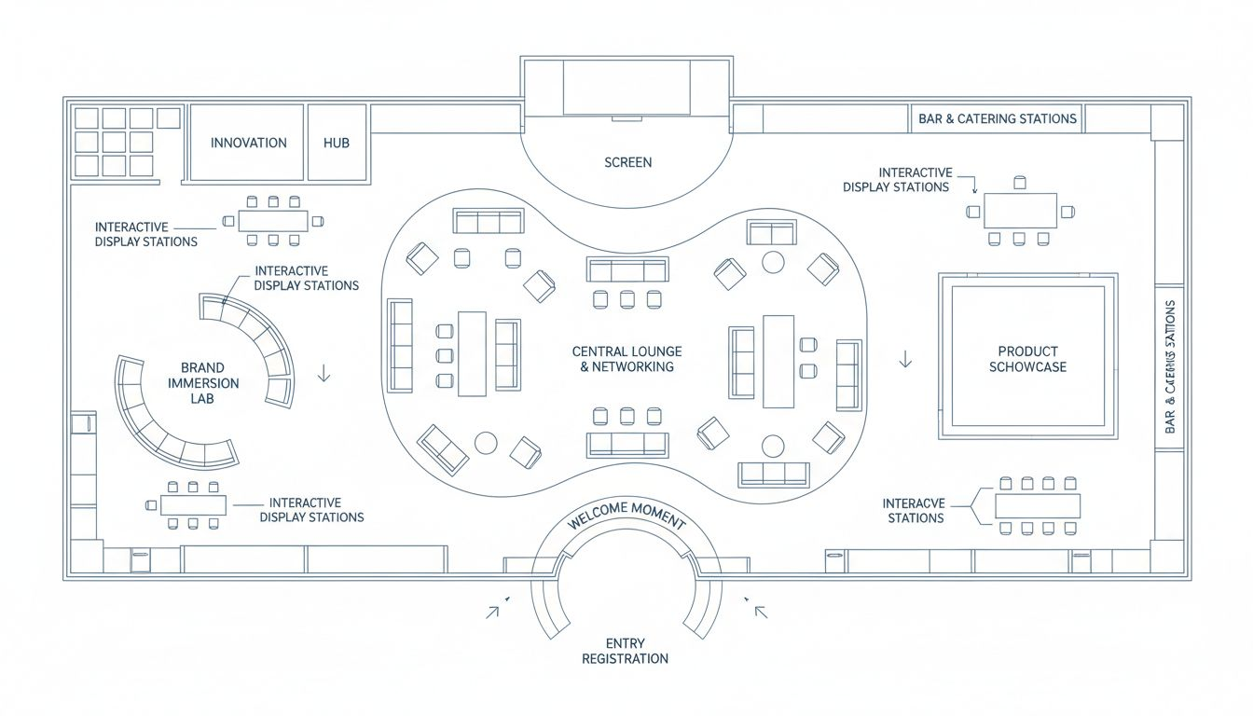
VENUE & ACTIVATION LAYOUT
Chicago: Fulton Market or 400 Lake Shore
100–250
Guest Capacity
Flexible Layout
Multi-zone design
Full AV Production
Screens, lighting, audio
Conceptual layout; venue floor plan not available
Brand Zones
Activation + lounge
[Provider_Company_D] | Brand Activation Proposal | [Prospect_Company_L]

Slide 5
The Attendee Experience Arc
1
2
3
4
ARRIVAL
BRAND JOURNEY
MAIN PROGRAM
CLOSE
Branded welcome moment, digital registration, custom name badge
Interactive project showcase stations — explore current and upcoming developments
Executive remarks, project previews, partner introductions
Open cocktail networking, curated gifting moment, warm farewell
[Provider_Company_D] | Brand Activation Proposal | [Prospect_Company_L]

Slide 6
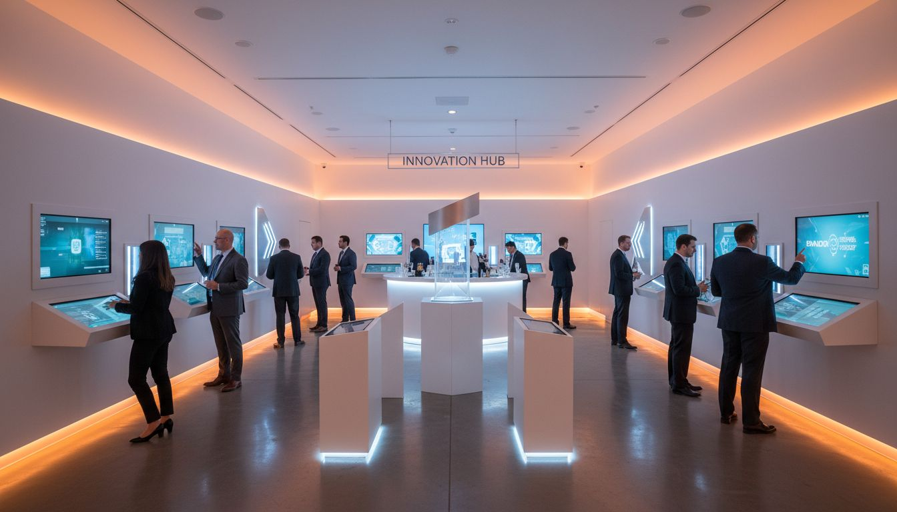
Key Touchpoints
Brand Activation
Opportunities
Welcome Wall
Oversized branded entry installation — the first impression guests see
Digital Showcase
Touchscreen project discovery displays featuring current developments
Partner Features
Curated space for key community and development partners
Branded Gifting
Custom takeaway moment connecting guests to your portfolio story
[Provider_Company_D] | Brand Activation Proposal | [Prospect_Company_L]

Slide 7
Why [Provider_Company_D]
Chicago-Native Production
High-Budget Event Capability
Deep city knowledge — venues, vendors, neighborhoods. We get things done here.
Full production value for discerning corporate audiences. No corners cut.
Turnkey Team
Corporate Event [Provider_Company_D]ists
Venue sourcing, logistics, brand experience, staffing — one point of contact.
We produce the events your brand deserves — polished, memorable, on-brand.
[Provider_Company_D] | Brand Activation Proposal | [Prospect_Company_L]

Slide 8
Ready to Create
Something Remarkable?
Let's design your next signature Chicago experience together.
Connect with the SEM Team
[Provider_Company_D] | Chicago, Illinois
hello@[Provider_Company_D].com | 312-XXX-XXXX

