Slide 1
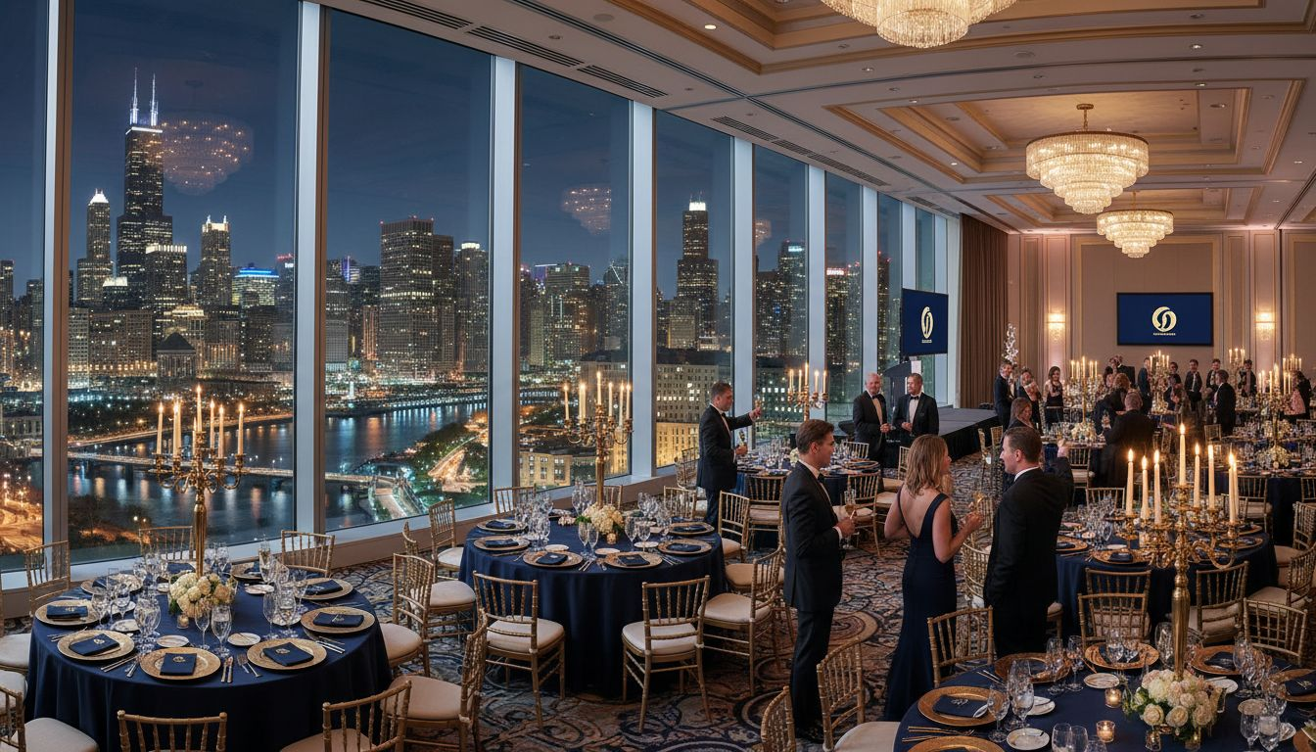
THE [Prospect_Company_K]'
[Prospect_Company_K] OF [Prospect_Company_K]
Annual Leadership Gala
2026
Proposed: October 2026
Downtown [Prospect_Company_K] Venue
Produced by [Provider_Company_D] | [Prospect_Company_K], Illinois

Slide 2
A Proposal for The [Prospect_Company_K]' [Prospect_Company_K]
Purpose
Vision
Approach
Elevate your annual gala into [Prospect_Company_K]'s defining leadership moment of the year.
A polished, sponsor-activated experience that reflects the prestige of your membership.
Turnkey full-service production — from concept design through post-event wrap.
[Provider_Company_D] | [Prospect_Company_K], Illinois | Executive Proposal

Slide 3
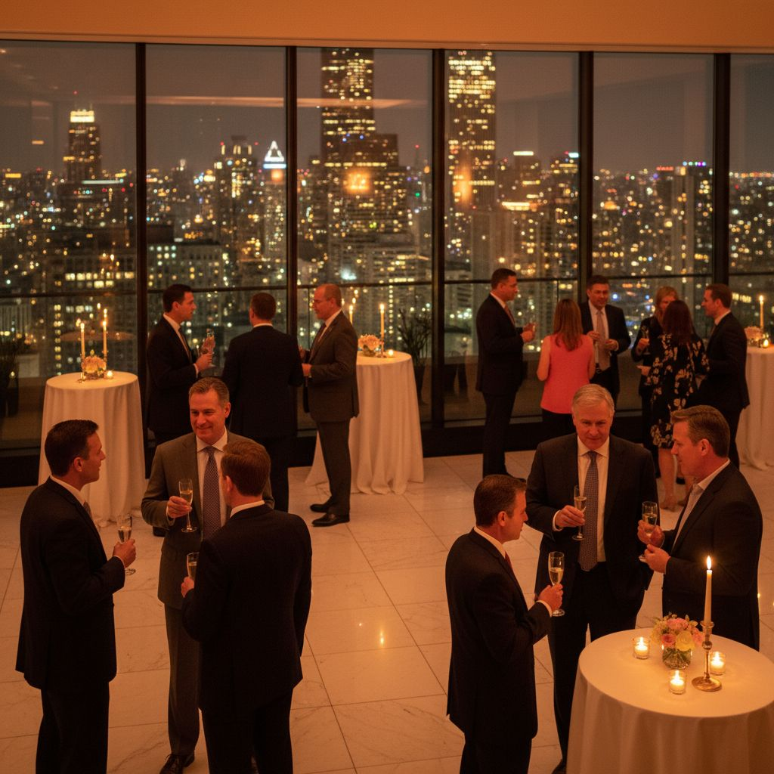
Event Concept
The Leadership
Gala
— An evening celebrating [Prospect_Company_K]'s most influential [Prospect_Company_K]
— Keynote program · Curated networking · Sponsor showcase
— 150–400 attendees | Black tie optional
— Proposed: October 2026 | Downtown [Prospect_Company_K]
[Provider_Company_D] | Executive Proposal | [Prospect_Company_K]' [Prospect_Company_K] of [Prospect_Company_K]

Slide 4
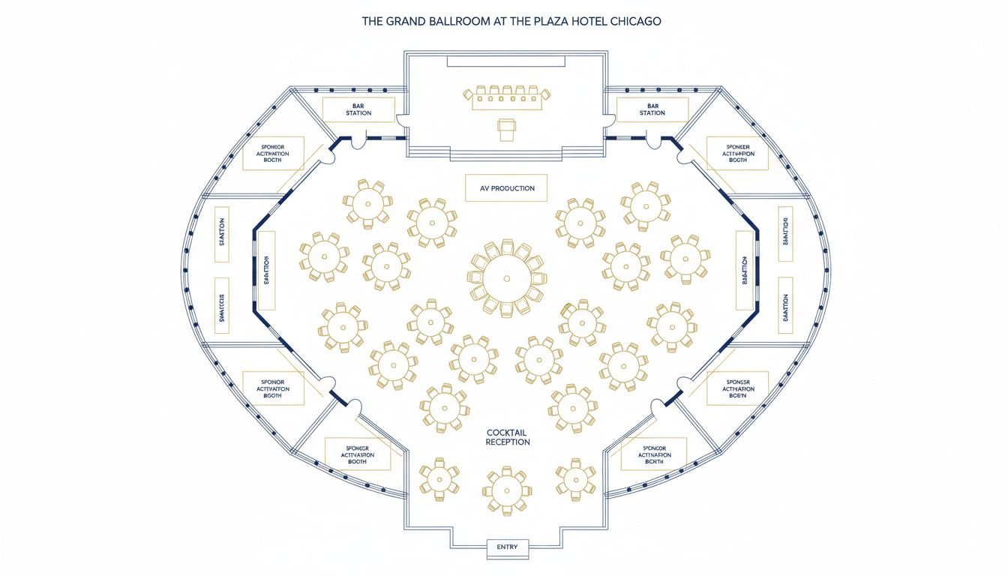
VENUE SPOTLIGHT
[Prospect_Company_K] Grand Venue
250–400
Guest Capacity
5,000 sq ft+
Event Space
Stage + AV
Production Setup
Conceptual layout; venue floor plan not available
Sponsor Zones
Flanking Main Floor
[Provider_Company_D] | Executive Proposal | [Prospect_Company_K]' [Prospect_Company_K] of [Prospect_Company_K]

Slide 5
The Attendee Journey
6:00 PM
6:30 PM
7:30 PM
9:00 PM
Arrival & Registration
Cocktail Reception
Seated Dinner & Keynote
Closing Reception
Branded welcome moment, name badge pickup, photo opportunity at entry
Sponsor activations, passed appetizers, curated networking with open bar
Executive keynote address, award presentations, gourmet plated dinner
Awards recognition, dessert buffet, open networking and farewell moments
[Provider_Company_D] | Executive Proposal | [Prospect_Company_K]' [Prospect_Company_K] of [Prospect_Company_K]

Slide 6
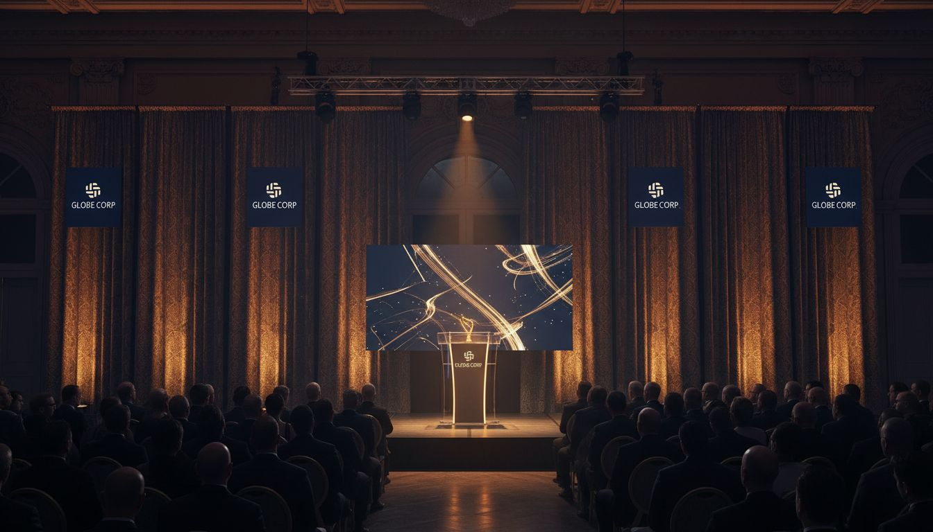
Sponsorship Opportunities
Sponsor &
Partner Activation
PRESENTING SPONSOR
Stage naming rights, branded registration portal, premier remarks
RECEPTION SPONSOR
Cocktail hour branding, custom display, premium guest interaction
AWARDS SPONSOR
Award moment recognition, on-stage remarks, branded materials
COMMUNITY PARTNER
Expo table, program listing, digital recognition, logo placement
[Provider_Company_D] | Executive Proposal | [Prospect_Company_K]' [Prospect_Company_K] of [Prospect_Company_K]

Slide 7
Why [Provider_Company_D]
[Prospect_Company_K]-Rooted
Full-Service Production
Born and built in [Prospect_Company_K]. We know the venues, vendors, and logistics that make events work here.
Venue sourcing, AV production, lighting, F&B coordination, staffing, and day-of execution — one team.
Executive Audience Expertise
Sponsor Activation Mastery
Proven experience producing polished events for high-level corporate and membership audiences.
We design sponsor integrations that deliver real ROI — not just logo placement.
[Provider_Company_D] | Executive Proposal | [Prospect_Company_K]' [Prospect_Company_K] of [Prospect_Company_K]

Slide 8
Let's Build Something
Extraordinary
We'd love to bring this vision to life for The [Prospect_Company_K]' [Prospect_Company_K] of [Prospect_Company_K].
Schedule a Discovery Conversation
[Provider_Company_D] | [Prospect_Company_K], Illinois
hello@[Provider_Company_D].com | 312-XXX-XXXX

