Slide 1
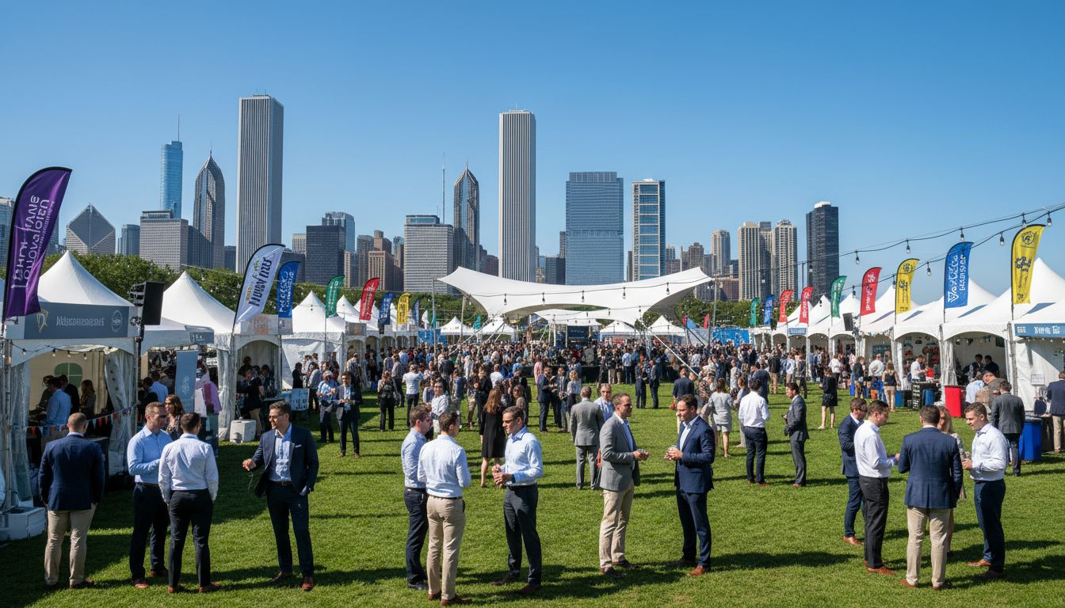
[Prospect_Company_J] [Prospect_Company_J] OF [Prospect_Company_J]®
Summer Member
Festival 2026
Proposed: August 2026 | [Prospect_Company_J], Illinois
Produced by [Provider_Company_D]

Slide 2
A Proposal for [Prospect_Company_J] [Prospect_Company_J] of [Prospect_Company_J]®
Purpose
Vision
Approach
Bring 16,000+ members together for [Prospect_Company_J]'s must-attend real estate community celebration of the year.
A vibrant outdoor festival rooted in the [Prospect_Company_J] neighborhoods your members know and serve every day.
Full-service outdoor production — permits, tenting, AV, F&B, entertainment, and sponsor integration.
[Provider_Company_D] | [Prospect_Company_J], Illinois | Member Festival Proposal

Slide 3
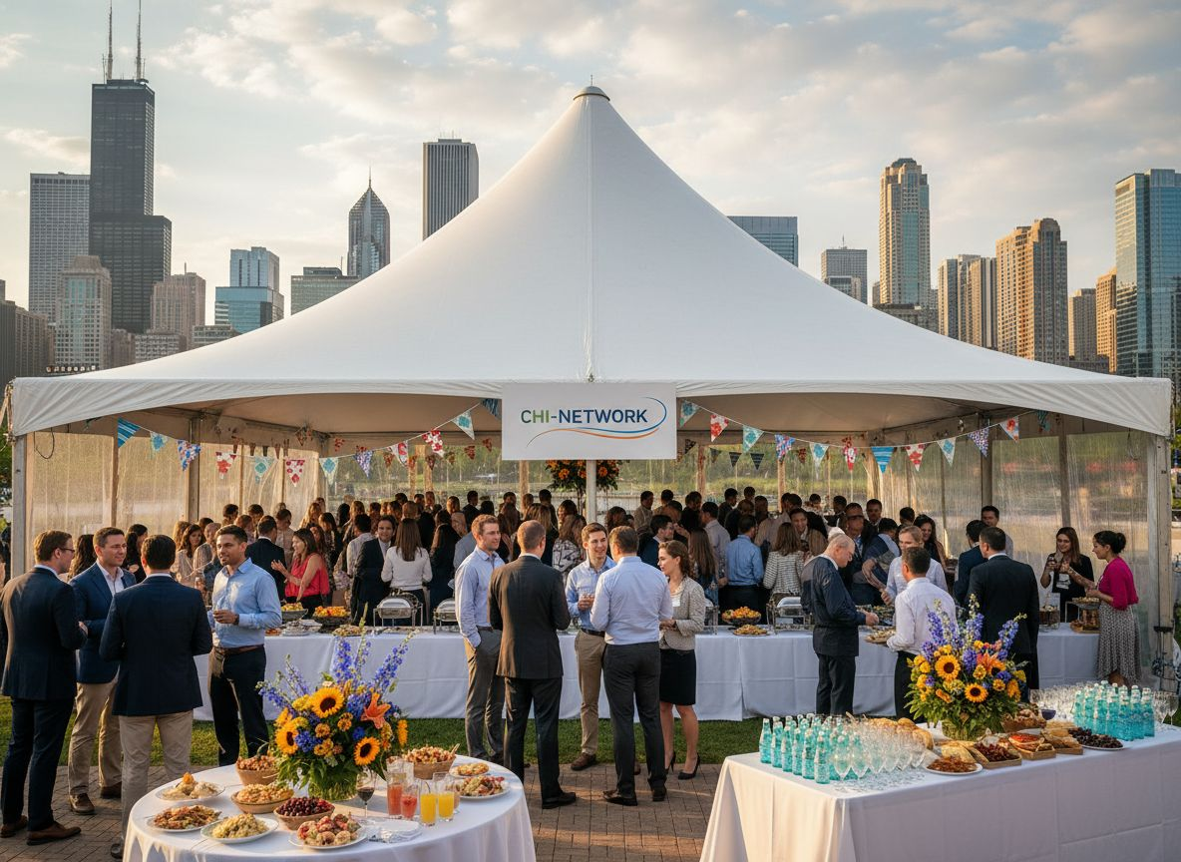
EVENT CONCEPT
[Prospect_Company_J] [Prospect_Company_J]®
Summer Fest
An outdoor celebration of [Prospect_Company_J] real estate & community
Live entertainment · Sponsor expo · Member networking
300–800 attendees | Members, affiliates, community partners
Proposed: August 2026 | [Prospect_Company_J] lakefront park setting
[Provider_Company_D] | Member Festival Proposal | [Prospect_Company_J] [Prospect_Company_J] of [Prospect_Company_J]®

Slide 4
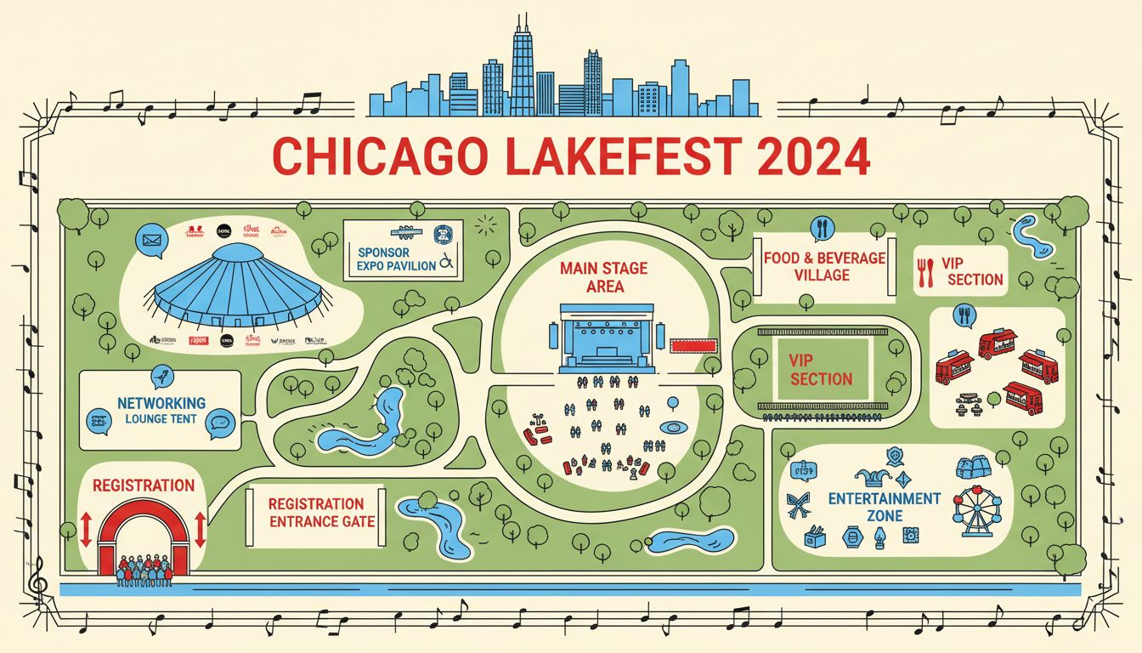
VENUE: [Prospect_Company_J]'S GREAT OUTDOORS
Millennium Park or [Prospect_Company_J] Riverwalk
300–800
Guest Capacity
Multi-Zone
Festival layout
Full Permits
SEM manages logistics
Conceptual layout; outdoor venue permit and final layout subject to park authority approval
Sponsor Expo
Branded booths + activations
[Provider_Company_D] | Member Festival Proposal | [Prospect_Company_J] [Prospect_Company_J] of [Prospect_Company_J]®

Slide 5
The Festival Experience
11:00 AM
12:00 PM
2:00 PM
4:00 PM
Gates Open
Festival Begins
Main Program
Sunset Reception
Welcome moment, sponsor check-in activations, branded first impression
Live entertainment on main stage, food village opens, member expo
Industry speakers, member awards ceremony, [Prospect_Company_J] spotlights
Outdoor networking reception, curated music, warm farewell close
[Provider_Company_D] | Member Festival Proposal | [Prospect_Company_J] [Prospect_Company_J] of [Prospect_Company_J]®

Slide 6
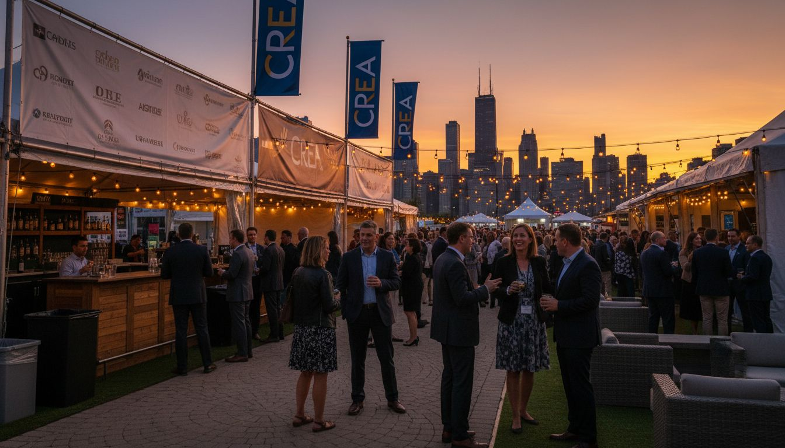
Partner with [Prospect_Company_J] [Prospect_Company_J]®
Sponsorship &
Affiliate Opportunities
PRESENTING SPONSOR
Main stage naming rights, branded welcome arch, logo prominence throughout
FOOD VILLAGE SPONSOR
Branded catering zone, sampling experiences, member interaction moments
ENTERTAINMENT SPONSOR
Live performance recognition, stage branding, on-program acknowledgment
COMMUNITY PARTNER
Expo booth, program listing, member-facing digital and print visibility
[Provider_Company_D] | Member Festival Proposal | [Prospect_Company_J] [Prospect_Company_J] of [Prospect_Company_J]®

Slide 7
Why [Provider_Company_D]
[Prospect_Company_J]-Native Team
Outdoor Event [Provider_Company_D]ists
Deep city knowledge — we know the parks, permit processes, and production partners.
Tenting, AV, power, weather contingency, load-in logistics — we handle it all.
[Prospect_Company_J] Event Experience
Sponsor Integration Mastery
We understand member-driven audiences and how to make them feel valued.
Designing activations that deliver measurable value for sponsors at every level.
[Provider_Company_D] | Member Festival Proposal | [Prospect_Company_J] [Prospect_Company_J] of [Prospect_Company_J]®

Slide 8
Let's Celebrate
[Prospect_Company_J] Together
We're ready to bring the [Prospect_Company_J] [Prospect_Company_J]® Summer Fest to life.
Schedule a Site Walk & Planning Call
[Provider_Company_D] | [Prospect_Company_J], Illinois
hello@[Provider_Company_D].com | 312-XXX-XXXX

