Slide 1
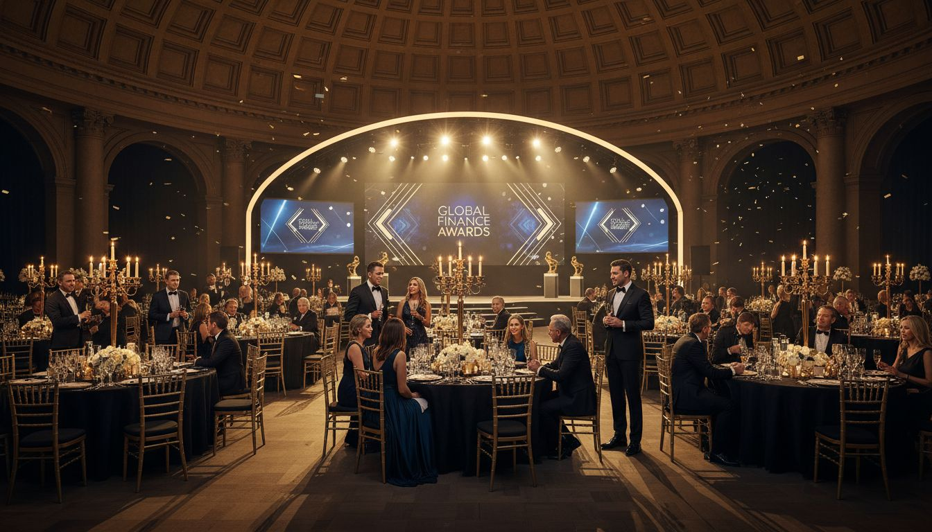
A LANDMARK ANNUAL GALA AT [Provider_Company_C]
The [Prospect_Company_I]
Corporate Gala, Launch & [Prospect_Company_I] Summit Partnership Proposal
[Provider_Company_C] | [Provider_Company_C] Oly[Prospect_Company_A]c Park | Proposed: October 2027

Slide 2
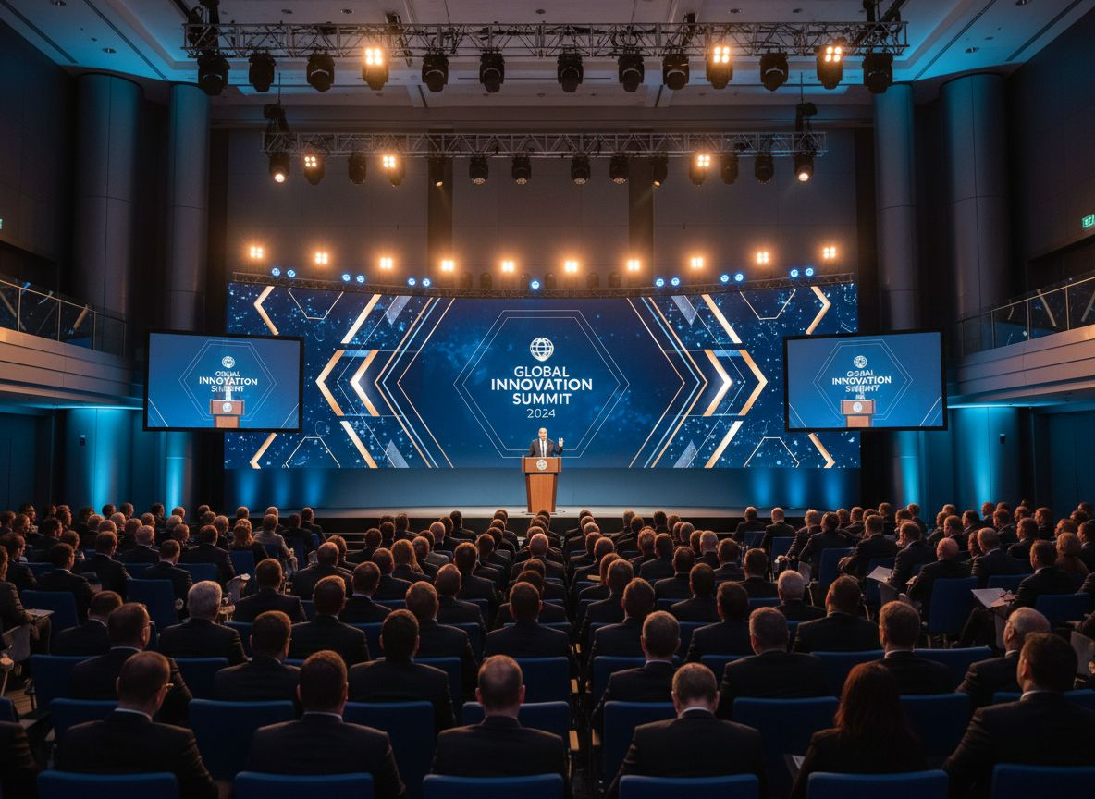
THE [Prospect_Company_I] DESERVES [Provider_Company_C]'S FINEST VENUE
Australia's Leading
[Prospect_Company_I] professional association — 30+ years of membership excellence
The [Prospect_Company_I] Summit
Flagship annual conference attracting Australia's top [Prospect_Company_I] practitioners
National Conferences
Forums, conventions, masterclasses and awards across Australia
[Provider_Company_C]
[Provider_Company_C]'s most prestigious major event address at Oly[Prospect_Company_A]c Park

Slide 3
EVENT CONCEPT: THE [Prospect_Company_I] SUMMIT 2027 AT [Provider_Company_C]
Two days. One iconic precinct. Australia's definitive [Prospect_Company_I] event.
DAY 1
DAY 2
MORNING
MORNING
[Prospect_Company_I] Summit Keynote Plenary in The Dome — 1,500+ delegates
CPD workshop streams and panel discussions
AFTERNOON
AFTERNOON
Technical masterclasses in exhibition hall breakout theatres
Member and sponsor exhibition — [Prospect_Company_I] Expo floor
EVENING
EVENING
Sponsor networking drinks on the Exhibition Hall floor
Annual Awards Gala dinner in The Dome — Australia's [Prospect_Company_I] night of nights

Slide 4
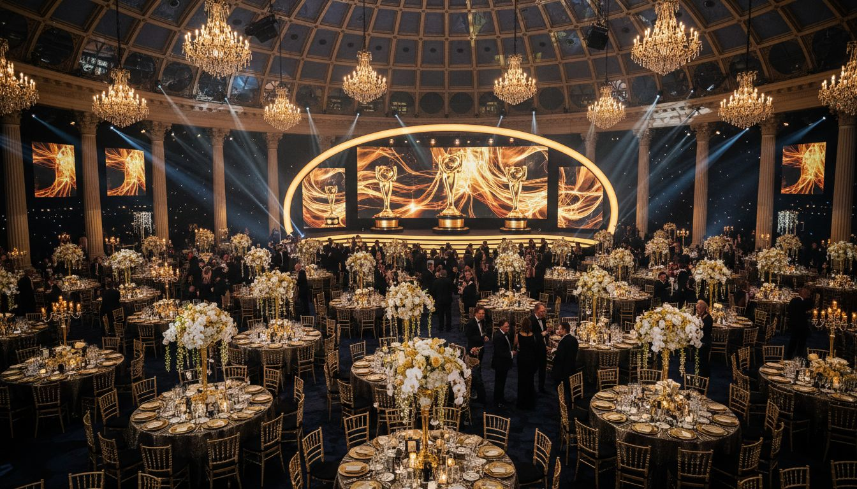
THE DOME — [Provider_Company_C]'S MOST ICONIC GALA VENUE
Transformed for a black-tie awards evening like no other — bespoke production, lighting & staging
Capacity: 1,000–3,000 guests seated | Award-winning culinary team | Custom AV packages

Slide 5
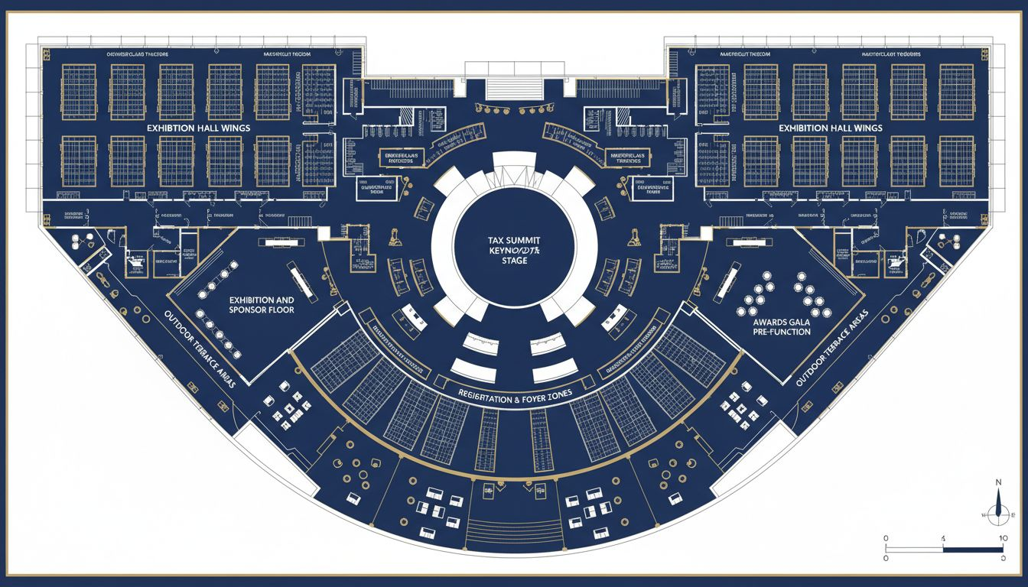
FROM SUMMIT STAGE TO GALA DINNER IN ONE PRECINCT
The Dome
[Prospect_Company_I] Summit keynote plenary
& Awards Gala dinner
Exhibition Halls
Sponsor expo floor
& CPD masterclass theatres
Conference Foyers
Delegate registration,
networking & catering
Breakout Rooms
Technical workshops
& committee sessions
Conceptual layout — venue floor plan not available

Slide 6
SPONSOR VALUE: PUTTING PARTNERS AT THE CENTRE OF AUSTRALIA'S [Prospect_Company_I] PROFESSION
Premium Naming Rights
Branded Sponsor Lounges
Naming rights for the exhibition floor, sponsor lounges or gala spaces
Curated lounge zones within the main conference delegate flow
VIP Partner Suites
Elevated ROI
Private suites with bespoke catering and dedicated delegate access
Purpose-built sponsor activation environment — not an afterthought

Slide 7
WHY [Provider_Company_C] OLY[Prospect_Company_A]C PARK FOR THE [Prospect_Company_I]
The practical and prestige case for Australia's leading [Prospect_Company_I] body
15 MIN FROM CBD
ADJACENT HOTELS
Direct train to Oly[Prospect_Company_A]c Park Station — easy for [Provider_Company_C]-based members, clients, and interstate visitors.
Multiple hotel options within walking distance for multi-day [Prospect_Company_I] Summit delegates.
150+ EVENTS / YEAR
ICONIC ADDRESS
Operational excellence is proven at scale — [Provider_Company_C] runs more events annually than any comparable venue.
[Provider_Company_C] Oly[Prospect_Company_A]c Park: globally recognised, prestige-tier, and synonymous with landmark Australian events.

Slide 8
LET'S PLAN AUSTRALIA'S NEXT GREAT [Prospect_Company_I] SUMMIT TOGETHER
[Provider_Company_C] — where Australia's finest professions make their mark
1. Book a venue walkthrough and event concept session
2. Receive a bespoke proposal for [Prospect_Company_I] Summit 2027 and Annual Awards Gala
3. Our dedicated event team handles everything — you focus on your members
CONTACT [Provider_Company_C] TODAY
sales@[Provider_Company_C].[Company_Website_A] | [Provider_Company_C].[Company_Website_A]

