Slide 1
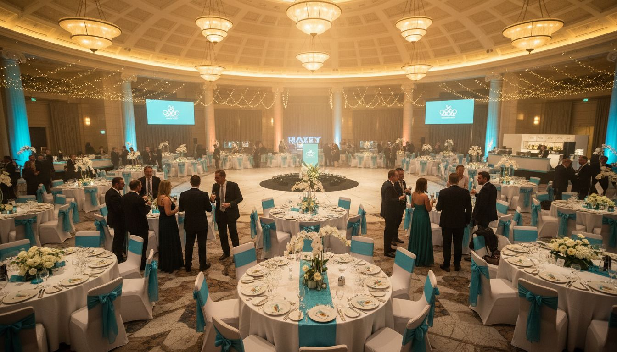
A PREMIUM CONFERENCE HOME FOR
Occupational Therapy Australia
Annual National Conference & Hospitality Partnership Proposal
[Provider_Company_C] | [Provider_Company_C] Oly[Prospect_Company_A]c Park | Proposed: March 2027

Slide 2
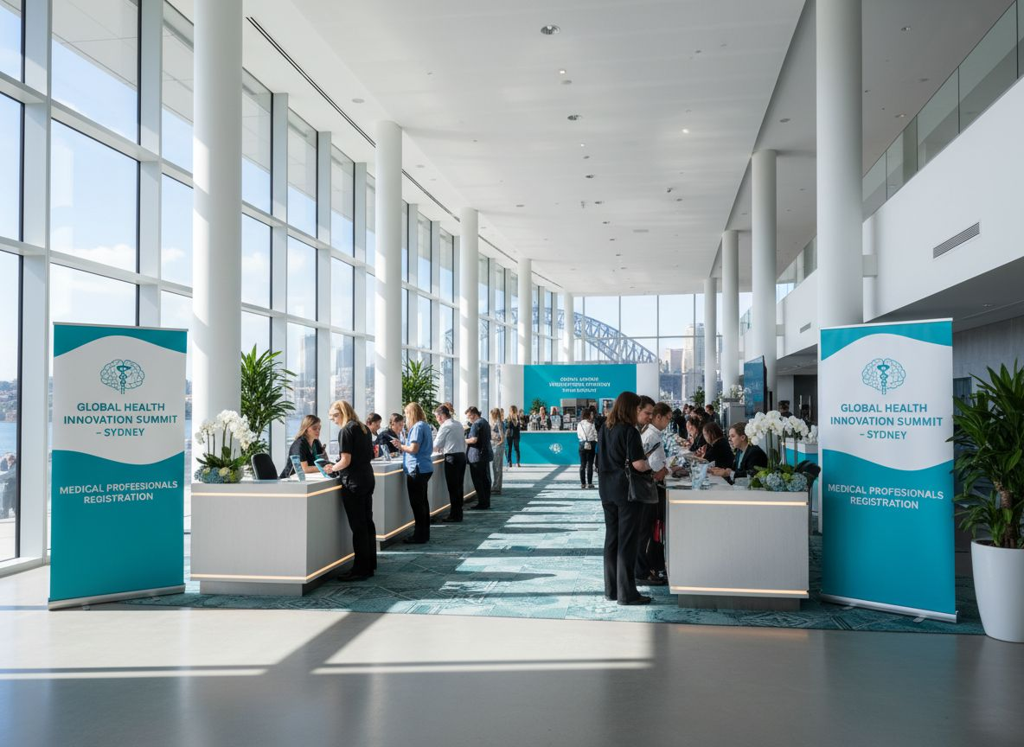
WHY [Prospect_Company_H]'S NEXT CONFERENCE BELONGS AT [Provider_Company_C]
34,000+
occupational therapists represented nationally
150+
major events hosted at [Provider_Company_C] per year
10,000+
car spaces at [Provider_Company_C] Oly[Prospect_Company_A]c Park — easy delegate access
One precinct
conference + CPD + expo + hospitality — seamlessly connected

Slide 3
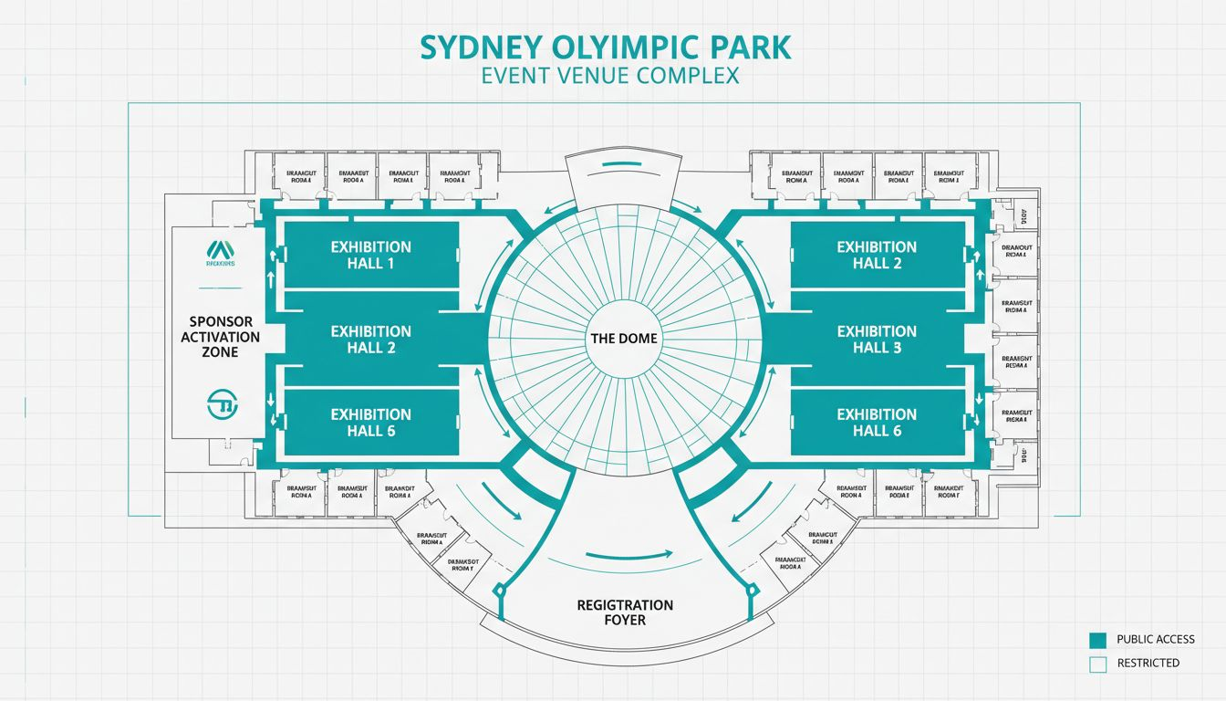
SPACES BUILT FOR EXCEPTIONAL DELEGATE EXPERIENCES
The Dome
Up to 5,000 guests — gala dinners & headline plenaries
Exhibition Halls
40,000+ sqm — flexible expo & sponsor activation space
Breakout Rooms
CPD workshops, masterclasses & training streams
Full Production
AV, staging & catering via in-house expert teams
Conceptual layout — venue floor plan not available

Slide 4
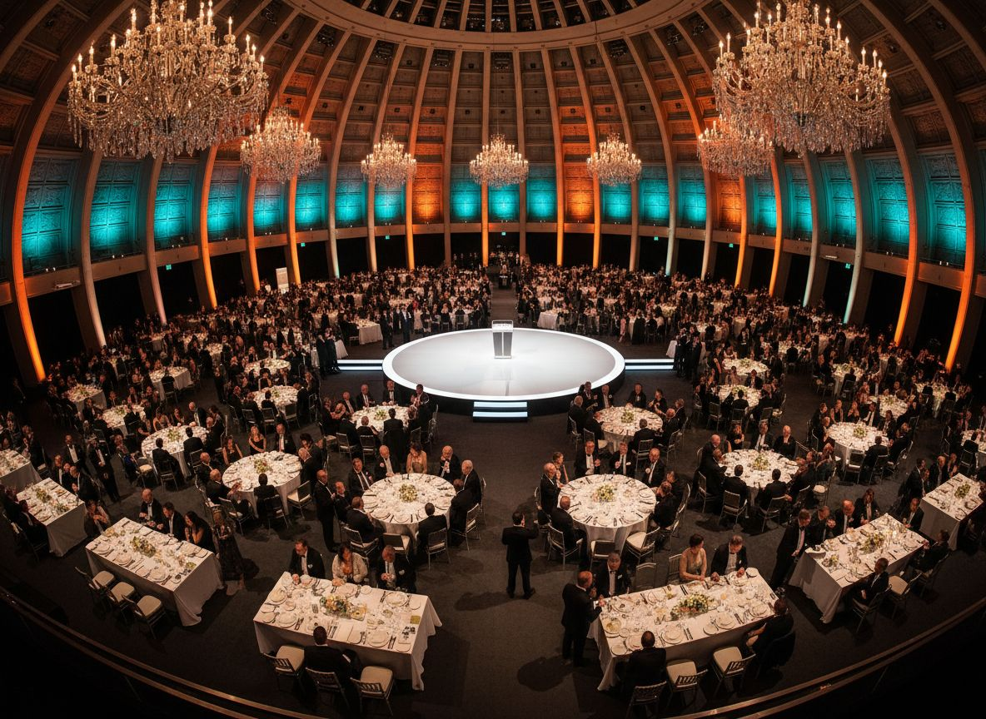
THE DOME EXPERIENCE
Gala Dinner &
Closing Celebration
Australia's most iconic conference dome — any theme, any scale
Gala dinners, awards ceremonies, closing celebrations
Bespoke menus using finest Australian produce
Seamless delegate journey — conference to gala in one precinct

Slide 5
DELEGATE GUEST JOURNEY: FROM ARRIVAL TO GALA
A seamless, end-to-end delegate experience at [Provider_Company_C] Oly[Prospect_Company_A]c Park
ARRIVE
LEARN
CELEBRATE
10,000+ car spaces
Direct rail to Oly[Prospect_Company_A]c Park Station
REGISTER
Plenary keynotes + CPD
workshops in breakout rooms
CONNECT
Formal gala dinner
in The Dome
Grand registration foyer
Delegate welcome and networking
Sponsor expo floor
Product demos & partner lounges
1
2
3
4
5

Slide 6
SPONSORSHIP ACTIVATION: CONNECTING INDUSTRY TO YOUR MEMBERS
Dedicated Expo Floor
Branded Stand Options
Adjacent to conference spaces — curated sponsor and supplier exhibition
Branded stands, product demos, lounge zones and VIP hospitality suites
Exhibitor Services
Sponsor ROI
[Provider_Company_C]'s full exhibitor services team handles all logistics
Drive meaningful delegate engagement through a curated event flow

Slide 7
PARTNERSHIP PACKAGE OPTIONS
Tailored to suit [Prospect_Company_H]'s annual conference goals and member experience standards
FULL VENUE
PARTNERSHIP
HOSPITALITY
PARTNERSHIP
GALA-ONLY
PACKAGE
✓ Conference + expo floor
✓ The Dome dinner package
✓ Annual awards ceremony
✓ Gala dinner in The Dome
✓ Welcome reception add-on
✓ Closing celebration dinner
✓ Dedicated Event Manager
✓ Bespoke menu selection
✓ Themed production options
✓ Catering, AV & production
✓ Full hospitality services
✓ Standalone event management
Pricing: TBD
Pricing: TBD
Pricing: TBD

Slide 8
LET'S PLAN YOUR 2027 [Prospect_Company_H] NATIONAL CONFERENCE
[Provider_Company_C] — where Australia's professions come together
1. Schedule a venue site tour at [Provider_Company_C] Oly[Prospect_Company_A]c Park
2. Meet our dedicated conference and event planning team
3. Receive a tailored proposal for your 2027 national event
CONTACT [Provider_Company_C] TODAY
sales@[Provider_Company_C].[Company_Website_A] | [Provider_Company_C].[Company_Website_A]

