Slide 1
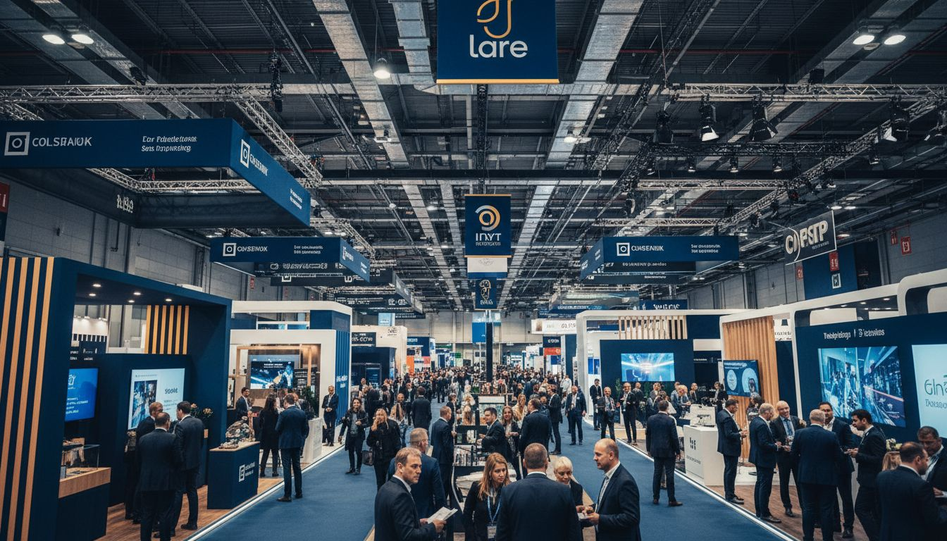
[Provider_Company_C]'S PREMIER EXHIBITION & CONFERENCE VENUE PARTNER
[Prospect_Company_G] Global
Exhibitor Activation & Sponsorship Partnership Proposal
[Provider_Company_C] | [Provider_Company_C] Oly[Prospect_Company_A]c Park | NSW Major Projects Conference 2026 — and Beyond

Slide 2
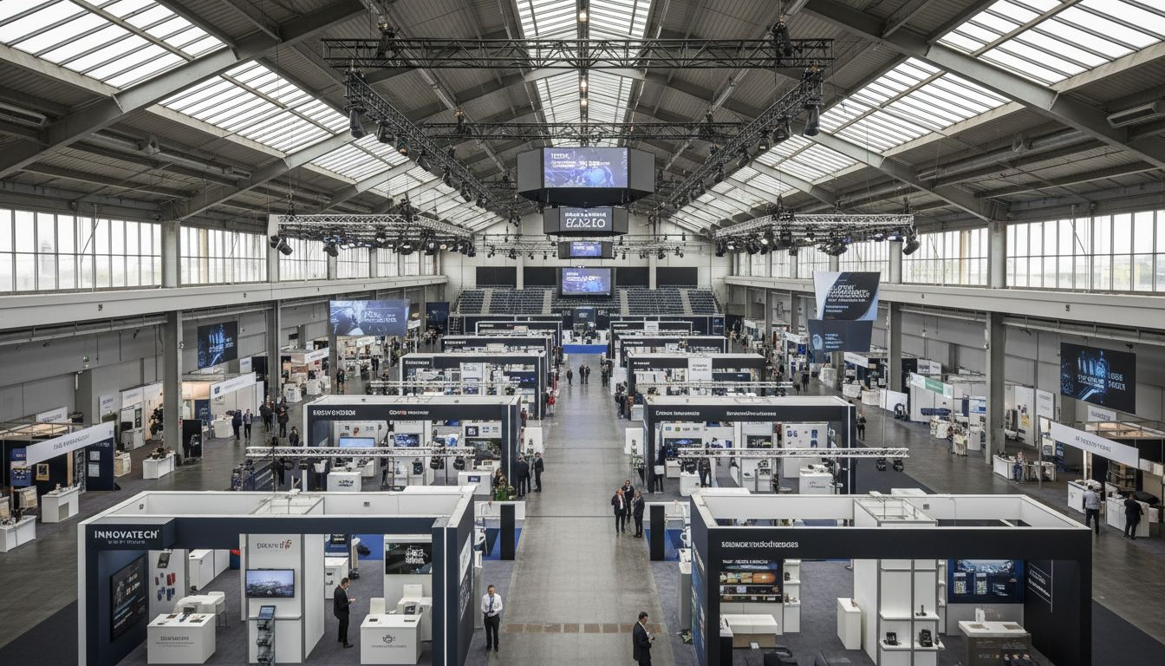
BUILT FOR WORLD-CLASS CONFERENCES AND TRADE SHOWS
150+
Major events hosted annually
at [Provider_Company_C]
40,000+
sqm exhibition floor across
five interconnected halls
5,000
Peak delegate capacity for
plenary and keynote sessions
20+ years
[Prospect_Company_G]'s proven track record
of world-class conferences

Slide 3
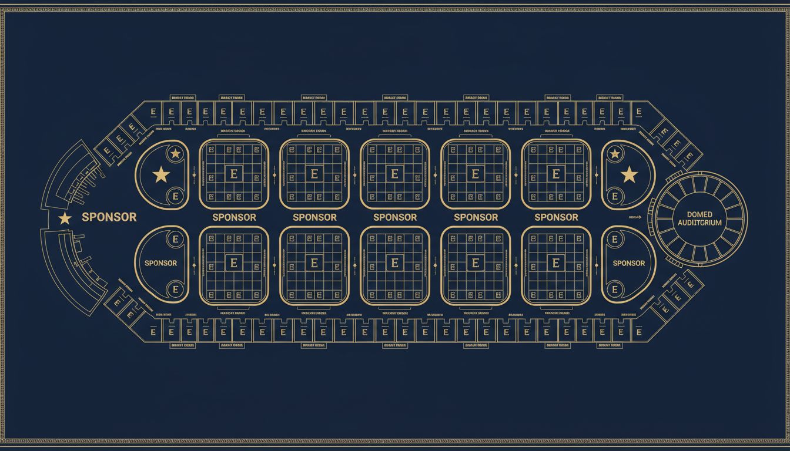
YOUR EVENT MAPPED AT [Provider_Company_C]
Hall 1
Major sponsor pavilions & feature activations
Halls 2–3
Trade floor, exhibitor booths, networking aisles
Hall 4
Satellite conference sessions & CPD workshops
The Dome
Plenary keynote, opening ceremony & gala dinner
Conceptual layout — venue floor plan not available

Slide 4
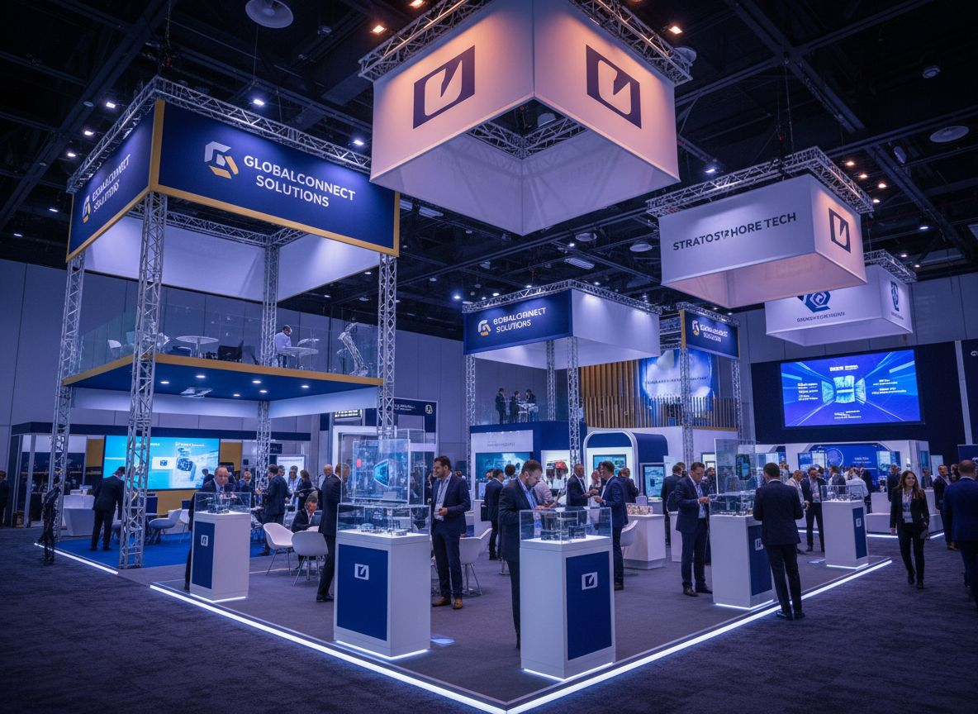
SPONSOR ACTIVATION
INFRASTRUCTURE
Maximising Exhibitor ROI at [Provider_Company_C]
Feature pavilion positions — 6m+ clearance heights
Rigging & structural loading for large-format installs
VIP hospitality suites with private catering access
Managed exhibitor services: utilities, connectivity, signage

Slide 5
DELEGATE JOURNEY: FROM REGISTRATION TO SUMMIT GALA
[Provider_Company_C] delivers a seamless, production-grade conference experience across every touchpoint
ARRIVE
DAY 1 AM
DAY 1 PM
DAY 2
EVENING
Direct rail to
Oly[Prospect_Company_A]c Park Station
10,000+ car spaces
Plenary keynote
in main conference
hall
Exhibition floor opens
Sponsor activations
B2B meetings
CPD breakout sessions
Technical workshops
Networking
Summit gala dinner
or networking
reception in The Dome
1
2
3
4
5

Slide 6
WHY [Provider_Company_C] OLY[Prospect_Company_A]C PARK?
Location, Scale, and Prestige — the complete package for [Prospect_Company_G] events
ACCESS
SCALE
Direct rail from [Provider_Company_C] CBD
— 15 minutes to Oly[Prospect_Company_A]c Park
Station. 10,000+ car spaces.
40,000+ sqm exhibition halls.
5,000 delegate capacity.
150+ events annually.
HOTELS
PRESTIGE
Adjacent hotel accommodation
for multi-day conference
delegates.
[Provider_Company_C]'s most iconic event
precinct — trusted by Australia's
top conferences.

Slide 7
PARTNERSHIP TIERS: FROM SINGLE EVENT TO MULTI-YEAR
SINGLE EVENT
ANNUAL PARTNER
MULTI-YEAR STRATEGIC
NSW Major Projects Conference
September 2026
Preferred [Provider_Company_C] venue across all
[Prospect_Company_G] Australia conferences
Strategic venue partnership with
preferential long-term terms
• Exhibition hall + conference rooms
• Priority venue access & booking
• Multi-year rate commitment
• Full exhibitor services support
• Dedicated account management
• Custom exhibitor services agreement
• Event Manager assigned
• Volume pricing advantages
• Named venue partnership rights
• Catering + AV + security
• Joint event marketing support
• Co-branded event promotion
Pricing: TBD
Pricing: TBD
Pricing: TBD

Slide 8
LET'S BUILD [Provider_Company_C]'S BEST B2B CONFERENCE TOGETHER
[Provider_Company_C] — [Provider_Company_C]'s home for world-class conferences and exhibitions
1. Schedule a technical site inspection and floor plan consultation
2. Receive a tailored exhibitor services and sponsorship package
3. Meet the [Provider_Company_C] events and exhibitor services team
CONTACT [Provider_Company_C] TODAY
sales@[Provider_Company_C].[Company_Website_A] | [Provider_Company_C].[Company_Website_A]

