Slide 1
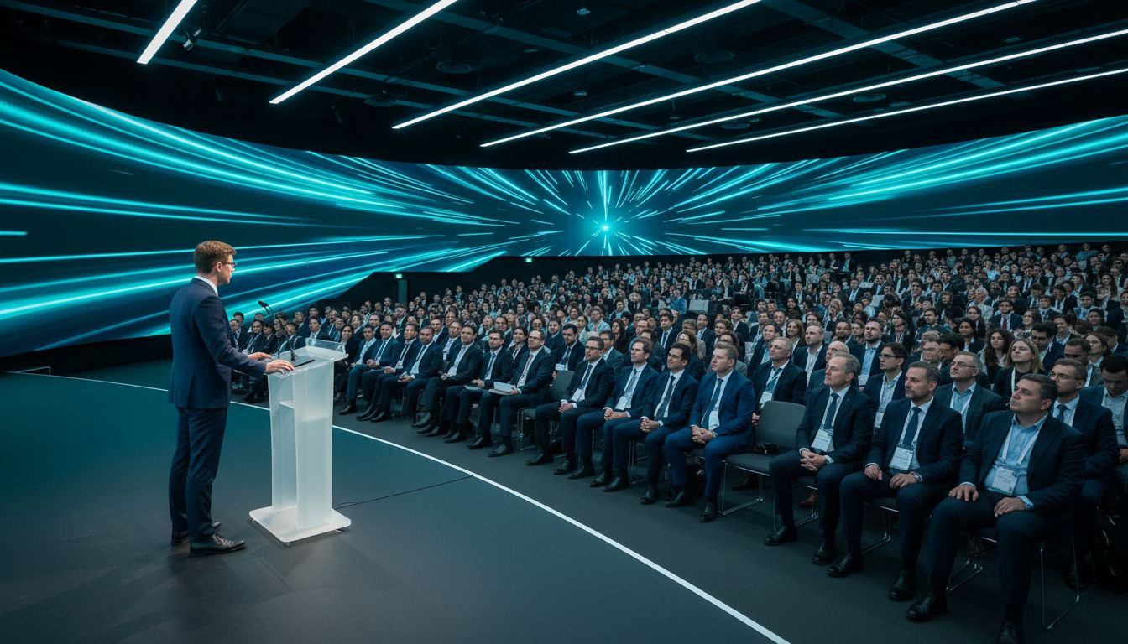
Where Regulatory Knowledge
Meets Exceptional Experience
[Provider_Company_B] × [Prospect_Company_A]
A Proposal for Convergence 2027 and the [Prospect_Company_F] Conference Series
Proposed: October 2027 | Washington Convention Center
[Provider_Company_B].com

Slide 2
The [Prospect_Company_F] Event Ecosystem
Convergence
3,000+ global regulatory professionals at the flagship annual conference
Euro Convergence
European regulatory community gathering — growing international footprint
Conference Series
Specialized regulatory education tracks throughout the year
Virtual Programs
Online workshops, CE credits, and remote learning year-round
Chapter Events
Local Networking Groups (LNGs) in key regulatory hubs worldwide
[Provider_Company_B] supports every format: in-person, hybrid, and virtual — from single-track workshops to multi-day global conferences.
[Provider_Company_B] · Toronto, Ontario, Canada · [Provider_Company_B].com

Slide 3
The [Provider_Company_B] Platform — [Provider_Company_A] [Prospect_Company_A]
Credentialing-Aligned
Registration & CE Tracking
Branded Convergence
Event App
Hybrid Session Delivery
& Live Streaming
Automated CE credit tracking integrated with [Prospect_Company_F] credentialing workflows
Custom [Prospect_Company_F]-branded app with full agenda, speaker profiles, and networking
Multi-track hybrid conference with synchronized in-room and remote access
Sponsor Visibility
Suite
Attendee Networking
& Community
Post-Event Analytics
& Reporting
Sponsor profiles, banner placements, lead capture, and ROI analytics
AI matchmaking, peer messaging, and session-based community groups
Attendee engagement metrics, session performance, and sponsor ROI packs
[Provider_Company_B] · Toronto, Ontario, Canada · [Provider_Company_B].com

Slide 4
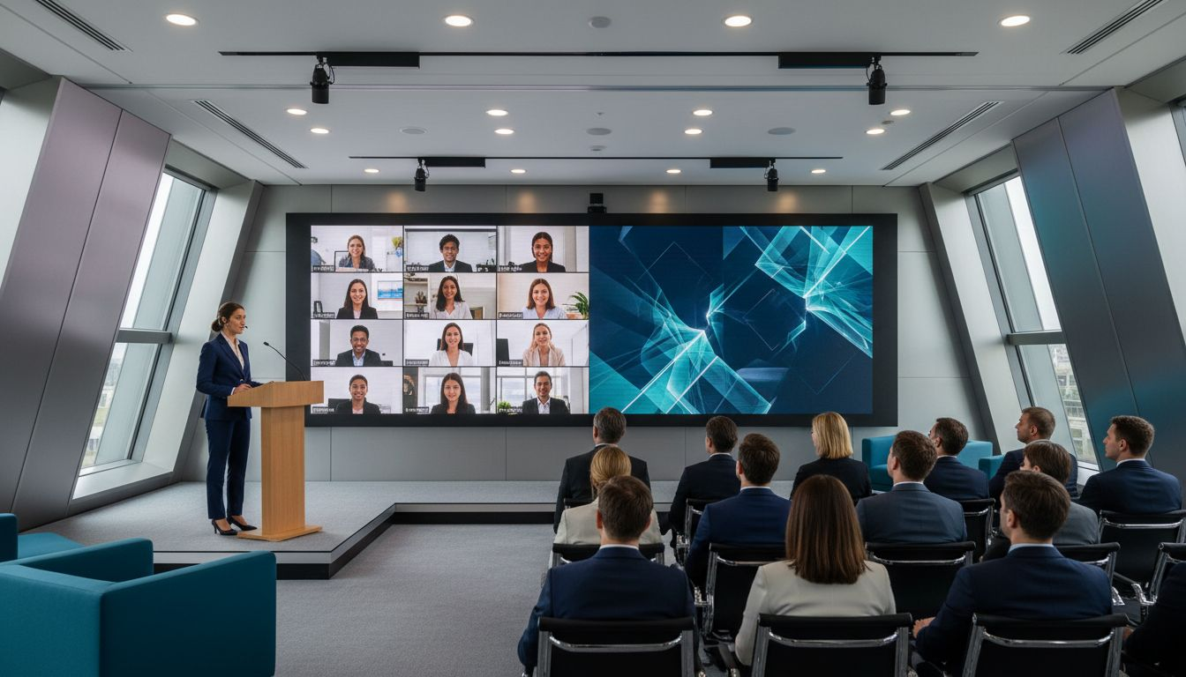
HYBRID DELIVERY
Hybrid Education
Sessions —
No Delegate Left Behind
Live hybrid sessions with synchronized CE credit tracking
Real-time Q&A, moderated polling, and session interaction
On-demand session replay for missed CE opportunities
Multilingual captioning and accessibility built in
Every regulatory professional — whether in Washington or Tokyo — gets the same world-class Convergence experience.
[Provider_Company_B] · Toronto, Ontario, Canada · [Provider_Company_B].com

Slide 5
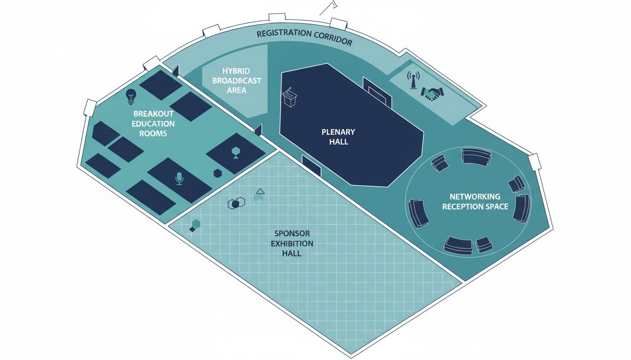
Venue & Conference Flow — Convergence 2027
📍 Proposed Venue
Washington Convention Center, Washington D.C.
🚶 Flow
Plenary → Sponsor Expo → Breakout Education Tracks → Networking
🚪 Registration
Digital check-in corridor at main entrance — [Provider_Company_B] integrated
🎥 Hybrid Studio
Dedicated broadcast suite for simultaneous remote Convergence delivery
📡 Virtual Access
Remote delegates access full CE sessions via [Provider_Company_B] platform
Conceptual layout · venue floor plan not available — final plan developed with [Prospect_Company_F] event team
[Provider_Company_B] · Toronto, Ontario, Canada · [Provider_Company_B].com

Slide 6
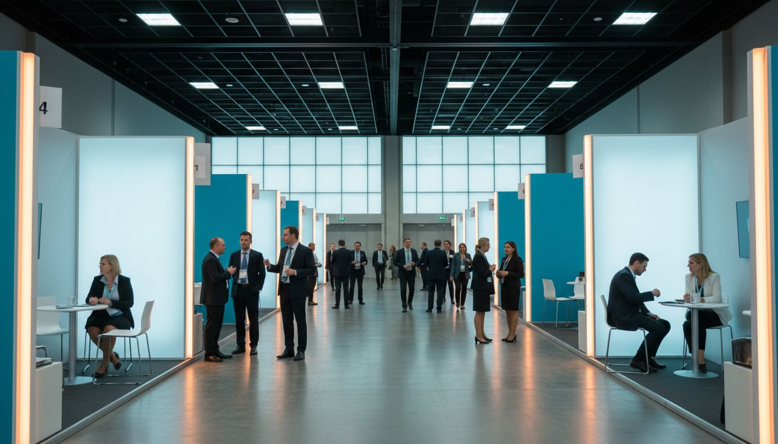
SPONSOR EXPERIENCES
Sponsor & Exhibitor
Experiences Built for
Scientific Audiences
Sponsor profiles with attendee matching by specialty
In-app banner and push notification packages for pharma sponsors
Lead capture and attendee interest analytics for exhibitors
Sponsor ROI package delivered within 7 days post-event
Give your pharma and medtech sponsors the precise data they need.
[Provider_Company_B] · Toronto, Ontario, Canada · [Provider_Company_B].com

Slide 7
Scope & Investment
Conference Core
Hybrid Package
Convergence
Enterprise
from $15,000 CAD
from $32,000 CAD
from $55,000 CAD
✓ Registration + [Prospect_Company_F]le app
✓ Full hybrid delivery
✓ Custom full platform
✓ Up to 1,000 delegates
✓ CE credit tracking
✓ Multi-track hybrid
✓ Standard event app
✓ Sponsor profiles & leads
✓ Dedicated success mgr
✓ Session scheduling
✓ Advanced analytics
✓ White-glove onboarding
* All prices in CAD. Annual multi-event licensing available for Convergence + Conference Series. Contact for enterprise quote.
[Provider_Company_B] · Toronto, Ontario, Canada · [Provider_Company_B].com

Slide 8
[Provider_Company_A] Matters.
So Does Partnership.
Built for the events that advance professional knowledge.
Let's connect before Convergence 2027 planning begins.
[Provider_Company_B] — Toronto, Ontario, Canada · [Provider_Company_B].com

