Slide 1
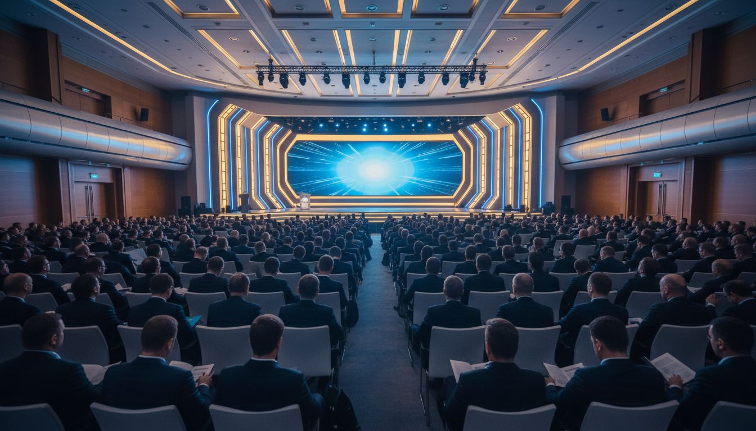
Powering Events That Move People
[Provider_Company_B] × Meeting Professionals International
A Partnership Proposal for WEC 2027 and Beyond
Proposed: June 2027 | Toronto Metro Convention Centre
[Provider_Company_B].com

Slide 2
Why This Partnership Matters
130k+
13k+
$13B
Global Event Professionals in the [Prospect_Company_E] Community
Engaged [Prospect_Company_E] Members Across 69 Chapters & Clubs
Member Buying Power in the Meetings Industry
[Provider_Company_B] powers the full attendee journey — from registration to post-event insight. Together we deliver measurable engagement, production excellence, and branded experiences that strengthen every [Prospect_Company_E] conference, chapter event, and member program.
[Provider_Company_B] · Toronto, Ontario, Canada · [Provider_Company_B].com

Slide 3
The [Provider_Company_B] Platform — Built for Conferences Like Yours
Registration
& Badging
Branded
Event App
Hybrid &
Live Streaming
Smart online registration, QR badge printing, on-site check-in
Custom-branded attendee app with agenda, maps, and alerts
Multi-track hybrid delivery with remote audience engagement
Sponsor &
Exhibitor Hub
Attendee
Networking
Real-Time
Analytics
Digital sponsor profiles, lead capture, and analytics
AI matchmaking, 1:1 messaging, and community features
Live dashboards, post-event reporting, and sponsor ROI packs
[Provider_Company_B] · Toronto, Ontario, Canada · [Provider_Company_B].com

Slide 4
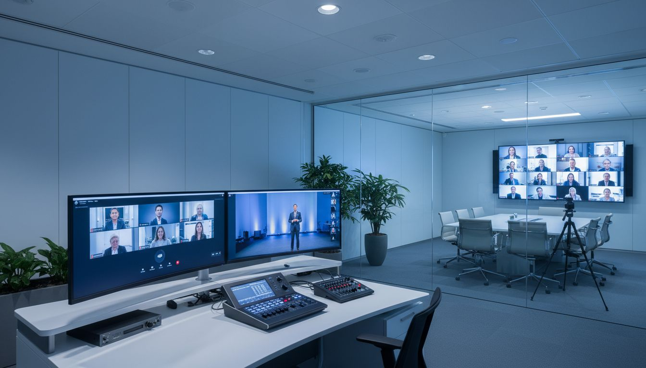
HYBRID EXCELLENCE
Hybrid Conference
Execution —
Seamless From Any Seat
In-room and remote attendees on one connected platform
Live Q&A, polling, and session interaction across all formats
Real-time hybrid audience management dashboard
Branded virtual viewing rooms with sponsor integrations
Hybrid-first production that keeps every delegate engaged — in the room or around the world.
[Provider_Company_B] · Toronto, Ontario, Canada · [Provider_Company_B].com

Slide 5
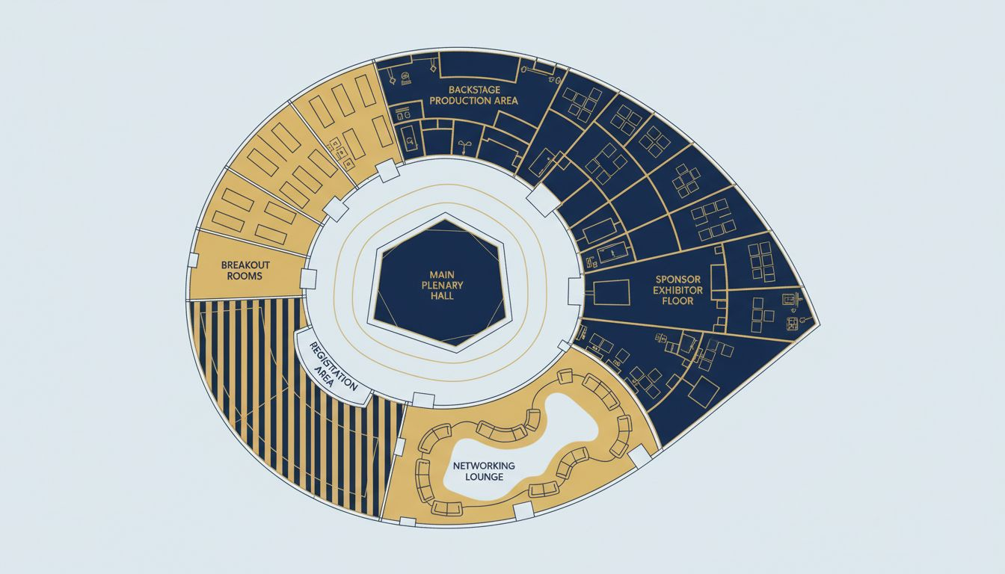
Venue & Event Flow — Toronto Metro Convention Centre
📍 Venue
Toronto Metro Convention Centre, Toronto ON
👥 Capacity
3,000+ delegates — plenary, breakouts & exhibitor floor
🚪 Registration
North entrance hub with digital check-in & badge printing
🎥 Hybrid Studio
Broadcast suite for live streaming all plenary sessions
📦 Production
Full AV rigging, loading dock, and backstage access
Conceptual layout · Venue floor plan not available
[Provider_Company_B] · Toronto, Ontario, Canada · [Provider_Company_B].com

Slide 6
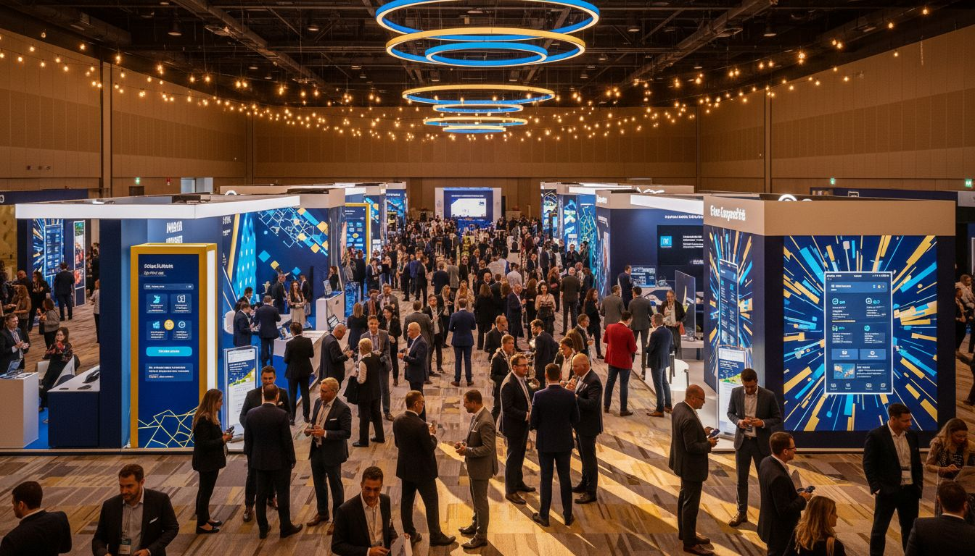
SPONSORS & ROI
Sponsor Visibility
& Engagement ROI
Digital sponsor profiles with one-tap attendee connection
Push notification campaigns during live sessions
Lead capture with real-time analytics dashboards
Post-event sponsor ROI report — measurable exposure metrics
Give your sponsors the data and visibility they need to return year after year.
[Provider_Company_B] · Toronto, Ontario, Canada · [Provider_Company_B].com

Slide 7
Scope, Investment & Next Steps
Starter
Professional
Enterprise
from $12,000 CAD
from $28,000 CAD
Contact for Quote
✓ Registration + [Prospect_Company_E]le App
✓ Full hybrid delivery
✓ Custom branded experience
✓ Up to 500 attendees
✓ Sponsor hub & lead capture
✓ Multi-track hybrid events
✓ Standard event app
✓ Custom branded app
✓ Dedicated success manager
✓ Basic analytics
✓ Advanced analytics
✓ White-glove onboarding
* All prices in CAD. Annual multi-event licensing available. [Provider_Company_B] Toronto team provides Canadian market expertise.
[Provider_Company_B] · Toronto, Ontario, Canada · [Provider_Company_B].com

Slide 8
Let's Build Something
Remarkable Together
Your event. Your brand. Measured results.
[Provider_Company_B] — Toronto, Ontario, Canada
[Provider_Company_B].com
Ready when you are.

