Slide 1
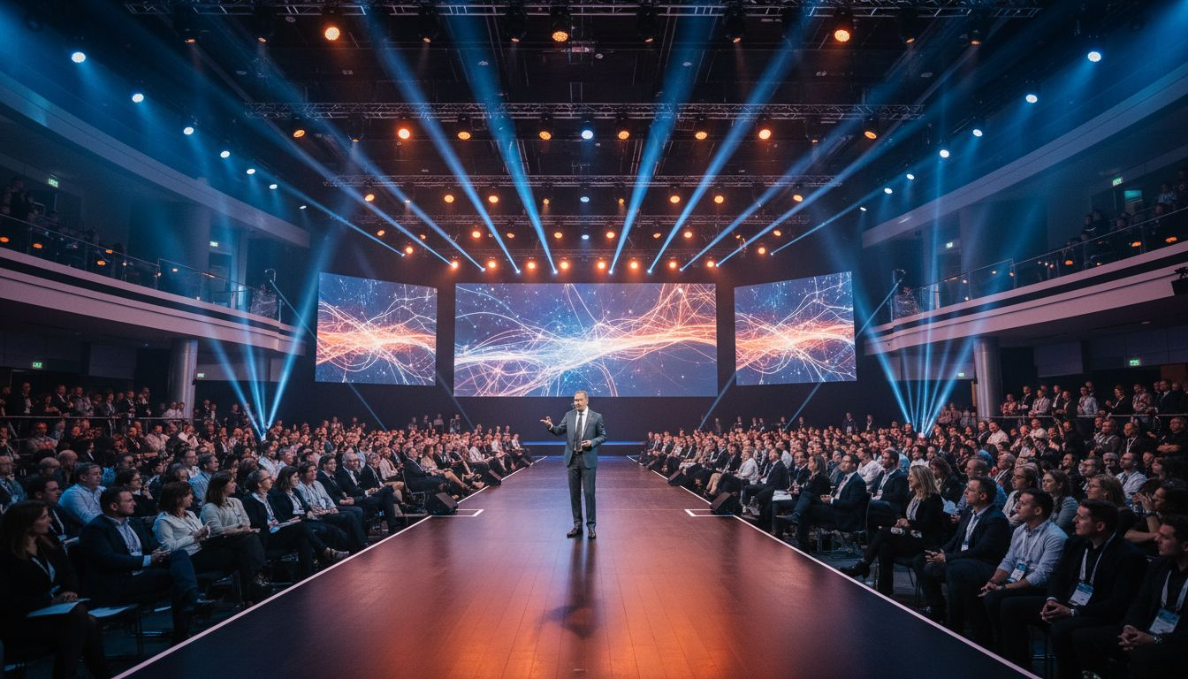
Amplify Every
Marketing Moment
[Provider_Company_B] × [Prospect_Company_A]
A Proposal for Elevated Conference & Chapter Experiences
Proposed: October 2026 | National Conference
[Provider_Company_B].com

Slide 2
The [Prospect_Company_D] Event Opportunity
70+
10,000+
Year-Round
[Prospect_Company_D] Chapters
Across North America
Marketing Professionals
At National Conferences
Conferences, Chapter Events,
Workshops & Meetups
[Provider_Company_B] turns each [Prospect_Company_D] event into a branded, measurable community experience — from a single chapter meetup to the national conference. Smart registration, sponsor activation, and real-time attendee engagement that your members will actually use.
[Provider_Company_B] · Toronto, Ontario, Canada · [Provider_Company_B].com

Slide 3
[Provider_Company_B] — Your End-to-End Event Platform
Smart Registration
& Check-in
Branded
Member App
Chapter Event
Management
Online sign-up, automated reminders, QR check-in, and badge printing
Custom [Prospect_Company_D]-branded event app with agenda, speaker bios, and alerts
Consistent experience across all 70+ chapter events with one platform
Sponsor &
Partner Hub
Session Networking
& Matchmaking
Post-Event
Analytics
Sponsor profiles, banner placements, lead capture, and ROI reporting
AI-powered 1:1 meeting tools and peer connection features
Attendee engagement scores, session metrics, sponsor performance data
[Provider_Company_B] · Toronto, Ontario, Canada · [Provider_Company_B].com

Slide 4
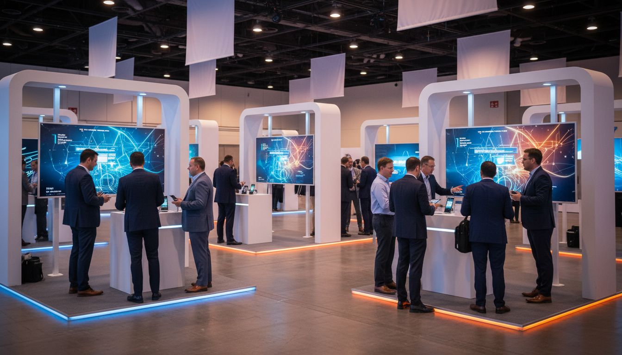
SPONSOR ACTIVATION
Sponsor Activation
That Marketers
Will Notice
Branded sponsor profiles with one-tap attendee connect
Push campaigns and in-app ad placements during sessions
Real-time lead capture dashboard for exhibitors
Post-event sponsor ROI report — the kind of data marketers love
[Provider_Company_B] · Toronto, Ontario, Canada · [Provider_Company_B].com

Slide 5
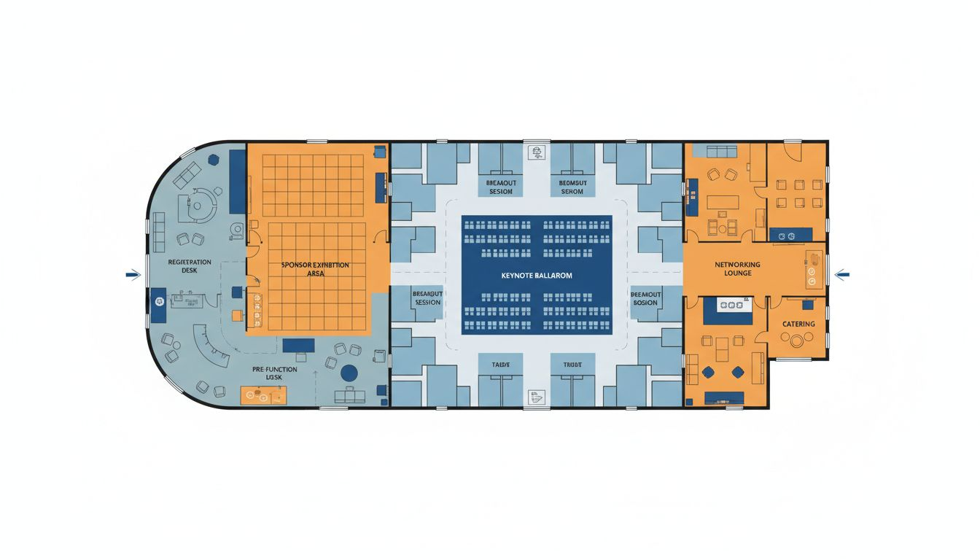
Venue & Event Flow Concept
📍 National Venue
Hyatt Regency Chicago (national) or selected chapter venues
📐 Event Flow
Keynote → Sponsor Expo → Breakout Tracks → Networking Lounge
🚪 Registration
Digital check-in at main entrance; badge printing on arrival
📡 Hybrid Ready
Live streaming capability for national sessions to remote members
🎪 Chapter Events
Scalable platform works for 50-person chapter meetups to 5,000+ national
Conceptual layout · venue floor plan not available — to be finalized with [Prospect_Company_D] event team
[Provider_Company_B] · Toronto, Ontario, Canada · [Provider_Company_B].com

Slide 6
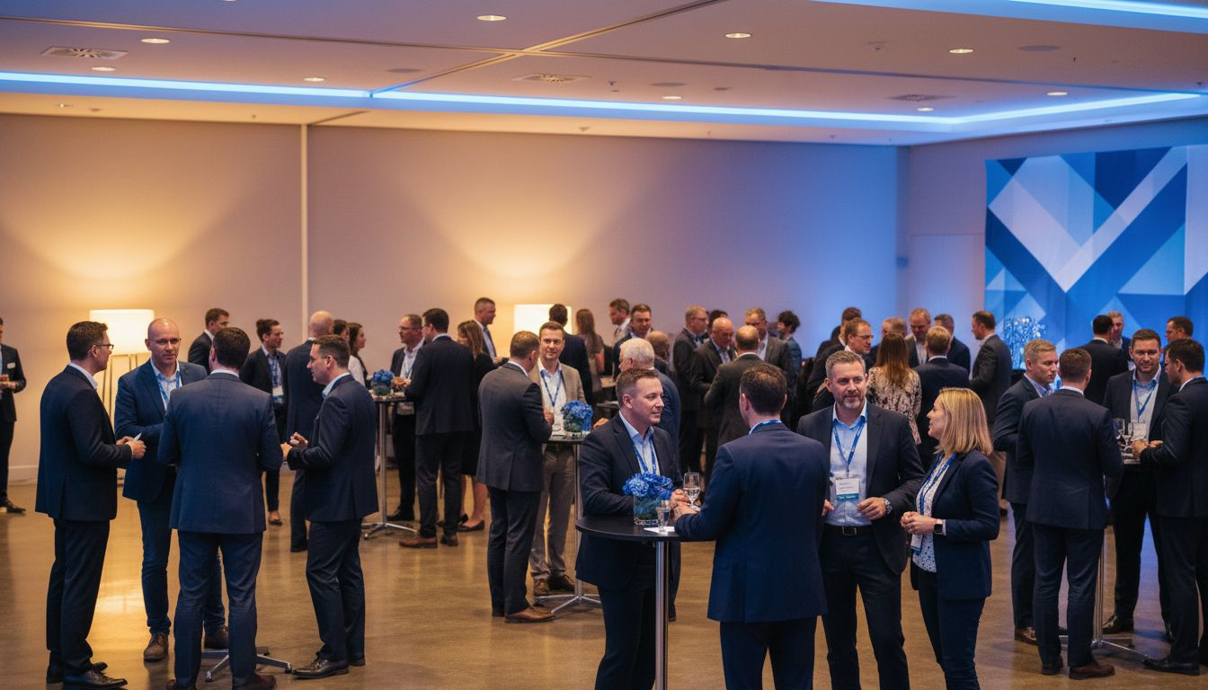
ATTENDEE ENGAGEMENT
Attendee Engagement —
From Session to Connection
AI-powered attendee matchmaking and networking tools
Live session Q&A, polls, and real-time audience interaction
Chapter-level community features within the [Prospect_Company_D] event app
Post-event session replay and community feed engagement
Engagement doesn't end when the session ends.
[Provider_Company_B] · Toronto, Ontario, Canada · [Provider_Company_B].com

Slide 7
Scope, Pricing & Program Options
Chapter Starter
Chapter Pro
National Suite
from $4,500 CAD
from $9,500 CAD
from $24,000 CAD
✓ Single event [Prospect_Company_D]le app
✓ Networking & matchmaking
✓ Full platform + analytics
✓ Online registration
✓ Sponsor profiles & leads
✓ Hybrid session delivery
✓ Up to 200 attendees
✓ Push notifications
✓ Sponsor ROI dashboards
✓ Basic check-in tools
✓ Post-event analytics
✓ Dedicated success manager
* All prices in CAD. Multi-event and annual chapter licensing available. [Prospect_Company_D] chapter discount programs on request.
[Provider_Company_B] · Toronto, Ontario, Canada · [Provider_Company_B].com

Slide 8
Ready to Elevate
Your Next [Prospect_Company_D] Event?
The platform your members will actually use.
Let's pilot together at your next chapter event.
[Provider_Company_B] — Toronto, Ontario, Canada · [Provider_Company_B].com

