Slide 1
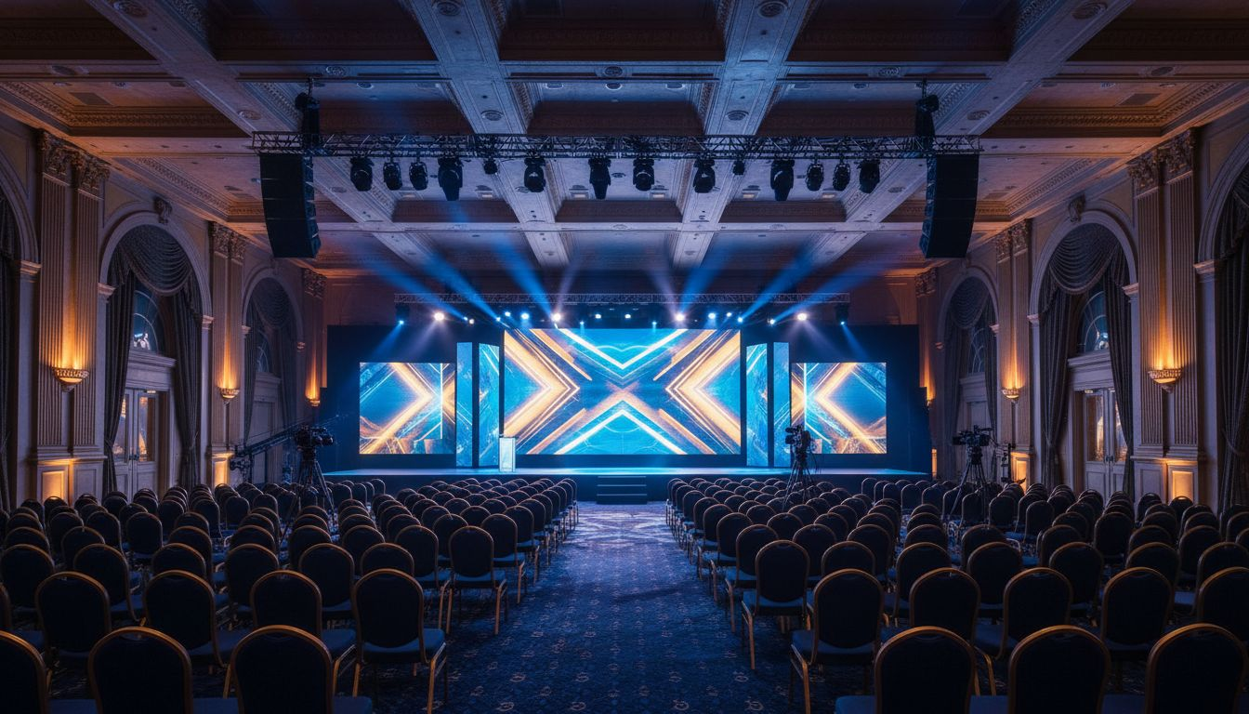
[Provider_Company_A] MEETINGS & EVENTS
[Prospect_Company_C] [Prospect_Company_A]
A Full-Service Event Production Proposal
Proposed: February 2027 | The Hay-Adams Hotel, Washington, D.C.
[Provider_Company_A] Meetings & Events | [Company_Website_A] | Washington, D.C.

Slide 2
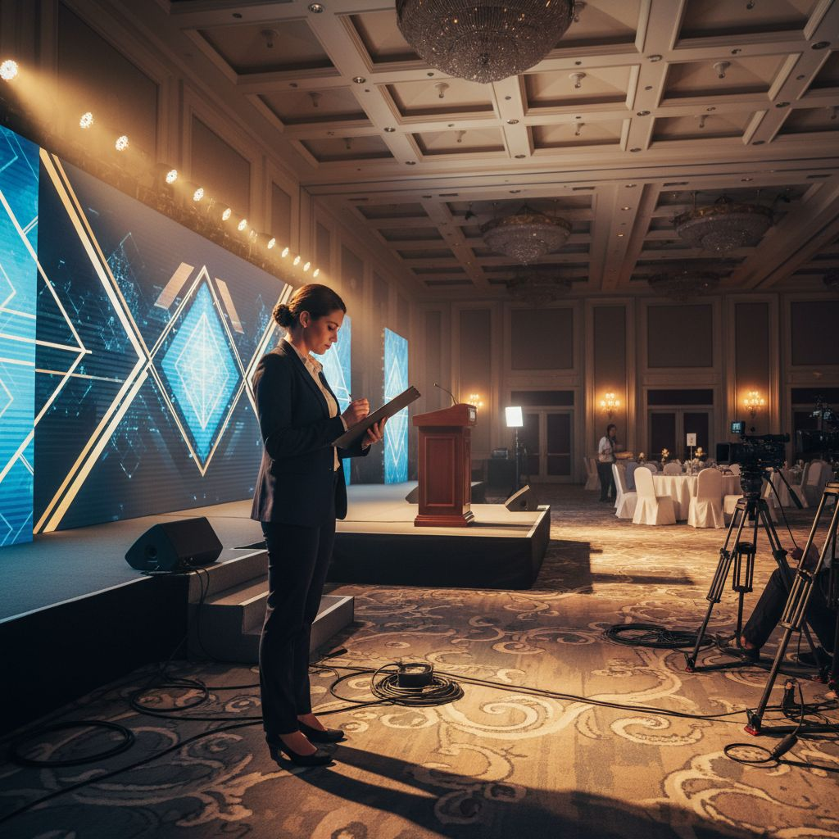
WHY NOW
A Word from
[Provider_Company_A]
• The media and entertainment industry demands flawless execution at every scale.
• [Provider_Company_A] Meetings & Events brings white-glove production discipline to your most critical gatherings.
• From run-of-[Prospect_Company_C] to VIP logistics — we handle every detail so you can focus on the story.
• Based in Washington, D.C. | Full-service event planning, production, and branded experiences.
[Provider_Company_A] Meetings & Events | [Company_Website_A] | Washington, D.C.

Slide 3
THE OPPORTUNITY
[Prospect_Company_C] — and the people who make it happen —
deserve a production partner as ambitious as the [Prospect_Company_C] itself.
90,000+
Two [Prospect_Company_C]s
Multi-Format
High Visibility
Media professionals convene at [Prospect_Company_C] annually — making execution stakes extraordinarily high.
Las Vegas in April. New York in October. Each requires distinct logistics and VIP protocols.
Keynotes, panels, exhibitor events, hybrid broadcasts — all requiring seamless coordination.
Sponsors, speakers, and C-suite guests expect a premium, polished experience at every touchpoint.
[Provider_Company_A] Meetings & Events | [Company_Website_A] | Washington, D.C.

Slide 4
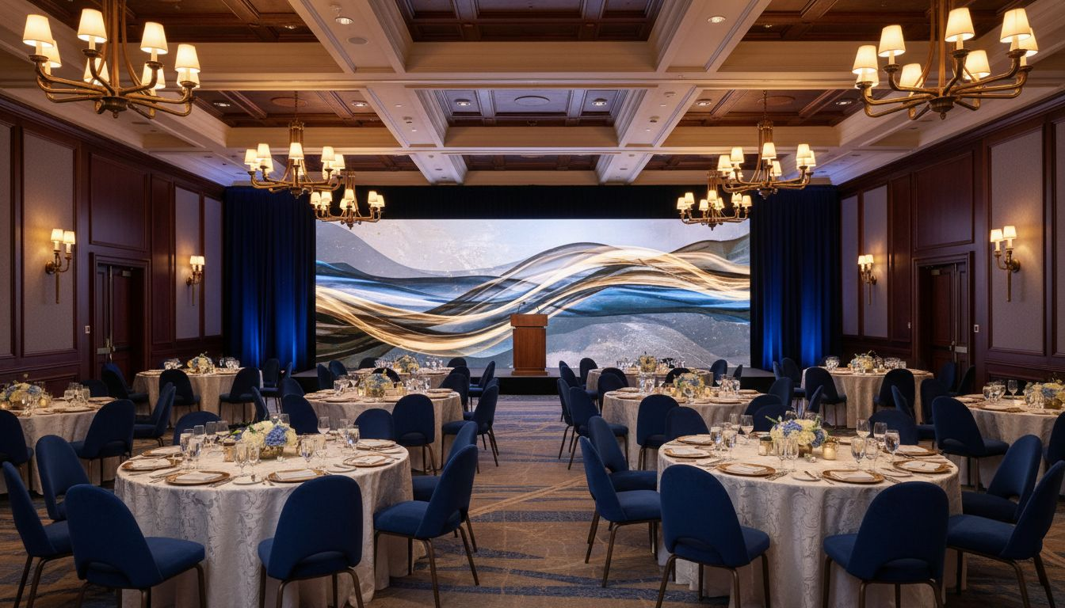
PROPOSED CONCEPT
[Prospect_Company_C] [Prospect_Company_A]
Venue
The Hay-Adams Hotel, Washington, D.C.
Date
Proposed: February 2027
Format
1-Day Executive Convening — panels, 1:1s, seated dinner, broadcast-ready stage
Capacity
75-120 senior attendees | Hybrid broadcast available
By
[Provider_Company_A] Meetings & Events — full-service, end-to-end
[Provider_Company_A] Meetings & Events | [Company_Website_A] | Washington, D.C.

Slide 5
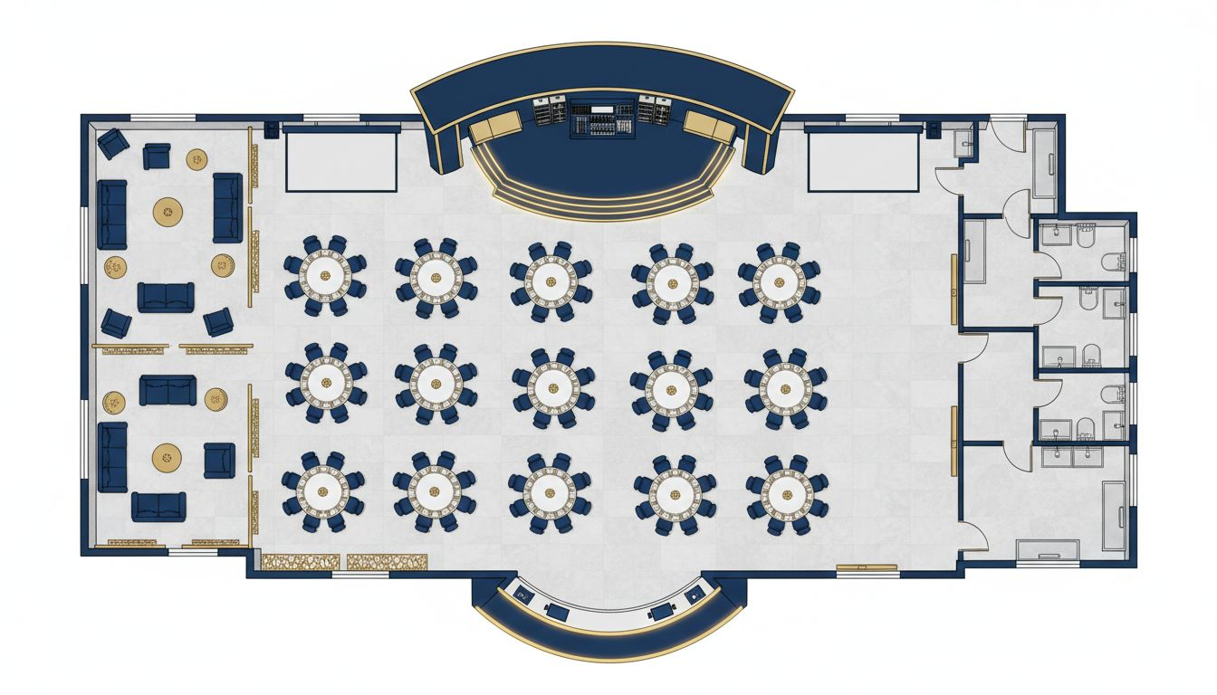
VENUE & FLOOR PLAN
The Hay-Adams Hotel | 1 Lafayette Square NW, Washington, D.C.
Main Stage
Broadcast-ready stage & AV alcove
Guest Tables
Round tables, 10 per table
VIP Reception
Pre-function lounge, cocktails
Registration
Welcome desk at main entrance
Breakout
Corridor suites for 1:1 sessions
Conceptual layout; venue floor plan not available
[Provider_Company_A] Meetings & Events | [Company_Website_A] | Washington, D.C.

Slide 6
HOW [Provider_Company_A] WORKS
Our Full-Service Model — Built for Event Brands Like [Prospect_Company_C]
01
02
03
04
Strategic Planning
& Site Selection
Speaker & VIP
Management
Hybrid & Virtual
Production
Full Logistics
Coordination
We identify the ideal venue, negotiate contracts, and build a master event calendar aligned with your goals.
Full-service speaker logistics, VIP itineraries, run-of-[Prospect_Company_C] ownership, and on-site guest management.
Seamless broadcast integration, live streaming, multi-city audience connection, and content production.
Decor, catering, transportation, A/V, registration, staffing — every operational detail handled end-to-end.
[Provider_Company_A] Meetings & Events | [Company_Website_A] | Washington, D.C.

Slide 7
SCOPE & INVESTMENT OVERVIEW
What's Included in Full-Service Production Management
Full-Service Event Planning & Production
Included
Core partnership engagement
Venue Sourcing & Contract Negotiation
Included
Site selection + preferred rates
Speaker & VIP Coordination
Included
Green room, itineraries, escort
Hybrid Broadcast & Live Streaming
TBD
Based on scope and platform
Decor, Catering & Transportation
TBD
Per client selections
On-Site Staffing (Event Day)
Included
Full production team
Registration Management
Included
Online + on-site check-in
Run-of-[Prospect_Company_C] & Timeline Ownership
Included
Master document + daily updates
Typical Lead Time: 5-6 months for full production calendar | Kickoff call available immediately
[Provider_Company_A] Meetings & Events | [Company_Website_A] | Washington, D.C.

Slide 8
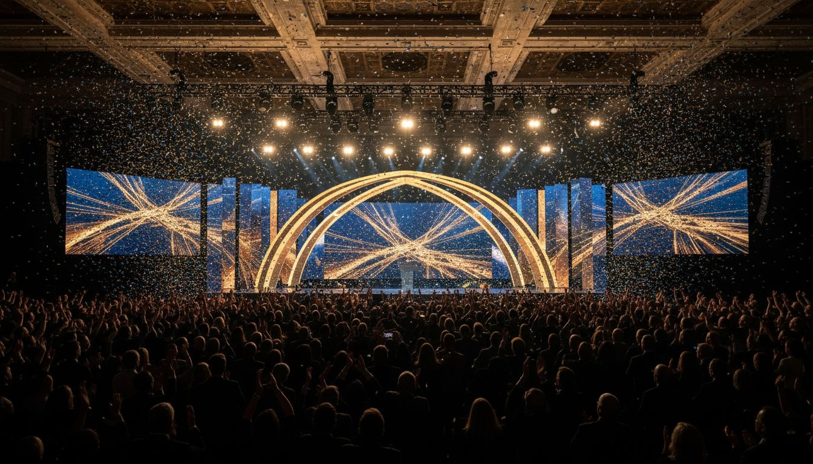
LET'S BUILD SOMETHING
EXTRAORDINARY.
[Provider_Company_A] Meetings & Events is ready to partner with [Prospect_Company_C] on your next executive gathering.
[Company_Website_A]
Schedule a Discovery Conversation
[Provider_Company_A] Meetings & Events | Washington, D.C. | Full-Service Corporate Event Planning & Production

