Slide 1
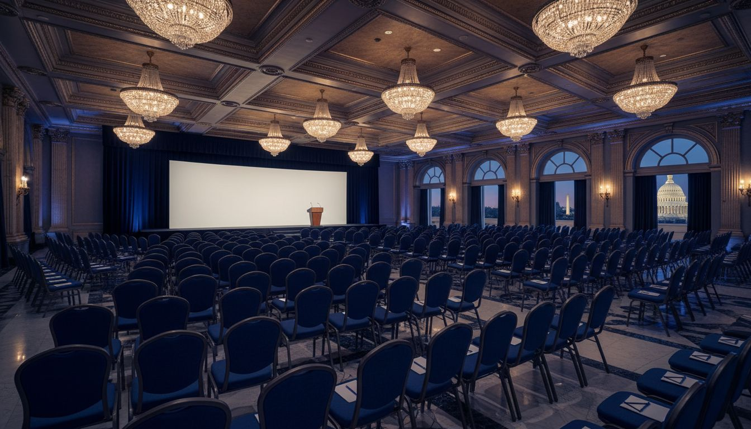
[Provider_Company_A] MEETINGS & EVENTS
[Prospect_Company_A] 2027
A Full-Service Conference & Executive Event Production Proposal
Proposed: October 2027 | The Ritz-Carlton, Washington, D.C.
[Provider_Company_A] Meetings & Events | [Company_Website_A] | Washington, D.C.

Slide 2
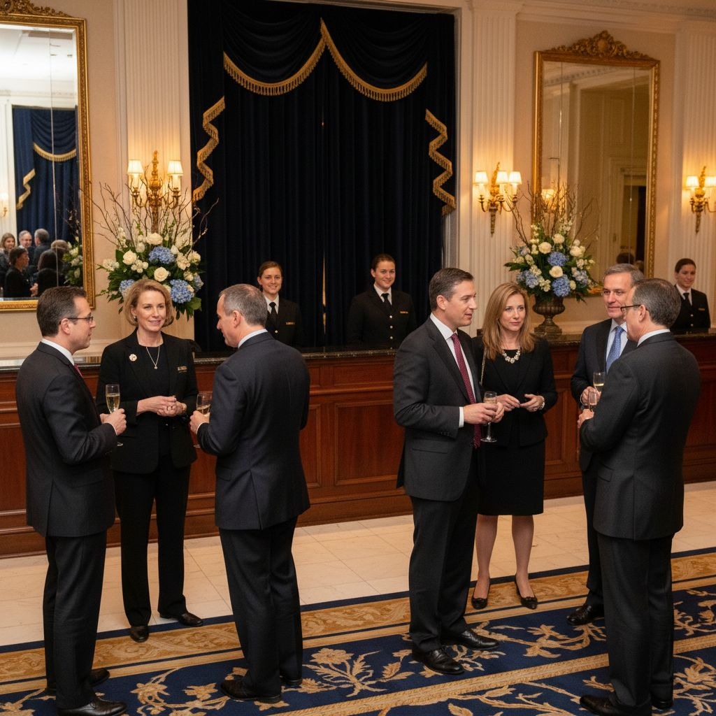
A PROPOSAL FROM [Provider_Company_A]
For [Prospect_Company_A]
Insurance Agents & Brokers
• Washington, D.C. is [Prospect_Company_A]'s home — and ours.
• [Provider_Company_A] specializes in high-stakes association events, executive forums, and government-adjacent programs.
• We understand your audience: senior brokers, carrier executives, and policymakers who expect the best.
• Let us help you elevate your signature events in 2027 and beyond.
[Provider_Company_A] Meetings & Events | [Company_Website_A] | Washington, D.C.

Slide 3
WHY [Provider_Company_A] — WHY NOW
[Prospect_Company_A]'s events define the standard for
insurance industry leadership gatherings.
10+ Annual Events
DC-Based Expertise
VIP & Board Logistics
Association Standard
Legislative Summit, ILF, EBLF, Working Groups — each requiring flawless stakeholder coordination.
[Provider_Company_A]'s Washington, D.C. home gives us native knowledge of the policy landscape your members navigate.
From board member itineraries to congressional speaker management — we handle every VIP touchpoint.
We produce branded, professional events that reflect the stature and reputation of premier industry councils.
[Provider_Company_A] Meetings & Events | [Company_Website_A] | Washington, D.C.

Slide 4
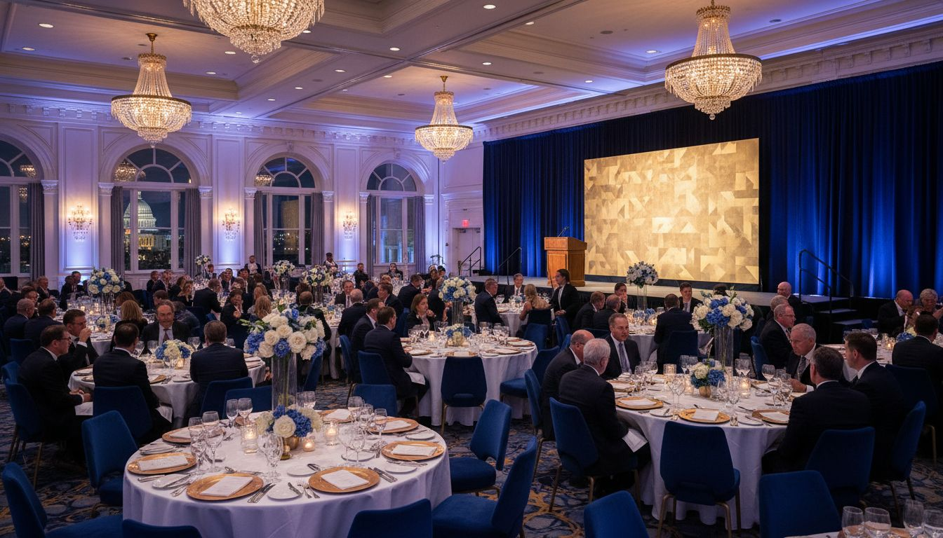
PROPOSED CONCEPT
[Prospect_Company_A] 2027
Venue
The Ritz-Carlton, Washington, D.C.
Date
Proposed: October 2027
Format
3-day leadership forum: keynotes, general sessions, working dinners, awards ceremony
Capacity
200-400 attendees | Full hybrid broadcast option available
By
[Provider_Company_A] Meetings & Events — full-service, end-to-end
[Provider_Company_A] Meetings & Events | [Company_Website_A] | Washington, D.C.

Slide 5
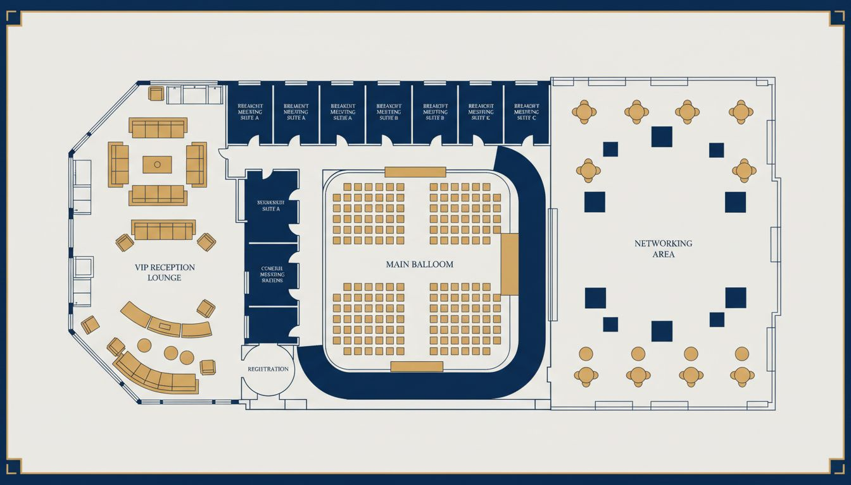
VENUE & EVENT LAYOUT
The Ritz-Carlton Washington, D.C. | 1150 22nd Street NW, West End
Grand Ballroom
Main plenary: 400 banquet
Breakout Suites
Working group meeting rooms
VIP Lounge
Pre-function reception area
Registration Hall
Main entrance welcome zone
Networking Terrace
Cocktail & sponsor reception
Conceptual layout; venue floor plan not available
[Provider_Company_A] Meetings & Events | [Company_Website_A] | Washington, D.C.

Slide 6
THE [Provider_Company_A] DIFFERENCE
[Prospect_Company_A]
01
02
03
04
Legislative &
Government-Adjacent
Speaker, VIP &
Board Coordination
Hybrid & Broadcast
Production
Full-Service
Logistics Management
Native DC expertise for events where policy, government relations, and high-profile speakers intersect.
Congressional speakers, C-suite VIPs, and board members — coordinated with discretion and [Provider_Company_A].
Professional hybrid integration: live streaming, remote participation, and on-demand content capture.
Decor, catering, transportation, A/V, registration, on-site staffing — one fully integrated partner.
[Provider_Company_A] Meetings & Events | [Company_Website_A] | Washington, D.C.

Slide 7
SCOPE & INVESTMENT
What's Included in Full-Service Association Event Production
Full-Service Event Planning & Production Management
Included
Core engagement
Site Selection & Contract Negotiation
Included
Preferred hotel rates secured
Speaker, VIP & Board Member Coordination
Included
Travel, prep, on-site escort
Hybrid Broadcast & Live Streaming
TBD
Scope-dependent
Decor, Catering & Hospitality
TBD
Per client selections
On-Site Production Staffing
Included
Full event-day team
Registration Management
Included
Online platform + on-site staff
Run-of-Show & Master Timeline
Included
Owned and managed by [Provider_Company_A]
Typical Lead Time: 5-6 months | Discovery call available at your convenience
[Provider_Company_A] Meetings & Events | [Company_Website_A] | Washington, D.C.

Slide 8
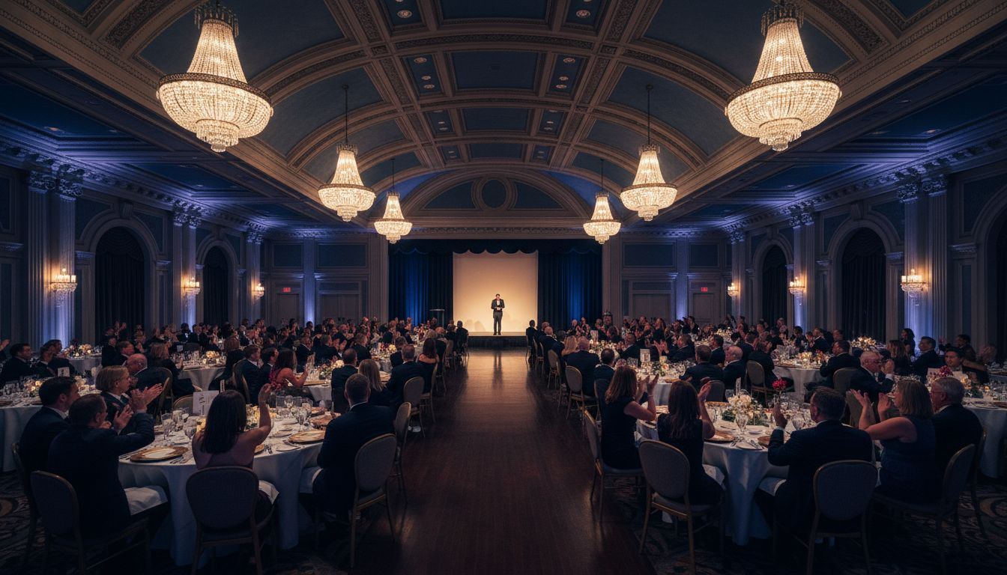
THE NEXT STEP —
LET'S TALK.
[Provider_Company_A] Meetings & Events would be honored to support [Prospect_Company_A]'s 2027 event calendar.
[Company_Website_A]
Schedule a Discovery Conversation
[Provider_Company_A] Meetings & Events | Washington, D.C. | Full-Service Corporate Event Planning & Production

