Slide 1
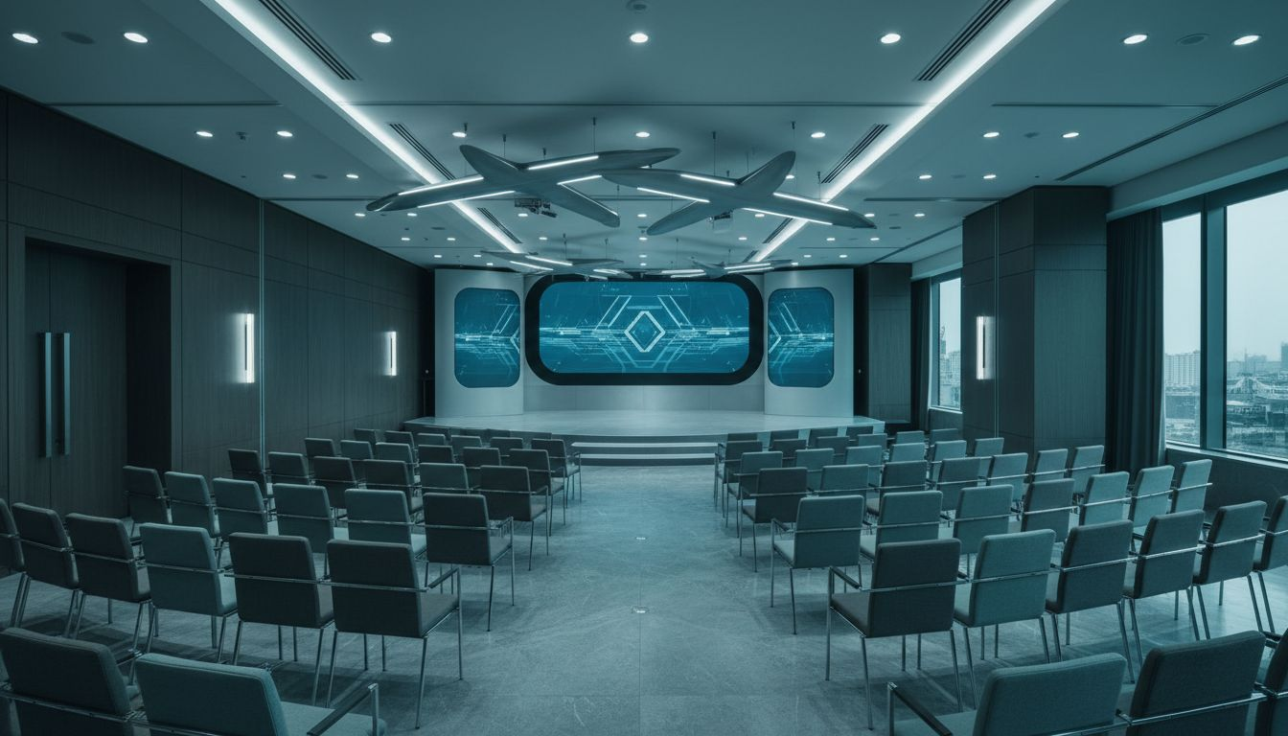
[Provider_Company_A] MEETINGS & EVENTS
[Prospect_Company_A] [Prospect_Company_A]
A Full-Service Conference & Executive Event Production Proposal
Proposed: October 2026 | JW Marriott Washington, DC
[Provider_Company_A] Meetings & Events | [Company_Website_A] | Washington, D.C.

Slide 2
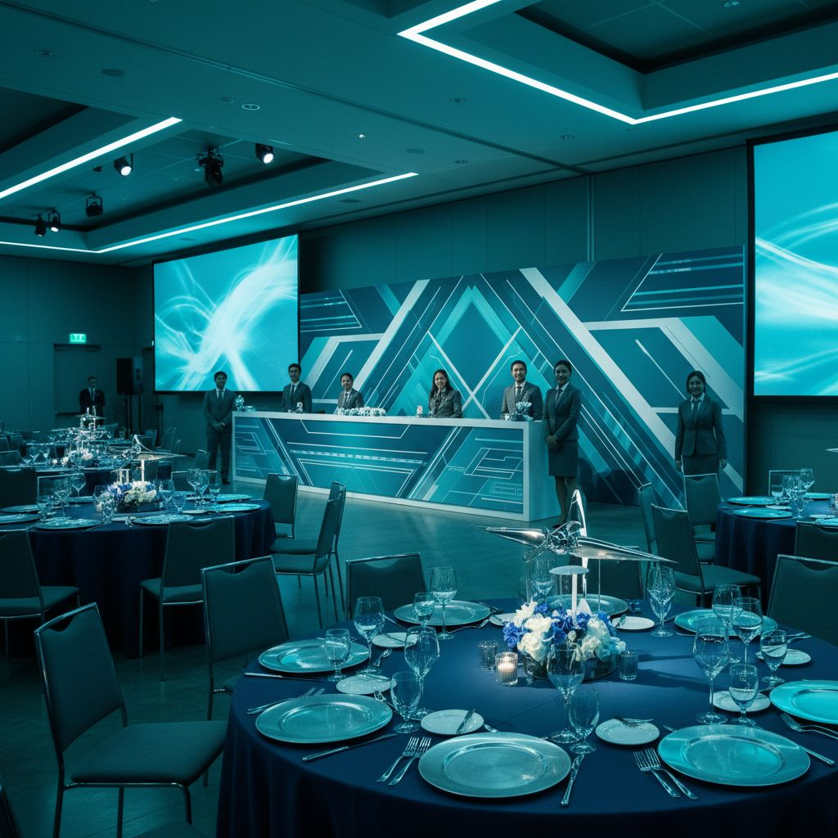
A PROPOSAL FROM [Provider_Company_A]
Elevating the In-Person
Conference Experience
• Elevating the air travel experience starts with elevating the events that shape it.
• [Provider_Company_A] designs and produces high-touch conferences, leadership forums, and executive programs.
• Headquartered in Washington, D.C. — serving global associations and industry leaders.
• We are ready to partner with [Prospect_Company_A] on its next North America gathering.
[Provider_Company_A] Meetings & Events | [Company_Website_A] | Washington, D.C.

Slide 3
THE [Prospect_Company_A] OPPORTUNITY
Your members expect first-class execution
at every event touchpoint — we deliver exactly that.
Global Membership
Multi-Format Events
Executive Audience
Hybrid Capability
Hundreds of airlines, airports, alliances, and key supplier partners — all demanding flawless coordination.
[Prospect_Company_A] runs global expos, TECH conferences, content markets, and regional forums — each with distinct needs.
Your attendees are senior airline and airport executives who expect a premium, [Provider_Company_A]-delivered experience.
Remote participation, live streaming, and multi-city programs require sophisticated technical production.
[Provider_Company_A] Meetings & Events | [Company_Website_A] | Washington, D.C.

Slide 4
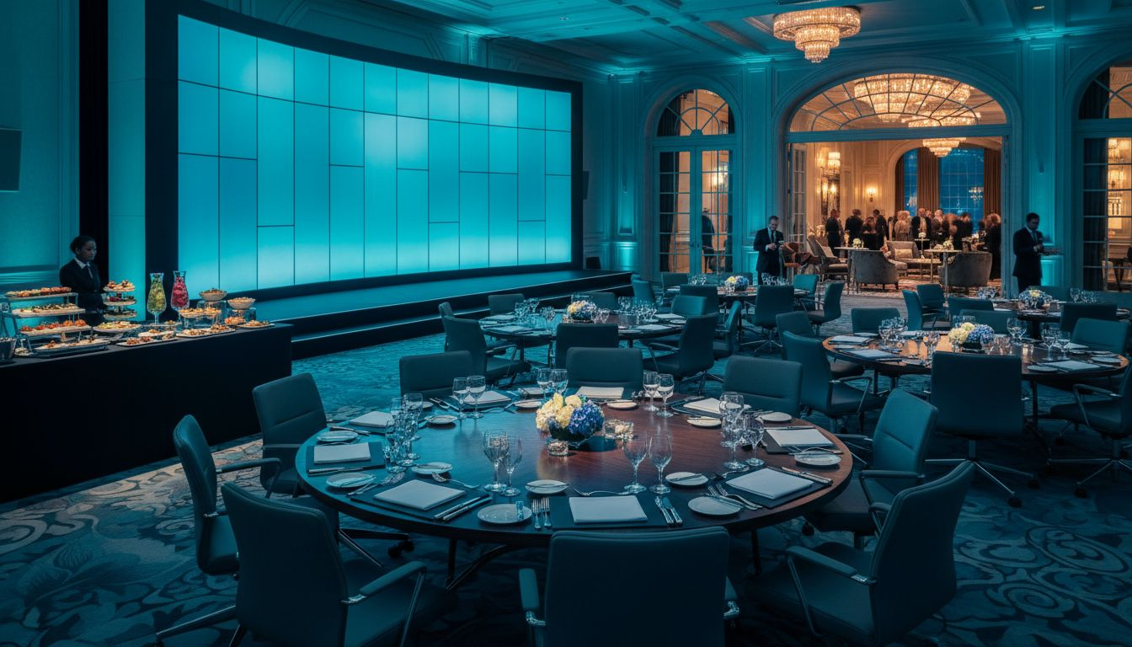
PROPOSED CONCEPT
[Prospect_Company_A] [Prospect_Company_A]
Venue
JW Marriott Washington, DC
Date
Proposed: October 2026
Format
2-day executive forum: keynotes, roundtables, networking reception, awards dinner
Capacity
100-200 attendees | Hybrid broadcast option available
By
[Provider_Company_A] Meetings & Events — full-service, end-to-end
[Provider_Company_A] Meetings & Events | [Company_Website_A] | Washington, D.C.

Slide 5
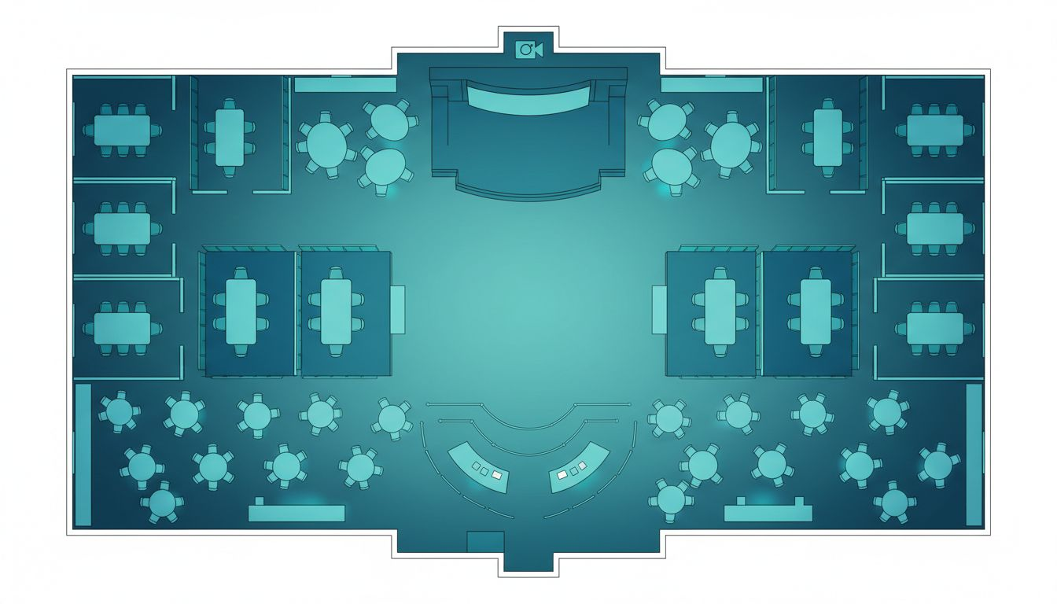
VENUE & FLOOR PLAN
JW Marriott Washington, DC | 1331 Pennsylvania Avenue NW
Plenary Hall
Main stage, 200-cap theater
Roundtable Pods
Executive breakout sessions
Registration
Welcome + check-in hall
Networking Zone
Cocktail & reception area
Hybrid Booth
AV/broadcast studio room
Conceptual layout; venue floor plan not available
[Provider_Company_A] Meetings & Events | [Company_Website_A] | Washington, D.C.

Slide 6
OUR CAPABILITIES
[Prospect_Company_A] — Delivered with [Provider_Company_A]
01
02
03
04
Conference &
Forum Design
International Speaker
& VIP Coordination
Hybrid Production
& Live Streaming
Catering, Decor
& Full Logistics
Full event design from agenda architecture to on-site experience, aligned with member expectations.
Travel logistics, speaker prep, VIP itineraries, green room, and on-site escort — handled flawlessly.
Professional broadcast integration, live streaming, and remote audience management for global reach.
Venue catering, decor concept, transportation, registration, A/V, and on-site staffing — all coordinated.
[Provider_Company_A] Meetings & Events | [Company_Website_A] | Washington, D.C.

Slide 7
SCOPE & INVESTMENT
What's Included in Full-Service Conference Production
Full-Service Event Planning & Production Management
Included
Core engagement
Site Selection & Contract Negotiation
Included
Preferred hotel rates secured
International Speaker & VIP Coordination
Included
Travel, prep, escort
Hybrid Broadcast & Live Streaming Production
TBD
Based on scope
Decor, Catering & Hospitality Coordination
TBD
Per selections
On-Site Production Staffing
Included
Full event-day team
Registration Management (Online + On-Site)
Included
Platform + staff
Master Run-of-Show & Timeline
Included
Owned by [Provider_Company_A]
Typical Lead Time: 4-6 months | Discovery call available at your convenience
[Provider_Company_A] Meetings & Events | [Company_Website_A] | Washington, D.C.

Slide 8
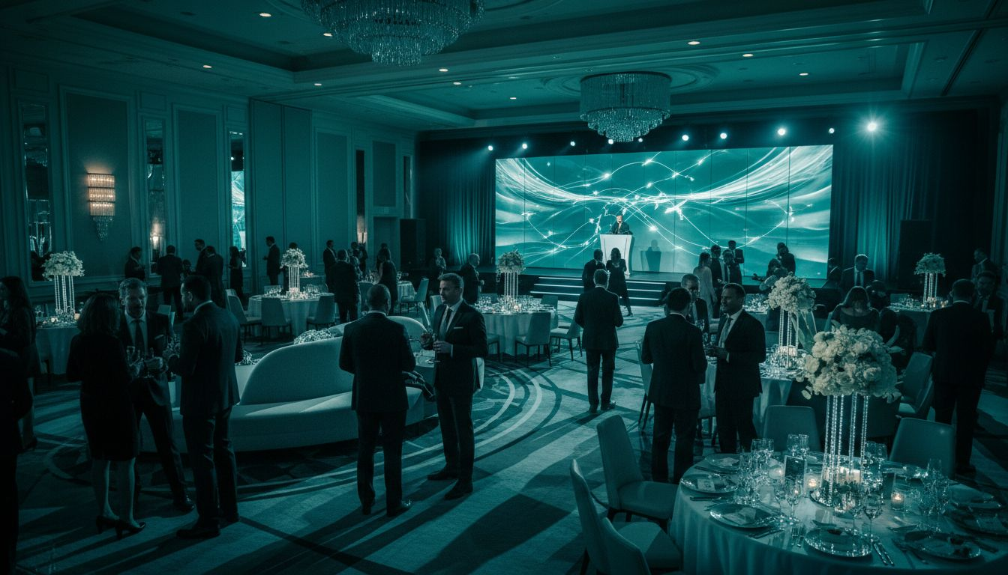
READY WHEN YOU ARE.
[Provider_Company_A] Meetings & Events is ready to partner with [Prospect_Company_A] on its next North America program.
[Company_Website_A]
Schedule a Discovery Conversation
[Provider_Company_A] Meetings & Events | Washington, D.C. | Full-Service Corporate Event Planning & Production

